Slide 1
The ITU & Regional Groups
USTTI Spectrum Management Class
September 24, 2024
John Alden, Chief (acting)
Spectrum Affairs and Information Division
Office of Spectrum Management

Slide 2
Preview
The Role of NTIA/OSM in U.S. Spectrum Management
ITU and WRC
The International WRC Preparatory Process
The U.S. WRC Preparatory Process
The role of CITEL and Other Regional Groups

Slide 3
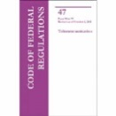
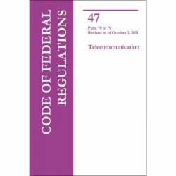
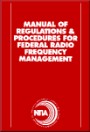
U.S. Spectrum Management
The President
Communications Act of 1934
Congress
NTIA Organization Act
NTIA
FCC
Federal Users
Non-Federal Users
47 CFR Part 300
Coordination
FCC-NTIA MOU
ITU preparation
FCC Rules
(47 CFR
Parts 0-101)
Advisory
Interdepartment Radio Advisory Committee
(IRAC)
Chaired by NTIA
19 federal agency members
Liaison
NTIA Manual
Commerce Spectrum Management Advisory Committee (CSMAC)
Interagency Spectrum Advisory Council
(ISAC)
Chaired by NTIA Assistant Secretary
Federal agencies plus FCC and the White House
Technological Advisory Council (TAC)

Slide 4
NTIA's Principal Responsibilities and Functions
Serves as the principal executive branch adviser to the President on telecommunications and information policy;
Develops and presents U.S. plans and policies at international communications conferences and related meetings;
Prescribes policies for and manages Federal use of the radio frequency spectrum;
Serves as the principal Federal telecommunications research and engineering laboratory, through NTIA's Institute for Telecommunication Sciences, headquartered in Boulder, CO;
Administers Federal programs to assist telecommunication facilities, public safety organizations, and the general public with the transition to digital broadcasting;
Provides grants through various programs to increase broadband accessibility in underserved areas of the United States.
Notes:
https://www.federalregister.gov/agencies/national-telecommunications-and-information-administration

Slide 5
Office of Spectrum Management
Manages the federal government’s use of the radio frequency spectrum;
Formulates spectrum policy concerning the allocations and regulations governing federal spectrum use;
Leads federal participation in World Radiocommunication Conferences and related technical and regional activities;
Certifies spectrum availability for future government systems;
Assigns frequencies, maintain the Government Master File;
Participates in federal emergency readiness activities;
Supports the administration’s commitments, such as making spectrum available for wireless broadband.

Slide 6
International Telecommunication Union (ITU)

Slide 7
International Telecommunication Union (ITU)
ITU is the United Nations specialized agency for information and communication technologies (ICTs)
193 Member States
1000+ Sector Members and Associates
www.itu.int
Structure of the ITU
Plenipotentiary Conference (the primary governing body – all powerful)
Council (acts on behalf of the Plenipotentiary Conference)
Core Sectors (ITU-R, ITU-T, ITU-D)
Radiocommunication Sector (ITU–R) – including World Radiocommunication Conferences
Telecommunication Standardization Sector (ITU–T)
Telecommunication Development Sector (ITU–D)

Slide 8
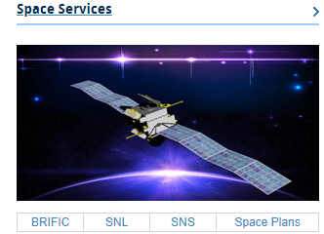
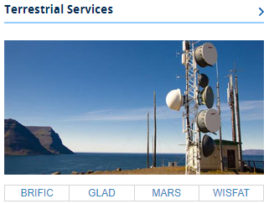
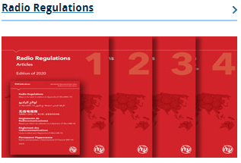
Radiocommunication Sector (ITU–R)

Slide 9
The Radiocommunication Bureau (BR)
The Radiocommunication Bureau (BR) organizes and coordinates the work of the Radiocommunication Sector (ITU-R) whose aim is to ensure the rational, equitable, efficient and economical use of the radio-frequency spectrum and the geostationary satellite orbit.
In addition to supporting ongoing work in the ITU-R Study Groups, the BR also:
maintains the Radio Regulations (an international treaty),
organizes meetings and conferences, such as World Radiocommunication Conferences,
provides services, such as the Master International Frequency Register (MIFR) for Terrestrial Services and Space Services,
provides satellite coordination services.

Slide 10
ITU-R Study Groups
The study groups carry out the technical work to support methods for addressing agenda items under a WRC as well as other work on Reports, Recommendations, and Handbooks for spectrum issues under their area of expertise and sharing and compatibility studies in cooperation with other study groups.
SG1 – Spectrum Management
SG3 – Radiowave Propagation
SG4 – Satellite Services
SG5 – Terrestrial Services
SG6 – Broadcasting Service
SG7 – Science Services
Coordination Committee On Vocabulary (CCV)
Conference Preparatory Meetings

Slide 11
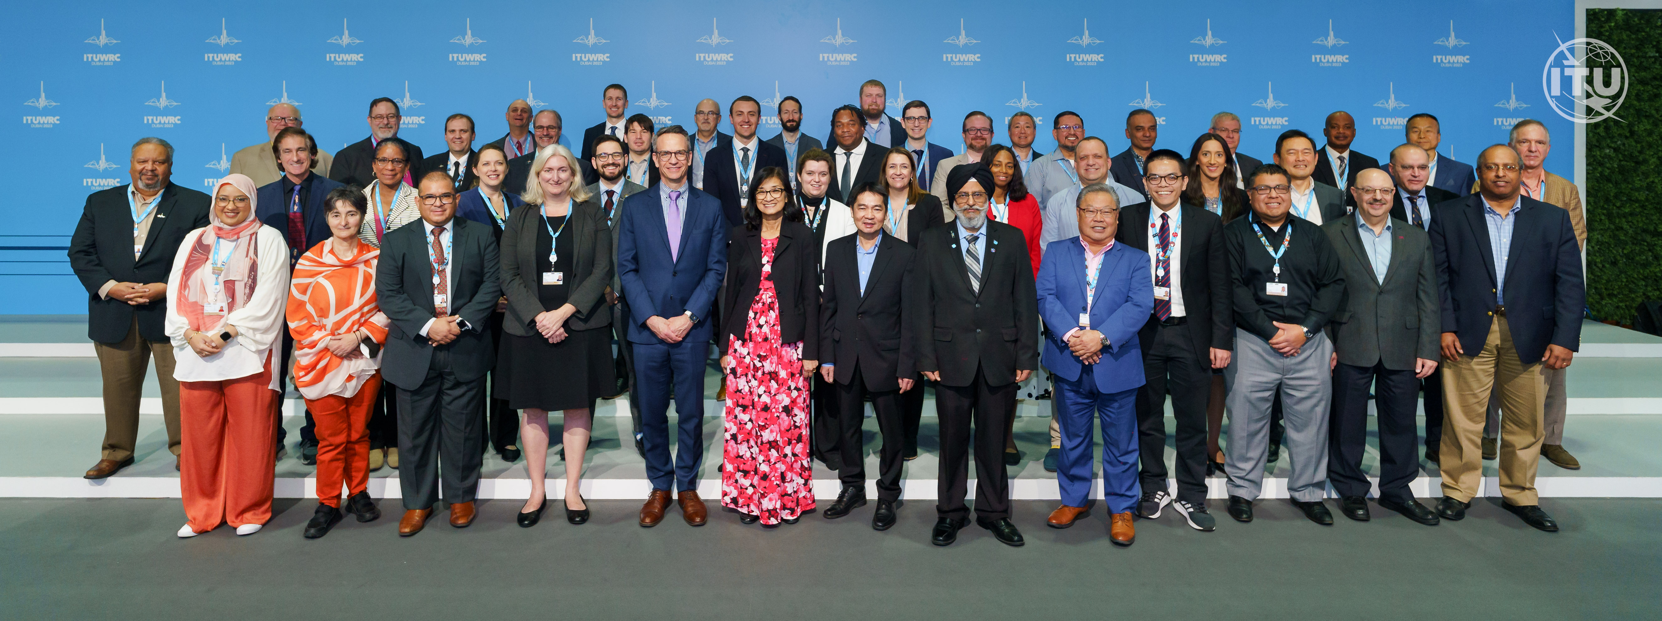
World Radiocommunication Conferences (WRCs)
WRCs are held every three to four years. It is the job of WRC to review, and, if necessary, revise the Radio Regulations, the international treaty governing the use of the radio-frequency spectrum and the geostationary-satellite and non-geostationary-satellite orbits.
Preparation for WRCs, such as conducting sharing and compatibility studies, are done in the ITU-R Study Groups.
The Conference Preparatory Meetings (CPMs) prepares a CPM report as a contribution to the WRC.
WRC-23 was held in Dubai, United Arab Emirates, from 20 November to 15 December 2023.
WRC-27 host is yet to be determined.

Slide 12
International WRC Preparatory Process
Technical Preparations
ITU-R Study Groups
2024 - 2026
CPM27-2 2027
CPM27-1
Dec 2023
Agenda developed by WRC-23
Dec 2023
Draft CPM Report Compiled in Late 2026
WRC-27
Domestic and Regional Organization 2024
Bilaterals
Preliminary Views
Mid-2024 to Mid-2025
Regional & Country Coordination 2024 - 2026
Regional & Country Proposals 2025 - 2027
Proposal Preparations

Slide 13
Conference Preparatory Meetings (CPM), Part 1
The CPM is one part of the family of ITU-R Study Groups.
The CPM prepares a report detailing the technical basis for agenda items being considered by a WRC, including “methods” to satisfy the agenda items.
CPM XX-1 is held immediately following a WRC.
Attended by Chairmen and Vice Chairmen of ITU-R Study Groups.
Determines the structure of the CPM report and designates Chapter Rapporteurs.
Assigns work to Working Parties of the Study Groups, which will conduct studies and prepare the text to be compiled in the report.

Slide 14
Conference Preparatory Meetings (CPM), Part 2
CPM XX-2 is held six months prior to the WRC.
This meeting is open to delegates from ITU member states.
The meeting reviews and finalizes the CPM report.
This meeting may lead to consensus on how to address some agenda items prior to the WRC, but the meeting could produce more options for some agenda items for the WRC to consider.
The CPM Report is a contribution to the WRC.

Slide 15
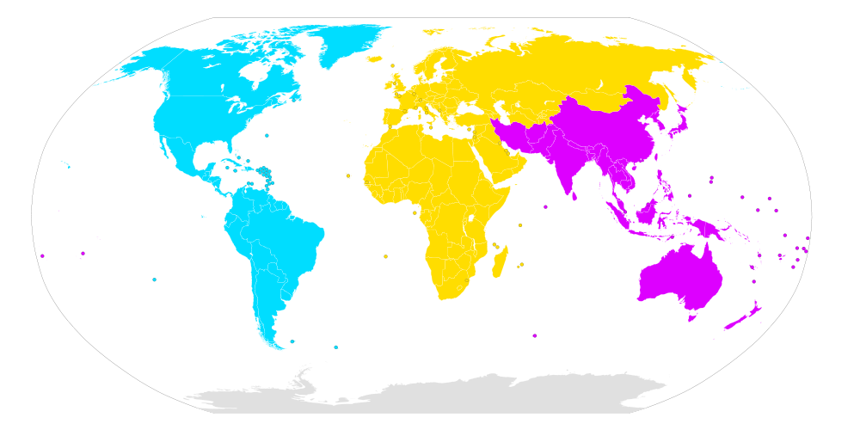
Regional Telecommunication Organizations
CEPT
RCC
ASMG
CITEL
APT
ATU
Notes:
Remember, in the ITU each member state is sovereign over the use of spectrum in its territory no matter what groups they may belong to.

Slide 16
Regional Telecommunication Organizations
Six main regional groups
CITEL – Inter-American Telecommunication Commission, 35 members
CEPT – European Conference of Postal and Telecommunication Administrations, 48 members
APT – Asia Pacific Telecommunity, 38 members
ASMG – Arab Spectrum Management Group, 22 members
ATU – African Telecommunications Union, 48 members
RCC – Regional Commonwealth in the Field of Communications, 11 members
The Regional Groups play increasingly important roles in reaching decisions on difficult issues.
There are other external organization, such as ICAO, IMO, IUCAF, and NATO, which have spectrum interests and contribute to the discussions.

Slide 17
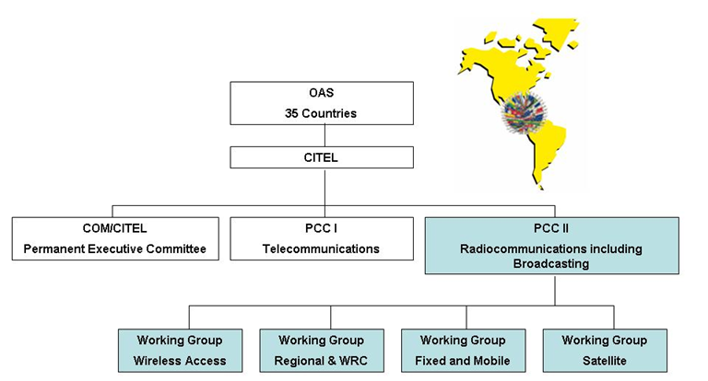
Inter-American Telecommunication Commission (CITEL)

Slide 18
European Conference Of Postal And Telecommunications Administrations (CEPT)
CEPT Assembly
Council
Presidency
The Chairmen of the Committees (ECC, CERP and Com-ITU)
form the Presidency of CEPT
Working Group
Spectrum Engineering
(WG SE)
Working Group
Frequency Management
(WG FM)
ECO
ECC
Working Group
Numbering and
Networks (WG NaN)
Conference
Preparatory Group
(WG CPG)
Committee
Task Groups and
Project Teams
Working Group
Policy
Working Group
UPU
CERP
Com-ITU
Committee
Task Groups and
Project Teams
Support from ECO
ECO is the permanent office of CEPT established in Copenhagen
Updated: October 2013

Slide 19
Regional Preparations for WRCs
In recent WRCs, the participation of member states as part of Regional Groups (groups of countries associated by geography as well as politics) has been an important part of reaching consensus on the issues before each conference.
Regional Groups prepare views and proposals on WRC agenda items and submit proposals to the WRC on behalf of their regional group.
Each Regional Group has its own set of rules and procedures for producing regional proposals to the WRC.
Examples of Regional Group preparations can be seen at:
http://www.itu.int/en/ITU-R/conferences/wrc/2019/Pages/reg-prep.aspx

Slide 20
U.S. WRC Preparatory Process
There are two spectrum regulators in the U.S.:
NTIA – Represents Federal Government Agencies
The Radio Conference Subcommittee (RCS) of the IRAC develops federal preliminary views and proposals
NTIA forwards views and proposals to the FCC
FCC – Represents the Private Sector and General Public
The FCC’s WRC Advisory Committee (WAC) develops private sector preliminary views and proposals
The WAC forwards views and proposals to the FCC
NTIA & FCC coordinate, modify, and reconcile U.S. views and proposals, with State’s input as needed.
The State Department submits U.S. views and proposals to CITEL or the ITU.

Slide 21
U.S. WRC Preparatory Process
WRC-27
CITEL
Negotiation of final technical input to the WRC
Optional
Preferred
CPM27-2
State Department
ITU-R Study Groups, Working Parties & Task Groups
Advocating U.S. technical inputs internationally
NTIA
FCC
U.S. Domestic Preparatory Work
U.S. preparation of technical inputs
IRAC RCS
WRC-27 WAC
RCS Working Groups
WAC Informal Working Groups
CPM27-1
Organization of ITU-R Study Group Work
U.S. View and Proposal Preparation
U.S. Technical Preparation

Slide 22
Results of WRC-23 (Highlights)
Identified additional spectrum for 5G (IMT); maintained spectrum for unlicensed use (WiFi) in the 6 GHz band; and ensured protections for critical services to safeguard national security and public safety (WRC-23 AI 1.1 and 1.2)
Agreed to new AMS(R)S allocation to bolster flight safety in oceanic and remote areas (WRC-23 AI 1.7)
Upgraded SRS allocation and allocated new inter-satellite services to support more efficient transmission of scientific data at higher rate (WRC-23 AI 1.13 and 1.17)
Final Acts WRC-23 (https://www.itu.int/pub/R-ACT-WRC.16-2024)

Slide 23
WRC-27 Outlook (Highlights)
19 specific WRC-27 agenda items plus standing items
WRC-27 is a very space-heavy cycle
Six WRC-27 AIs on Fixed Satellite Service
Four WRC-27 AIs on Mobile Satellite Service
Five WRC-27 AIs on Science Services
Only four terrestrial WRC-27 AIs
AI 1.7, Terrestrial Mid‐Band IMT
AI 1.8, Radiolocation above 231.5 GHz
AI 1.9, Appendix 26 aeronautical HF modernization
AI 1.10, Article 21 PFD and EIRP limits for FSS, MSS, and BSS at 70 and 80 GHz
Multiple AIs require close collaborations between different ITU-R Working Parties
Large number of overlapping frequency bands between agenda items
General deadline on criteria, characteristics and methodologies on the 31 December 2024

Slide 24
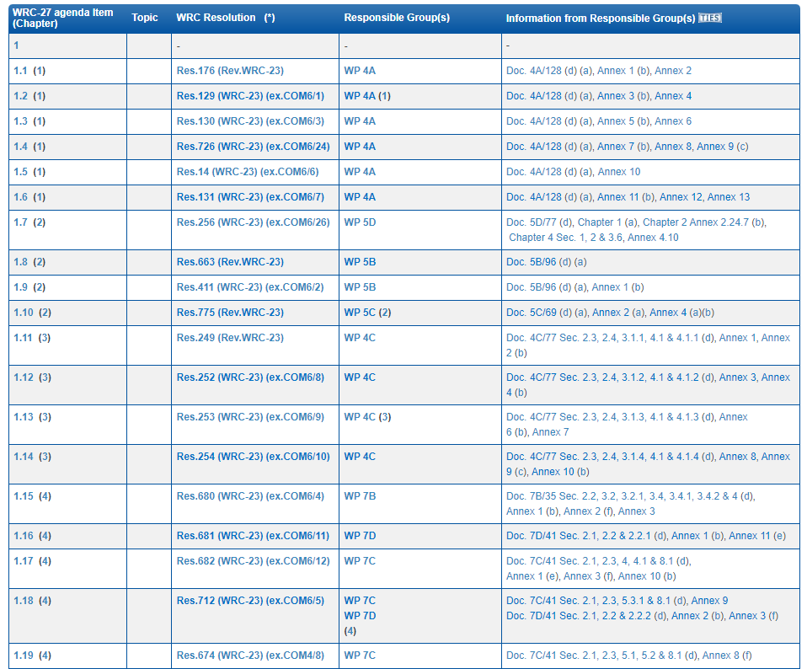
ITU-R Preparatory Studies for WRC-27
See Resolution 813 (WRC-23) for full list of WRC-27 Agenda Items
https://www.itu.int/en/ITU-R/study-groups/rcpm/Pages/wrc-27-studies.aspx

Slide 25
Questions?

