Slide 1
The U.S. Federal Government’s Spectrum Management Processes
John Alden, Chief (acting)
Spectrum Affairs and Information Division
Office of Spectrum Management
National Telecommunications and Information Administration
jalden@ntia.gov

Slide 2
Topics To Be Covered
Review: Basic Concepts & Functions of Spectrum Management
The U.S. Approach to Spectrum Management
Overview of Federal Spectrum Uses
How the Federal Government Manages Its Spectrum Use
Legal framework
Regulatory framework
Who Carries Out Key Functions of Federal Spectrum Management
Coordination with Other Spectrum Managers & Policymakers
National: the Federal Communications Commission
International: CITEL and ITU

Slide 3
Policy, Regulation & Management
Policy = High-level government goals and objectives.
Policy is set & articulated by Congress, the President and the Courts.
Regulation = Rules that are applied to achieve policy goals.
Regulators develop rules and apply them to market players or stakeholders.
Regulations are expressed through legal or regulatory codes, with enforcement regimes.
Management = Expert-level administration of standard processes needed to implement policy and regulatory decisions.
Examples include equipment certification, frequency assignment, coordination of satellite operations.
All three are developed through public input, informed by multiple interests & constituencies, and (should be) applied by experts.
Spectrum use is recognized as a legitimate area for policy, regulation & management.

Slide 4
Spectrum Management Elements
There are several basic elements of spectrum management & regulation:
Planning
Allocation
Assignment
Setting rules/regulations
Monitoring
Enforcement
In the U.S., there are two agencies that divide and coordinate spectrum management roles and duties: The Federal Communications Commission (FCC) and the Department of Commerce’s National Telecommunications and Information Administration (NTIA

Slide 5
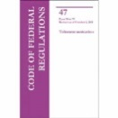
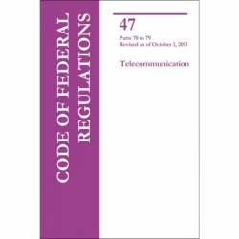
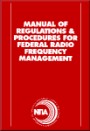
U.S. Spectrum Management Framework
The President
Communications Act of 1934+
Congress
NTIA Organization Act+
NTIA
FCC
47 CFR Part 300
Domestic and International Coordination
Federal Users
FCC Chair + NTIA A/S bi-annual meeting
Non-Federal Users
FCC Rules
47 CFR
Parts 0-199
Interdepartment Radio Advisory Committee
Chaired by NTIA OSM
19 Federal agency members
NTIA Manual
Advisory
Interagency Spectrum Advisory Council (ISAC)
Chaired by NTIA Assistant Secretary
Federal agencies + FCC and White House
Liaison
Commerce Spectrum Management Advisory Committee
Non-government advisors to Department of Commerce/NTIA
Technological Advisory Council Non-government advisors to FCC

Slide 6
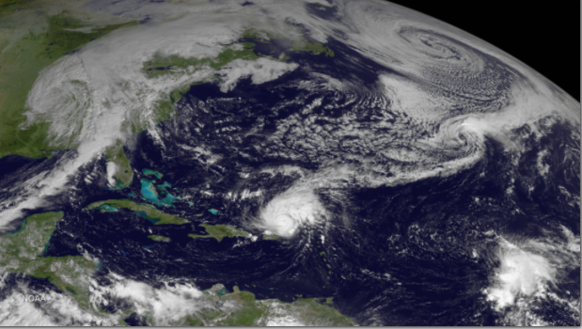
Overview of Federal Spectrum Uses
National defense
Law enforcement and public safety
Air traffic control
Space exploration and science
Weather and earth science
Resource management & recreation
Just to name a few….

Slide 7
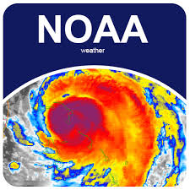
Scale & Scope of Federal Usage
The U.S. Federal government is among the most diverse & sophisticated users of spectrum in the world.
In CY 2022, there were 85,222 requests for frequency assignment actions, plus an additional 1,624 requests for Special Temporary Authority.
This covers space-based, aeronautical, maritime and terrestrial domains.
Includes radars, satellites, sensors, communications – the mast majority of ITU-defined services.

Slide 8
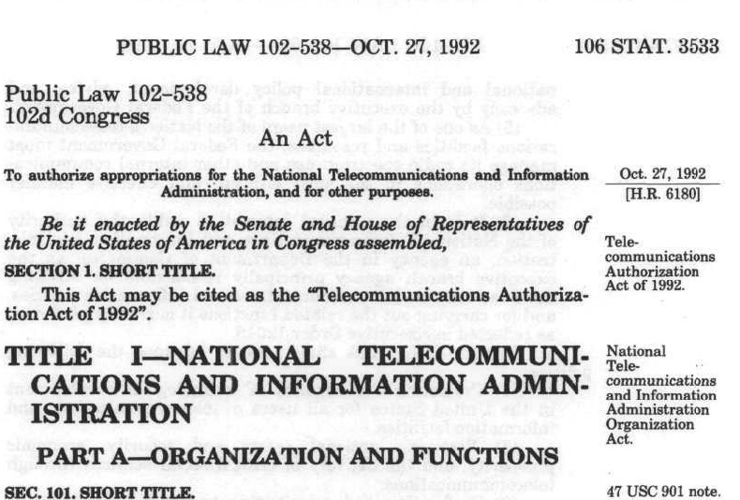
How the Federal Government Manages Its Own Spectrum
Legal Authority: The Communications Act of 1934, Section 305, reserves to the U.S. President the authority to regulate spectrum used by government stations.
Presidential authority has been delegated to NTIA through a series of executive actions.
President Nixon created the Office of Telecommunications Policy in 1970.
President Carter created NTIA in the Dept. of Commerce in 1978.
The NTIA Organization Act, passed by Congress in 1992, codified NTIA’s statutory role as manager of the Federal Government’s spectrum use.

Slide 9
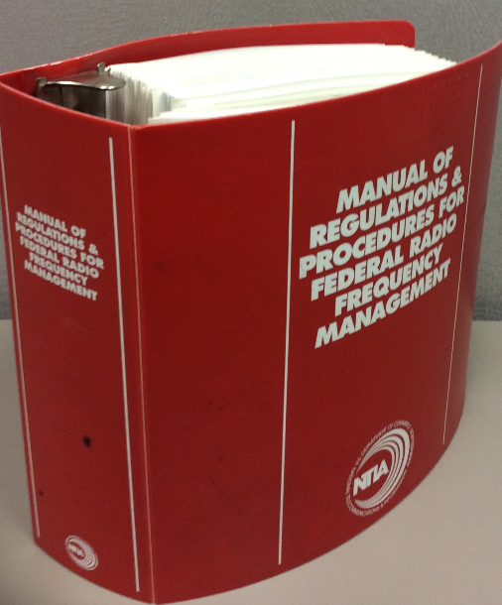
NTIA's Principal Responsibilities and Functions
Serving as the principal executive branch adviser to the President on telecommunications and information policy;
Prescribing policies for and managing Federal use of the radio frequency spectrum;
Developing and presenting U.S. plans and policies at international communications conferences and related meetings;
Serving as the principal Federal telecommunications research and engineering laboratory, through NTIA's Institute for Telecommunication Sciences (ITS), headquartered in Boulder, CO.
Notes:
https://www.federalregister.gov/agencies/national-telecommunications-and-information-administration

Slide 10
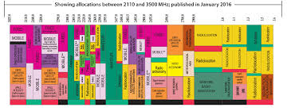
NTIA’s Spectrum Regulatory Structure
NTIA’s spectrum management activities are carried out by two offices:
The Office of Spectrum Management (OSM)
The Institute for Telecommunication Sciences (ITS)
NTIA works through an inter-agency group representing major federal users:
The Inter-Department Radio Advisory Committee or “IRAC.”
Federal spectrum rules are published in the NTIA Manual or “Red Book”

Slide 11
Office of Spectrum Management
Manages all federal government use of the radio spectrum
Develops policy & regulations governing spectrum use by federal agencies and departments
Supports national spectrum policy priorities, initiatives, and programs
Meeting the increasing spectrum needs of the United States while balancing the national security and economic interests of our nation

Slide 12
Office of Spectrum Management
Associate Administrator
Charles Cooper
Deputy Associate Administrator for Spectrum Management
Vacant
Executive Director
Scott Patrick
Deputy Associate Administrator for Spectrum Planning and Policy
Derek Khlopin
Spectrum Engineering and Analysis Division
Ed Drocella
IRAC Secretariat Division
Alan Frable
Spectrum Services Division
Binyam Tadesse
Strategic Planning Division
Byron Barker
International Spectrum Policy Division
Charles Glass
Spectrum Affairs and Information Division
John Alden
Spectrum Engineering Branch
Deputy, Chair Frequency Assignment Subcommittee
Deputy, Chair Spectrum Planning Subcommittee
Satellite Branch
Spectrum Analysis Branch
Terrestrial Branch
Frequency Assignment Branch
Systems Review Branch
12

Slide 13
IRAC Members*
Chair
(NTIA)
Air
Force
State
U.S.
Postal
Service
VA
NASA
Energy
BBG
DHS
Navy
Treasury
FCC
(Liaison)
Agriculture
FAA
Interior
NSF
Justice
Coast
Guard
Commerce
Army
Transportation
* Observers: Defense (DISA), NSA and FDA

Slide 14
IRAC Subcommittees
Emergency Planning Subcommittee (EPS)
Reviews National Security and Emergency Preparedness (NSEP) planning for spectrum-dependent systems.
Frequency Assignment Subcommittee (FAS)
Assignment and coordination of radio frequencies.
Radio Conference Subcommittee (RCS)
Preparing for CITEL and ITU conferences and meetings.
Space Systems Subcommittee (SSS)
International registration of federal government satellite systems with the ITU.
Spectrum Planning Subcommittee (SPS)
Apportionment of spectrum space for the support of established or anticipated radio services and among federal users.
Technical Subcommittee (TSC)
Addressing issues that relate to the technical aspects of the use of the electromagnetic spectrum, such as technical standards, propagation, EMC, etc.
Ad Hoc groups (task groups)

Slide 15
NTIA Manual or ‘Red Book’
Manual of Regulations and Procedures for Federal Radio Frequency Management (Red Book)
Incorporated by reference into Code of Federal Regulations
Specifically, 47 CFR, Section 300.1
Federal agencies must comply with the Manual when requesting or using radio frequency spectrum
11 Chapters and 15 Annexes
Proposed changes are discussed in the IRAC with final approval by NTIA
Notes:
§300.1 Incorporation by reference of the Manual of Regulations and Procedures for Federal Radio Frequency Management.
(a) The Manual of Regulations and Procedures for Federal Radio Frequency Management (the NTIA Manual) is issued by the Assistant Secretary of Commerce for Communications and Information, and is specifically designed to cover the Assistant Secretary's frequency management responsibilities pursuant to delegated authority under 47 U.S.C. 901 et seq.and Executive Order 12046 (March 27, 1978). Federal agencies must comply with the requirements in the NTIA Manual specified in paragraph (b) of this section.
(b) The NTIA Manual is incorporated by reference into this section with approval of the Director of the Federal Register under 5 U.S.C. 552(a) and 1 CFR part 51. All approved material is available for inspection at National Telecommunications and Information Administration, Office of Spectrum Management, 1401 Constitution Avenue NW, Room 1087, Washington, DC 20230, Peter Tenhula at (202) 482-9142, and is available from the sources indicated below. It is also available for inspection at the National Archives and Records Administration (NARA). For information on the availability of this material, call 202-741-6030 or go to www.archives.gov/federal-register/cfr/ibr-locations.html.
Original Manual written in 1965
Current Manual contains some 1965 language
Obsolete or archaic material
Excessive informational material
Unnecessary or irrelevant material
Unnecessary regulations
Need more user-friendly Manual
Need a modern Manual for the 21st century
….plan, manage, oversee, and implement a comprehensive review, overhaul, and modernization of the 52-year-old, 750+ page Manual of Regulations and Procedures for Federal Radio Frequency Management (NTIA Manual)
Via a Joint NTIA and IRAC Cross-Functional Team/Ad Hoc Group
No policy changes

Slide 16
NTIA Manual Contents
Authority and Organization
Telecommunication Policy
International Matters
Allocations, Allotments and Plans
Spectrum Standards
Definitions and Particulars of Assignments
Authorized Frequency Usage
Procedures and Principles for the Assignment and Coordination of Frequencies
Preparation of Applications for Frequency Assignment Action
Procedures for the Review of Telecommunications Systems
Public Access to the Federal Spectrum Management Process
Plus 15 Annexes

Slide 17
Coordination with Other Regulators
National Coordination
FCC coordination: MOU, meetings, preliminary view of draft decisions on some matters
Executive Branch: PPSG and WH/OMB
International Coordination:
ITU-R Study Groups and Working Parties
World Radiocommunication Conference prep
CITEL – The Inter-American Telecommunications Commission (PCC.II)

Slide 18
Summary & Conclusions
Different countries have evolved varying ways to manage spectrum resources.
The U.S. has a uniquely large government sector with advanced wireless systems.
Government spectrum use can foster technology innovation and dual-use technologies.
Coordination among all policymakers and regulators is vital to optimize spectrum use.

