Slide 1
Next Generation Spectrum Management
USTTI, Washington DC
Rajendra Singh,
Senior Digital Development Specialist
rsingh6@worldbank.org

Slide 2
Future Areas of Focus
Transformative Agenda of Digital Technologies
Spectrum Management
Building out infrastructure including infrastructure sharing
Consultative approach- Policy and Regulatory Decisions

Slide 3
What Next ? Do we really Know?
Future is nearer than what we think
Infrastructure competition may not be sustainable.
Future may have type of services using digital connectivity platform which you and me may not imagine today.
COVID, Conflict , and Climate have shown this

Slide 4
Digital is bending the arc of development and offering ways to shape the development paradigm
Global interconnected bandwidth is growing at 40 percent CAGR and is likely to reach around 100s TBPS within a short time period
The digital economy is the single most important driver of innovation , competitiveness and growth. Again, 3Cs have proven it.
AI data centers are adding further challenges in energy transition.

Slide 5
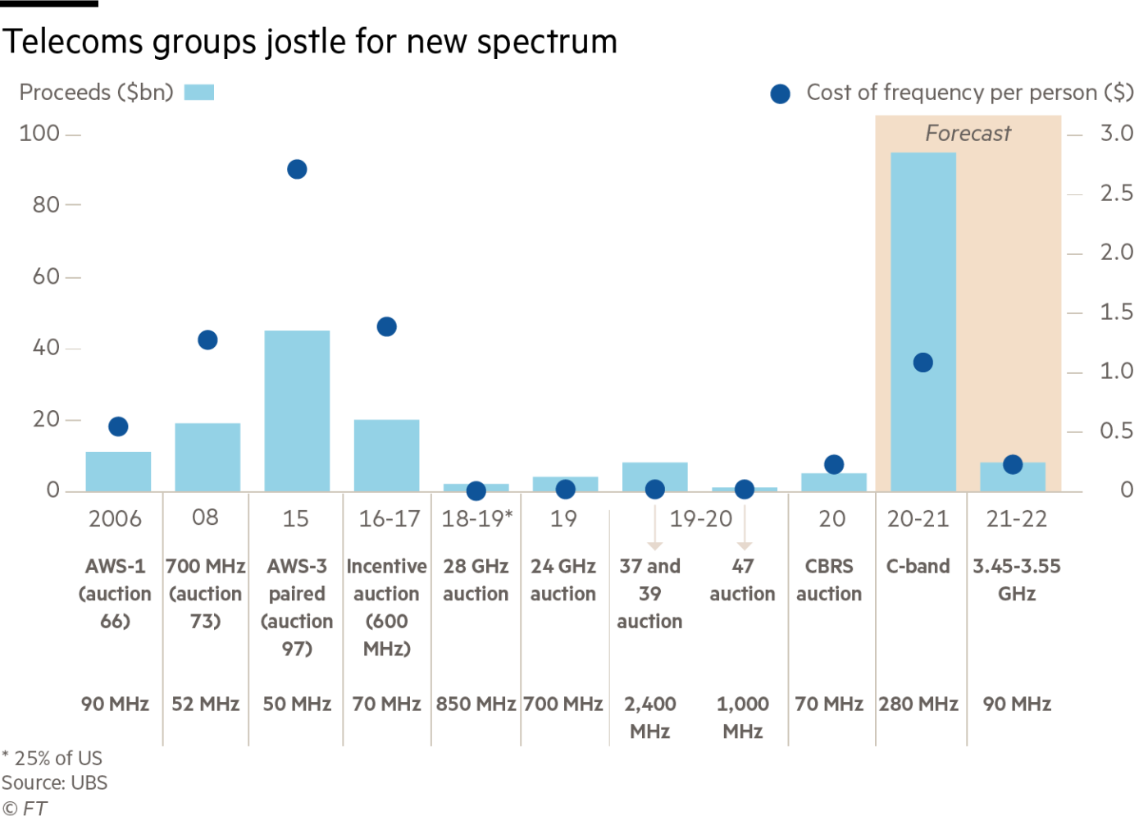
US Spectrum Auction

Slide 6
What is new in Spectrum Management?
Spectrum Availability- From Sub-2GHZ to MM Wave
More than 80 percent of telecommunication is within the buildings. Spectrum management for indoor and outdoor communication has different network attributes
Software Defined Radio ( SDR), Cognitive Radio , Open RAN, Telco Cloud, Disaggregation and virtualization of Networks

Slide 7
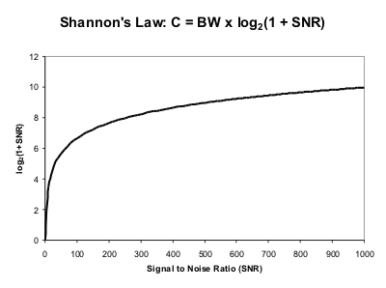
Shannon’s Theorem -What does it tell?
Bandwidth(BW) increase is the only solution to enhance the channel capacity(C) beyond a limit

Slide 8
Spectrum Management
Future wireless technologies will be driven by massive bandwidth , low latency as well, but high bandwidth is a big differentiator.
More than ten years ago, 4G services were launched with 10X10 MHz spectrum in different sub 3 GHz bands but today we are talking about 400 MHz to a Gig bandwidth. With more than ten-fold increase in spectral efficiency the uplink and downlink data speeds will be in multiple Gigs.
Even the current technology launch will easily achieve 1 GBPS peak speed
Use of MM wave ( 6-100 GHZ frequency range) will have its own challenges to the industry and regulators like small cell configurations in dense urban areas
Government has a monopoly in supplying spectrum

Slide 9
Spectrum Policy for Resilient Networks in Emergency
Telecom usage shifted from offices to residential areas during COVID-19. How to manage congestion with spectrum management flexibility. SoN Technology can help .
In case of natural disaster, traffic increases at the affected site. Temporary increase in capacity is necessary to avoid congestion.
Mobile Base station ( Towers) in case of emergency also need flexibility in spectrum management

Slide 10
Spectrum : Land or Sea
Should spectrum continue to be allocated like a piece of Land on lease for a definite period or spectrum be treated like Sea which can be accessed by different service providers following certain prescribed rules and regulations
Technology can permit this. Human ear example

Slide 11
Spectrum Management and Digital Divide
Dynamic Allocation of Spectrum and Network Sharing
National Roaming

Slide 12
Consultation Process
All policy and regulatory decisions should be taken in consultation with various stakeholders
We suggest to streamline the consultation process. The World Bank team will be very happy to share international experience in this regard.

Slide 13
Thank you !

