Slide 1
An Overview of Spectrum Management:
What, Why and How…
Eric Rosenberg
NTIA Office of Spectrum Management Spectrum Affairs and Information Division ERosenberg@ntia.gov
September 17, 2024
1

Slide 2
What is Spectrum Management?
Wikipedia says:
“Spectrum management is the process of regulating the use of radio frequencies to promote efficient use and gain a net social benefit.”
Is this too simplistic?
2

Slide 3
What is Spectrum Management?
“Radio frequency management is done by experts who meld years of experience with a curious blend of regulations, electronics, politics and not a little bit of larceny. They justify requirements, horse- trade, coerce, bluff, and gamble with an intuition that cannot be taught other than by long experience.”
Vice Admiral Jon L. Boyes, Director of Naval Communications, (1973-1975)
3

Slide 4
Why is Spectrum Management Important?
Spectrum is a basic building block for the future of telecommunications.
Effective spectrum management allows government and private industry to achieve their goals, co-exist and grow.
4

Slide 5
Why is Spectrum Management Important?
Spectrum supports
Government: public safety, infrastructure and services (utilities, weather reporting and forecasting, air traffic control, etc.), science and research.
Private Industry: broadcasting, various wireless services, data monitoring, mobile and fixed broadband (WiFi), “traditional” land mobile and microwave services, Bluetooth.
5

Slide 6
Why is Spectrum Management Important?
NTIA’s Spectrum Management Functions
Foster economic growth
Ensure our national and homeland security
Maintain U.S. global leadership in communications technology development and services
Satisfy other vital U.S. needs in areas such as public safety, scientific research, Federal transportation infrastructure, and law enforcement.
6

Slide 7
Why is Spectrum Management Important?
If there are no controls, the result is CHAOS:
Interference, decreased performance, inability to expand existing services or introduce new and enhanced services.
Results could be life-threatening!

Slide 8
How is Spectrum Management Carried Out?
- Development of policy and rules: Collaboration with all stakeholders and legislators
– Implementation of policy and rules:
Set realistic milestones
- Enforcement of rules:
Active monitoring of the spectrum

Slide 9
Is Spectrum Management A New Concept?
NO!
The International Telecommunications Union established the International Radio Consultative Committee or CCIR in 1927 (became the ITU-R in 1992).
The U.S. established the Interdepartment Radio Advisory Committee in 1922 (transferred to the Department of Commerce in 1927).

Slide 10
Is Spectrum Management Still Important?
YES!
As the demands for spectrum increase, the importance of effective spectrum management and the role of the spectrum manager is that much more important.

Slide 11
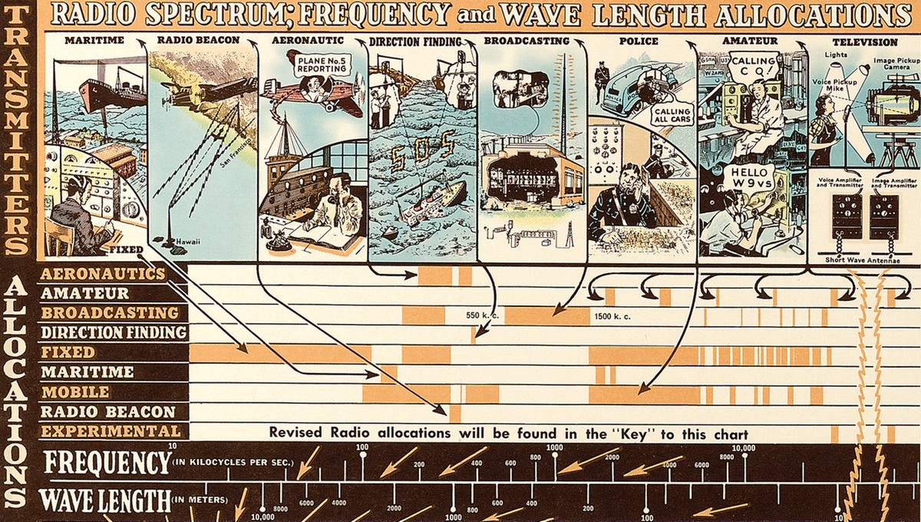
Spectrum Use Over the Years

Slide 12
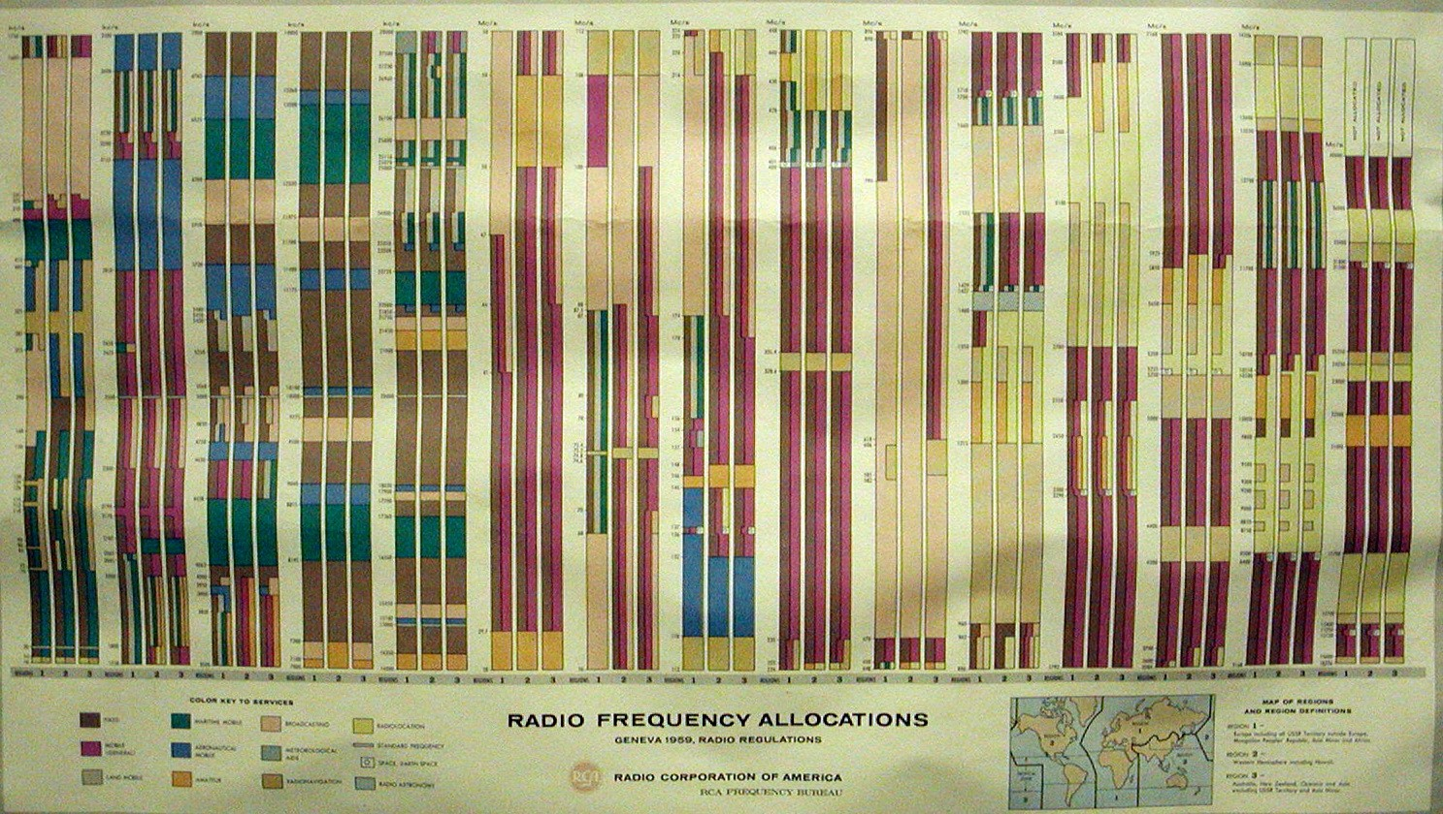
Spectrum Use Over the Years
1959

Slide 13
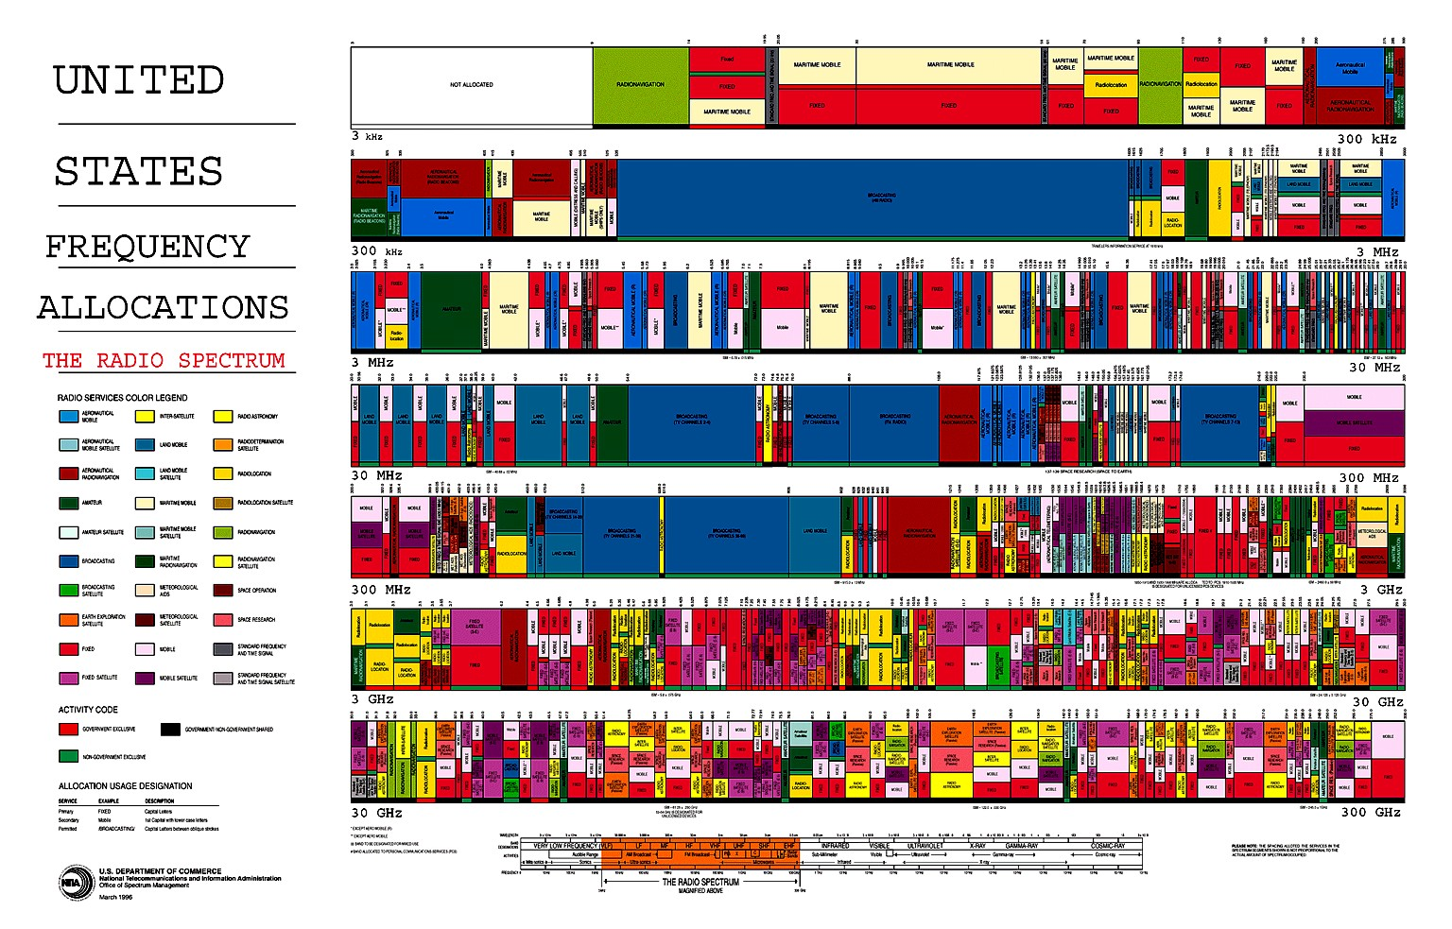
Spectrum Use Over the Years
1996

Slide 14
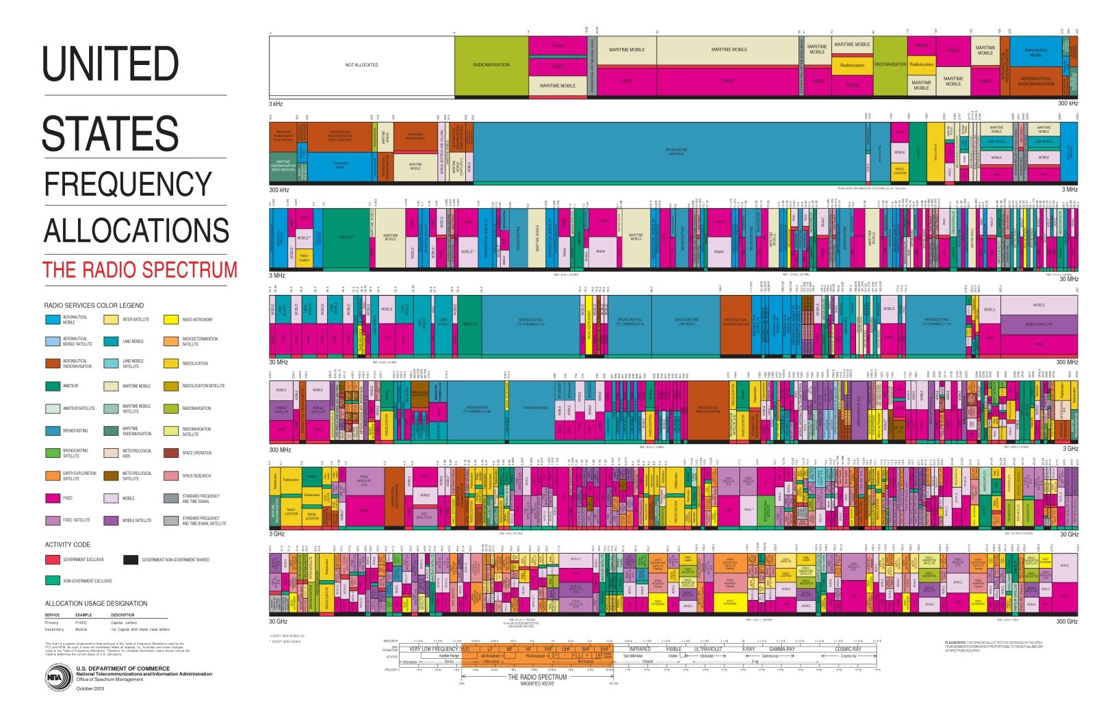
Spectrum Use Over the Years
2003
14

Slide 15
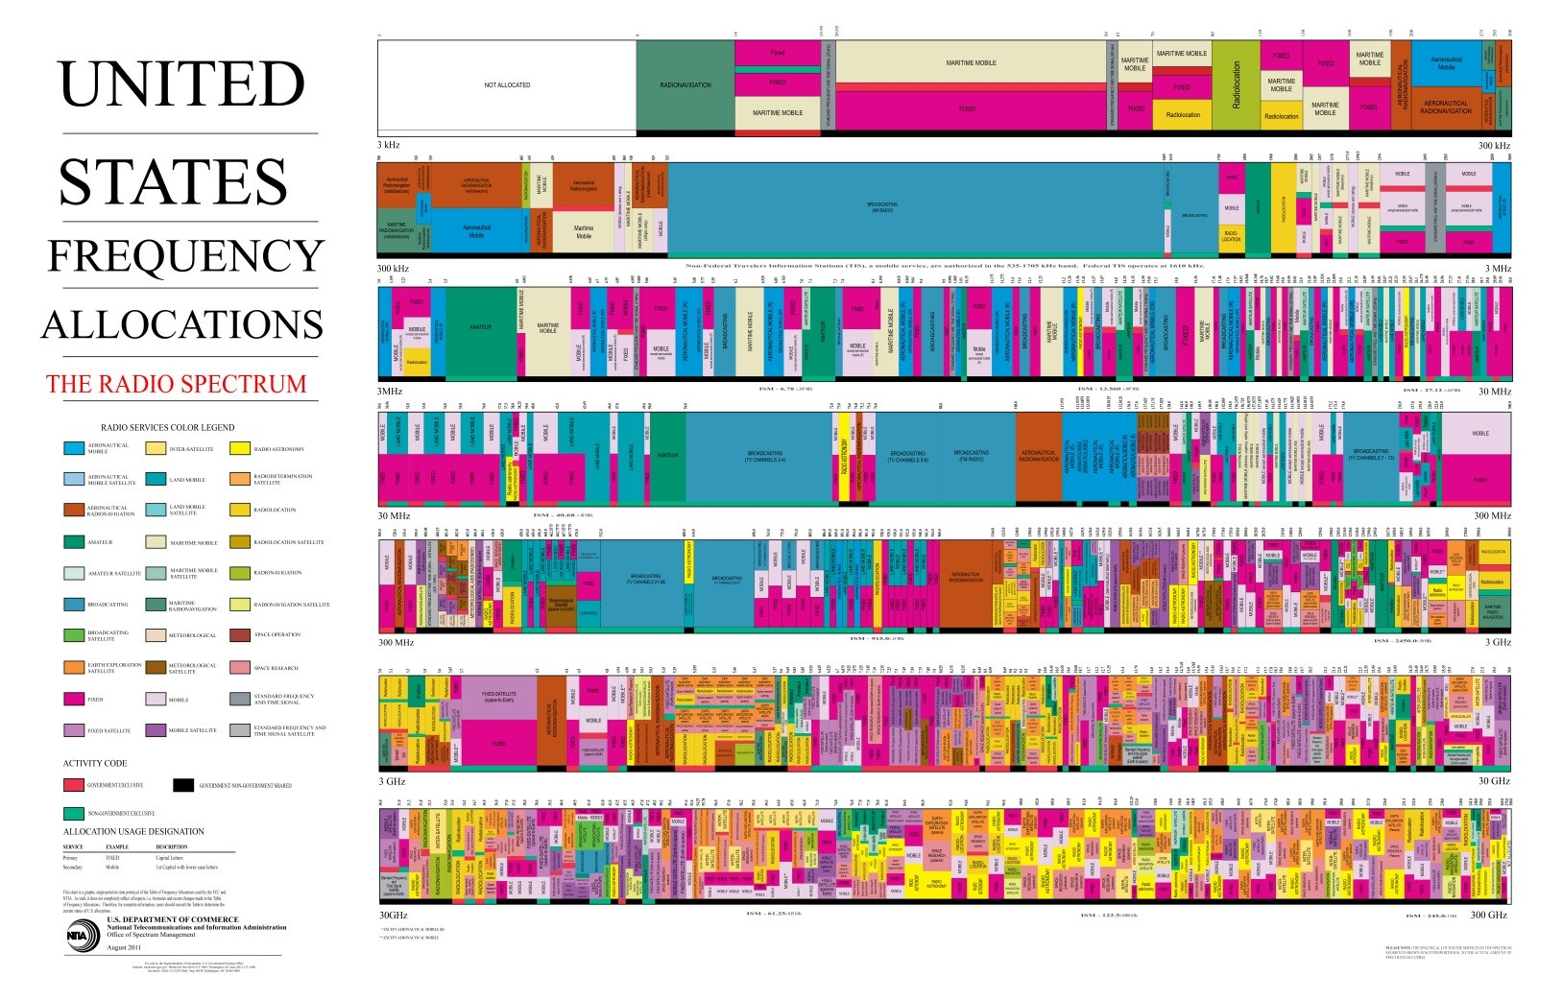
Spectrum Use Over the Years
2011

Slide 16

Spectrum Use Over the Years
2016

Slide 17
Questions
or
Comments?
Eric Rosenberg
NTIA Office of Spectrum Management
Spectrum Affairs and Information Division
ERosenberg@ntia.gov

