Slide 1
Spectrum Management Tools: Radio Regulations and Table of Frequency Allocations
Dr. LiChing Sung
Spectrum Affairs and Information Division
Office of Spectrum Management
National Telecommunications and Information Administration
lsung@ntia.gov

Slide 2
Topics to Be Covered
International Framework of Spectrum Management
Sovereign right of states to manage spectrum use
Intergovernmental organizations & multilateral diplomacy
Overview of the Radio Regulations
Instruments of the ITU
Guiding principle of RR
International recognition and protection from interference
Table of Frequency Allocations
Spectrum apportionment definitions
Allocations hierarchy
Footnotes

Slide 3
IGOs & Multilateral Diplomacy
Spectrum Knows No Borders
To avoid harmful interference, governments work through membership in inter-governmental organizations (IGOs).
The ITU is the global expert agency for spectrum.
UN-affiliated agency; HQ in Geneva, Switzerland
Founded in 1865 (one of the world’s oldest IGOs).
ITU’s Radiocommunication Sector (ITU-R) carries out members’ directions and implements the Radio Regulations (RR).
Regional IGOs maintain their own telecom-related agencies:
APT, ATU, CEPT, CITEL, etc.

Slide 4
Sovereign Right of States to Manage Spectrum Use
ITU recognizes sovereign right of States to manage the radio spectrum.
RR allows each State the greatest possible flexibility with regard to spectrum use.
Services allocated in the Table are not necessarily compatible locally; each State can select those it wishes to implement on its territory.
However, exercise of sovereign right should not conflict with the principle of promoting efficient and economical use of the spectrum and should not result in barriers to trade in services.

Slide 5
Legal Instruments of the ITU
Constitution
Convention
Administrative Regulations
Radio Regulations (RR)
International Telecommunication Regulations (ITRs)
Notes:
The instruments of the Union are not allowed to conflict with each other. The CS prevails over the CV and Administrative Regulations. The CV prevails over the Administrative Regulations. Neither Administrative Regulation prevails over the other.
Both the RRs and the ITRs are free to download from the ITU web site.

Slide 6
Radio Regulations
Principle regulatory framework within which States undertake to operate radio services and the basic tool for international spectrum use
International treaty status and binding on all Member States
Revised by World Radiocommunication Conferences (WRCs)
Supplement the Constitution and Convention of the ITU

Slide 7
Radio Regulations Define:
Frequency allocations to different categories of radiocommunication services
Mandatory technical parameters to be observed by radio stations, especially transmitters
Procedures for the coordination and notification of frequency assignments made to radio stations by national governments
Coordination: ensuring technical compatibility
Notification: formal recording and protection in the Master International Frequency Register (MIFR)
Other procedures and operational provisions
Notes:
Status of a frequency assignment in the MIFR
The international rights and obligations of administrations in respect of their own and other administrations’ frequency assignments shall be derived from the recording of those assignments in the the Master Register or from their conformity, where appropriate, with a Plan. Such rights shall be conditioned by the provisions of these Regulations and those of any relevant frequency allotment or assignment Plan.
Conform assignment
Any frequency assignment recorded in the Master Register with a favourable finding under RR 11.31 shall have the right to international recognition. For such an assignment, this right means that other administrations shall take this into account when making their own assignments, in order to avoid harmful interference. In addition, frequency assignments in frequency bands subject to coordination or subject to a Plan shall have a status derived from the application of the procedures relating to the coordination or associated with the Plan.
Non-conform assignment
A frequency assignment shall be known as a non-conforming assignment when it is not in accordance with the Table of Frequency Allocations or the other provisions of these Regulations. Such an assignment shall be recorded for information purposes, only when the notifying administration states that it will be operated in accordance with RR 4.4 (see also RR 8.5).

Slide 8
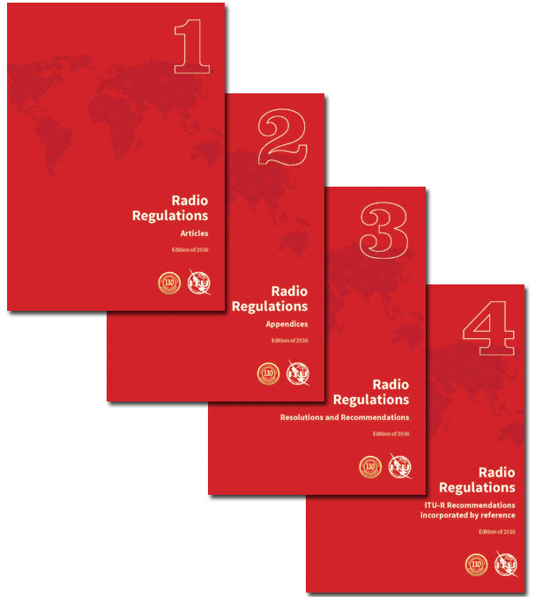
RR Structure
Volume 1 – Articles
Art 1: Terms and definitions
Art 5: Frequency allocations
Volume 2 – Appendices
App 7: coordination methods
App 30: BSS Plan; App 30B: FSS Plan
Volume 3 – Resolutions and Recommendations Volume 4 – ITU-R Recommendations incorporated by reference
Notes:
Vol 2, Appendix 7: Methods for the determination of the coordination area around an earth station in frequency bands between 100 MHz and 105 GHz
Appendix 30: BSS Plan
Appendix 30B: FSS Plan

Slide 9
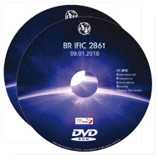
Master International Frequency Register
ITU-maintained database of satellite and terrestrial frequency assignments
Recording in the MIFR is the final stage of the frequency coordination process
Notifications of frequency assignments from administrations are examined and published in the BR IFIC
Confers international recognition and protection from interference
Notes:
Status of a frequency assignment in the MIFR
The international rights and obligations of administrations in respect of their own and other administrations’ frequency assignments shall be derived from the recording of those assignments in the the Master Register or from their conformity, where appropriate, with a Plan. Such rights shall be conditioned by the provisions of these Regulations and those of any relevant frequency allotment or assignment Plan.
Conform assignment
Any frequency assignment recorded in the Master Register with a favourable finding under RR 11.31 shall have the right to international recognition. For such an assignment, this right means that other administrations shall take this into account when making their own assignments, in order to avoid harmful interference. In addition, frequency assignments in frequency bands subject to coordination or subject to a Plan shall have a status derived from the application of the procedures relating to the coordination or associated with the Plan.
Non-conform assignment
A frequency assignment shall be known as a non-conforming assignment when it is not in accordance with the Table of Frequency Allocations or the other provisions of these Regulations. Such an assignment shall be recorded for information purposes, only when the notifying administration states that it will be operated in accordance with RR 4.4 (see also RR 8.5).

Slide 10
Spectrum Apportionment Definitions
Allocation – (of a frequency band): Entry in the Table of Frequency Allocations of a given frequency band for the purpose of its use by one or more radiocommunication services. (RR)
Allotment – (of a radio frequency or radio frequency channel): Entry of a designated frequency channel in an agreed plan. (RR)
Assignment – (of a radio frequency or radio frequency channel): Authorization given for a radio station to use a radio frequency or a radio frequency channel under specified conditions. (RR)
Notes:
FCC: The terms "allocation," "allotment," and "assignment" are used to describe the distribution of frequencies or
bands of frequencies. Allocations are made to radio services, for example, the fixed service, the aeronautical
mobile service, and the space research service. Allotments are made to areas or countries and, within the Federal
Government, to specific uses. Assignments are instruments of authorization of discrete frequencies to specific
radio stations.
Examples of allotment: European and African analog TV allotment plan and their successor GE 2006 for digital broadcasting, BSS allotment plan, FSS allotment plan

Slide 11
Frequency Allocations
Allocation and regulation of the radio frequency (RF) portion of the electromagnetic spectrum
RF ranges from 3 Hz to 3000 GHz (3 THz)
Allocated radio spectrum: 8.3 kHz - 275 GHz
Use of 275-1000 GHz for passive services is subject to No. 5.565
Use of 275-450 MHz for active services is subject to No. 5.564A
Allocations are made to radiommunication services defined in RR Article 1
Frequency bands are allocated to different services either worldwide or regionally
Notes:
Note WRC-19 Agenda Item 1.15 to “consider identification of frequency bands for use by administrations for the land-mobile and fixed services applications operating in the frequency range 275–450 GHz, in accordance with Resolution 767(WRC-15)

Slide 12
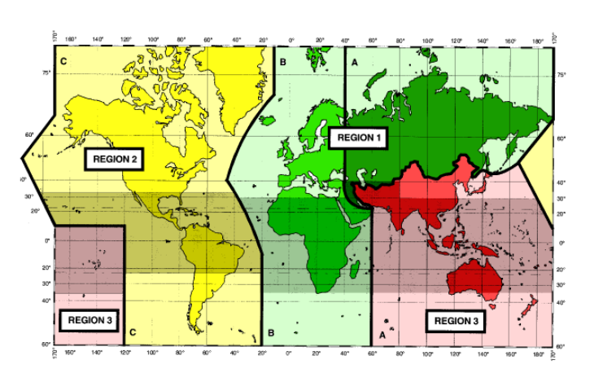
ITU Regions

Slide 13
Principle of Precedence
New uses must avoid causing harmful interference to the services provided by stations using frequencies assigned to them in accordance with the RR and recorded favorably in the MIFR.
In other words, new uses should enter a band in a way that does not cause harmful interference to existing services that are operating in accordance with the RR.
RR 4.4 allows countries to operate non-conforming assignments on a non-interference basis (NIB)
Notes:
The guiding principle underlying all Radio Regulations provisions is that new uses must avoid causing harmful interference to the services provided by stations using frequencies assigned to them in accordance with the RR and recorded favorably in the MIFR.

Slide 14
Partial List of Radiocommunication Services
Amateur service (AS)
fixed service (FS)
fixed-satellite service (FSS)
inter-satellite service
space operation service (SRS)
mobile service (MS)
mobile-satellite service (MSS)
land mobile service (LMS)
land mobile-satellite service (LMSS)
maritime mobile service (MMS)
maritime mobile-satellite service (MMSS)
aeronautical mobile service (AMS)
aeronautical mobile (R) service (AM(R)S)
aeronautical mobile (OR) service (AM(OR)S)
broadcasting service (BS)
broadcasting-satellite service (BSS)
radiodetermination service (RDS)
radiodetermination-satellite service (RDSS)
radionavigation service (RNS)
radionavigation-satellite service (RNSS)
maritime radionavigation service (MRNS)
maritime radionavigation-satellite service (MRSS)
aeronautical radionavigation service (ARNS)
radiolocation service (RLS)
radiolocation-satellite service (RLSS)
meteorological aids service (MAS)
Earth exploration-satellite service (EESS)
meteorological-satellite service (MetSat)
space research service (SRS)
Notes:
Total 41 radio services. Some radio services can be subsets of others.

Slide 15
Allocations Hierarchy
Primary Service: Printed in upper case
Receive highest priority and are designated as the principle authorized users of the band
Secondary service: Printed in lower case
shall not cause harmful interference to current or future stations of the primary service(s) for the band;
shall not claim protection from harmful interference caused by current or future stations of the primary service(s) for the band.
can claim protection from harmful interference from stations of the same or other secondary service(s)
Non-Interference Basis (NIB)
A condition of use relative to other specified uses that affords no protection from harmful interference, defined in Article 4.4
Notes:
4.4 Administrations of the Member States shall not assign to a station any frequency in derogation of either the Table of Frequency Allocations in this Chapter or the other provisions of these Regulations, except on the express condition that such a station, when using such a frequency assignment, shall not cause harmful interference to, and shall not claim protection from harmful interference caused by, a station operating in accordance with the provisions of the Constitution, the Convention and these Regulations.

Slide 16
Table of Frequency Allocations
Band allocations are set out in the Table of Frequency Allocations
Each band may be allocated to one or more services, with equal or different rights
Two categories of service: PRIMARY and Secondary
Exceptions or restrictions on allocations are covered in footnotes to the Table

Slide 17
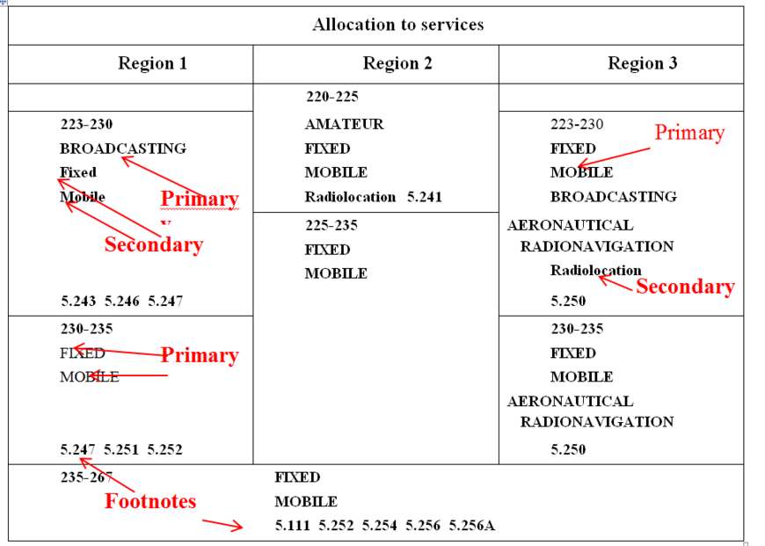
Partial Page from Allocations Table

Slide 18
Footnotes
Have the same regulatory status as allocated services in the Table
Used to cover:
Different category of service
Additional allocation
Alternative allocation
5. prefix
Examples: 5.149, 5.282, 5.388

Slide 19
Footnote Examples
5.204 Different category of service: in Afghanistan, Saudi Arabia, Bahrain, Bangladesh, Brunei Darussalam, China, Cuba, the United Arab Emirates, India, Indonesia, Iran (Islamic Republic of), Iraq, Kuwait, Montenegro, Oman, Pakistan, the Philippines, Qatar, Serbia, Singapore, Thailand and Yemen, the band 137-138 MHz is allocated to the fixed and mobile, except aeronautical mobile (R), services on a primary basis (see No. 5.33). (WRC-07)
5.176 Additional allocation: in Australia, China, Korea (Rep. of), the Philippines, the Dem. People’s Rep. of Korea and Samoa, the band 68-74 MHz is also allocated to the broadcasting service on a primary basis.
(WRC-07)
5.167 Alternative allocation: in Bangladesh, Brunei Darussalam, India, Iran (Islamic Republic of), Pakistan, Singapore and Thailand, the band 50-54 MHz is allocated to the fixed, mobile and broadcasting services on a primary basis. (WRC-07)

Slide 20
Frequency Bands Identification via Footnotes
Spectrum is allocated to radio services, not technologies and applications.
ITU uses frequency band identification or designation via footnotes to get around the limitation. Examples:
International Mobile Telecommunication (IMT)
Industrial, Science and Medical (ISM) applications

Slide 21
Examples of Footnote Identification
5.388 The frequency bands 1 885-2 025 MHz and 2 110-2 200 MHz are intended for use, on a worldwide basis, by administrations wishing to implement International Mobile Telecommunications (IMT). Such use does not preclude the use of these frequency bands by other services to which they are allocated. The frequency bands should be made available for IMT in accordance with Resolution 212 (Rev.WRC‑15) (see also Resolution 223 (Rev.WRC‑15)). (WRC‑15)
5.150 The following bands:
13 553-13 567 kHz (centre frequency 13 560 kHz),
26 957-27 283 kHz (centre frequency 27 120 kHz),
40.66-40.70 MHz (centre frequency 40.68 MHz),
902-928 MHz in Region 2 (centre frequency 915 MHz),
2 400-2 500 MHz (centre frequency 2 450 MHz),
5 725-5 875 MHz (centre frequency 5 800 MHz), and
24-24.25 GHz (centre frequency 24.125 GHz)
are also designated for industrial, scientific and medical (ISM) applications. Radiocommunication services operating within these bands must accept harmful interference which may be caused by these applications. ISM equipment operating in these bands is subject to the provisions of No. 15.13.
Notes:
IMT

Slide 22
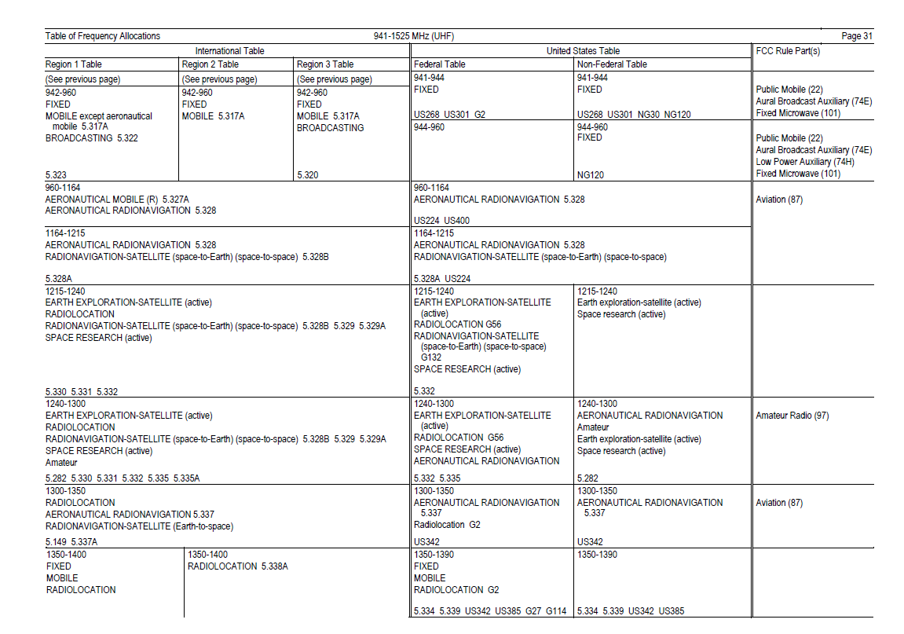
Sample of U.S. Frequency Allocations Table
ITU
NTIA
FCC

Slide 23
Sample of Japan Frequency Allocations Table

Slide 24
Sample of Moldova Frequency Allocations Table

Slide 25
Dr. LiChing Sung
Office of Spectrum Management
lsung@ntia.gov

