Slide 1

The National Spectrum Strategy
& Implementation Plan
John Alden
Chief (Acting), SAID
Office of Spectrum Management
September 25, 2024

Slide 2

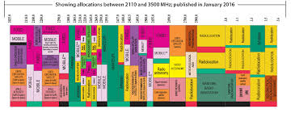
Preview
What is the National Spectrum Strategy (NSS)?
Development of the NSS, Including 2023 Presidential Memo
The Four Pillars of the NSS
Preparing the Implementation Plan (I-Plan)
Legacy of the NSS

Slide 3

What is the National Spectrum Strategy?
The Strategy is a high-level policy document establishing a vision and strategic objectives for improved spectrum management.
It is an initiative of the Biden Administration, along with the Department of Commerce (NTIA) and other federal agencies.
  Key White House offices: Office of Science and Technology Policy OSTP), National Economic Council (NEC), National Security Council (NSC)
It will be a “living” document, updated routinely to capture new policy requirements and issues.

Slide 4

Need for a National Spectrum Strategy
Growing demand for commercial spectrum access
Sustained need for spectrum to meet government mission mandates
Increasing difficulty with coordination across federal and non-federal jurisdictions
  24 GHz
  5.9 GHz
  Upper 3 GHz/4 GHz altimeters
Commerce Secretary Raimondo called for a strategy during congressional testimony as a nominee.

Slide 5

NTIA-FCC Coordination
February 2022: NTIA Administrator Alan Davidson & FCC Chairwoman Jessica Rosenworcel unveil a joint “Spectrum Coordination Initiative”
August 2022: NTIA & FCC sign an updated MOU governing coordination of spectrum actions:
  Increased meetings between leadership and staff
  Longer lead times for previewing decisions via the IRAC
  Commitment to more effective communications and exchange of information
Commonalities: Longer-range planning, evidence-based decision-making & reliance on data, analyses & engineering best practices

Slide 6


A Coalition To Develop the NSS
By late 2022, the Administration assembled a team of policy experts involving:
Executive Office of the President
  Office of Science & Technology Policy
  National Security Council
  National Economic Council
Department of Commerce
  NTIA’s Office of Spectrum Management & ITS
Federal Agencies
Federal Communications Commission

Slide 7
The 2023 Presidential Memo
The White House prepared a presidential memo to capture the goals of the NSS development process:
  Spur innovation by promoting efficient and effective spectrum use
  Accelerate U.S. leadership in wireless technologies
  Ensure spectrum access (agencies & private sector) for scientific, public safety, critical infrastructure, & national security uses
Nov. 13, 2023: PM released on “Modernizing United States Spectrum Policy & Establishing a National Spectrum Strategy”
  Set up the Interagency Spectrum Advisory Council (ISAC)
  Officially mandated creation of the NSS
  Called for an Implementation Plan within 120 days of submitting the Strategy
  Spelled out roles and duties of NTIA and federal agencies

Slide 8

The NSS Takes Shape
The NSS Coalition proceeded with NSS development pending the release of the PM.
NTIA undertook a public outreach effort thru 2023:
  Request for Comments (April 2023) > 130 comments
  Public listening sessions: (1) March 30 (in DC); (2) April 11 (University of Notre Dame)
  Tribal listening sessions
  Interagency input: (1) listening sessions & (2) comments/edits
  FCC had a role in preparing and commenting on draft NSS
WH released the National Spectrum Strategy on Nov. 13, 2023.

Slide 9
What’s In the NSS
The Strategy Includes Four Policy “Pillars”:
  A Spectrum Pipeline to Ensure U.S. Leadership in Advanced and Emerging Technologies
  Collaborative Long-Term Planning to Support the Nation’s Evolving Spectrum Needs
  Unprecedented Spectrum Innovation, Access, and Management through Technology Development
  Expanded Spectrum Expertise and Elevated National Awareness
Each pillar contains “strategic objectives” detailing the designed outcomes

Slide 10
NSS Implementation Plan
After NSS release, the public outreach continued:
  A Federal Register notice resulted in > 75 comments
  The 2024 NTIA Spectrum Policy Symposium (Feb. 1, 2024) focused on NSS implementation
  Inter-agency review and WH adjudication of inputs
The Implementation Plan was released by NTIA on March 12, 2024.
  Under the four pillars, each strategic objective was given multiple outcomes
  Target dates, lead agencies & contributing agencies were assigned for each outcome

Slide 11
Pillar One: Building a Spectrum Pipeline
The NSS calls for studies of five bands:
  3100-3450 MHz – co-led by NTIA & DoD (w/SSG and TIG)
  5030-5091 MHz – co-led by NTIA, FCC & FAA (w/WG)
  7125-8400 MHz – co-led by NTIA & affected agencies (w/SSG & 3 TIGs)
  18.1-18.6 GHz – co-led by NTIA & NASA (w/WG)
  37.0-37.6 GH – co-led by NTIA & DoD (w/WG)
Important: Other outcomes include documenting agency spectrum requirements & determining proper metrics and data for spectrum usage.

Slide 12
Mapping Out the Studies

Slide 13
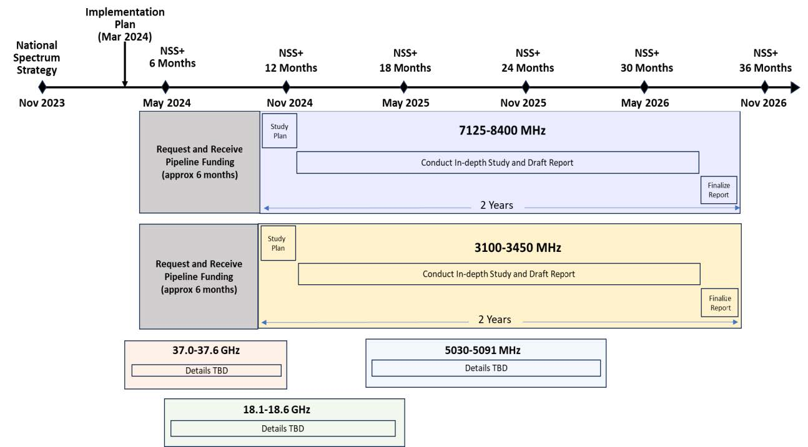
Timeline for the Band Studies

Slide 14
Pillar Two: Increased Coordination
Strategic Objective 2.1 -- Establish a persistent strategic spectrum planning process guided by the best available science and data
  Establish an improved collaboration framework
  Implement a national, long-term spectrum planning process
S.O. 2.2 – Develop & document an evidence-based decision-making methodology
  A value-based model to inform spectrum policy decisions
  A historical assessment of reallocated/auctioned bands
S.O. 2.3 – Define requirements & capabilities to capture data on spectrum use
  Define a methodology for representing current use and future needs
  Document new capabilities needed for data, IT & modeling
  Establish national best practices for unbiased technical, scientific, mission and economic analyses

Slide 15
Pillar Three: Investing in Technology
Exploring how to leverage new technologies to improve spectrum management
  A roadmap for improving receiver resistance to harmful interference
  Recommendations for a common platform for shared spectrum access, including potentially IIC
Committing to coordinated, focused & sophisticated R&D
  Development of a national spectrum R&D plan
  Establishing a data collection & measurement program
  Creating a Spectrum Sandbox Program
  An advanced dynamic spectrum sharing demonstration and report, plus a national DSS testbed
Pursuing policies that maximize flexible spectrum use and innovative technologies
  Spectrum Relocation Fund recommendations for improved coexistence and compatibility

Slide 16
Pillar Four: Workforce Development & Public Awareness
Attract, train and grow the next-generation spectrum workforce
  Develop a National Spectrum Workforce Plan
  Elevate agencies’ spectrum workforce programs
Improve policy-makers’ understanding of spectrum
  Build a senior-level spectrum training and awareness materials repository
  Establish a “Spectrum 101” training program for leaders at all levels of government
Build public understanding of spectrum’s importance
  Establish a public spectrum “literacy” program

Slide 17
Questions?

