Slide 1
OFFICE OF THE CHIEF INFORMATION OFFICER
IT Operations Directorate
United States Telecommunications Training Institute
Radio Frequency Spectrum Management
Scott Keslar, Spectrum Assignments Lead
September 19, 2024

Slide 2
Spectrum Licensing 101
“Radio Frequency Management is done by experts who meld years of experience with an a curious blend of regulation, electronics, politics and not a little bit of larceny. They justify requirements, horse-trade, coerce, bluff, and gamble with an intuition that cannot be taught other than by long experience.”
Vice Admiral Jon L. Boyes

Slide 3
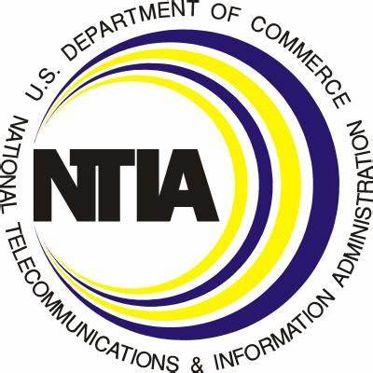
Spectrum Licensing 101
The Communications Act of 1934 and Title 47 of USC created the NTIA and FCC; each has different roles and responsibilities:
Advises the President on information and communication policies
Has authority to assign federally allocated spectrum and certify equipment
Identifies federal spectrum which may be auctioned for commercial use
Develops and presents plans representing US interests at international conferences
Performs engineering analysis and planning for spectrum use
An independent federal agency responsible to the US Congress
Regulates “common carriers”, provides communications services to the public
Licenses state, local, municipal, tribal, commercial/industrial
Enforcement Bureau is default organization to resolve interference issues
Hates CUAS test and training; “protect WFH and kids doing homework”

Slide 4
Spectrum Licensing 101
SPS
Spectrum Planning Subcommittee is the foundation for licensing by certifying transmitters;
OMB Circular A-11 section 31.12(c):
You must obtain a certification by the National Telecommunications and Information Administration (NTIA) of the Department of Commerce, or your agency as designated by NTIA, that the radio frequencies required can be made available before you submit estimates for the development or procurement of major radio spectrum-dependent communication-electronics systems (including all systems employing space satellite techniques). The NTIA, which is responsible for assigning spectrum to Federal users, may also review these analyses, during the assignment process.
Equipment - Tech data submitted to the SPS and NTIA engineers to validate antennas, amplifiers, waveforms, and emissions are IAW manufacturer’s and federal specifications
Locations – Organizational SPS representative will submit request for a certification for large-scale operations in required locations

Slide 5
Spectrum Licensing 101
FAS
Frequency Assignment Subcommittee reviews proposals from other federal agencies to protect their own assignments:
Agenda Processing – via SXXI, action officers review 300 to 600 proposals on a daily agenda
Represents component interests at the national level
submits proposals for assignment
deconfliction authority when interference is encountered

Slide 6
Spectrum Licensing 101
Spectrum licensing is requirements driven:
Spectrum licensing team may be involved in planning, but doesn’t become active until locations, equipment, and desired frequency bands are identified
Locations confirmed by Master Site List (MSL)
Equipment: certified by SPS, then locations validated in separate certs experimental or otherwise non-certified equipment can be used on a renewable basis
Frequency band assignments: cleared locally and secondary

Slide 7
Spectrum Licensing 101
Spectrum Licensing 101
LMR is most of what we do; create, submit, modify, and update proposals (directives); NTIA and other federal agencies review and vote
DHS has 28750 assignments in the Government Master File
~19000 Land Mobile Radio assignments (66%)
ACCEPT or TABLE – When approved, NTIA grants RFA (radio frequency authorization aka the legal authority to operate)
Other functions:
*Agendas *Process STA/Windmills *Interference analysis
*Five Year Review *Coverage plots *Emergency operations
*Inter-agency and external coordination *Support NSSE/SEAR *CUAS

Slide 8
Spectrum Licensing 101
Policy Review
Documents received from FCC are reviewed for impact to DHS mission and existing assignments
Informational papers and proposals drafted and submitted by NTIA for agency review
DHS Spectrum implements the DHS OCIO guidance and management directives to the components

Slide 9
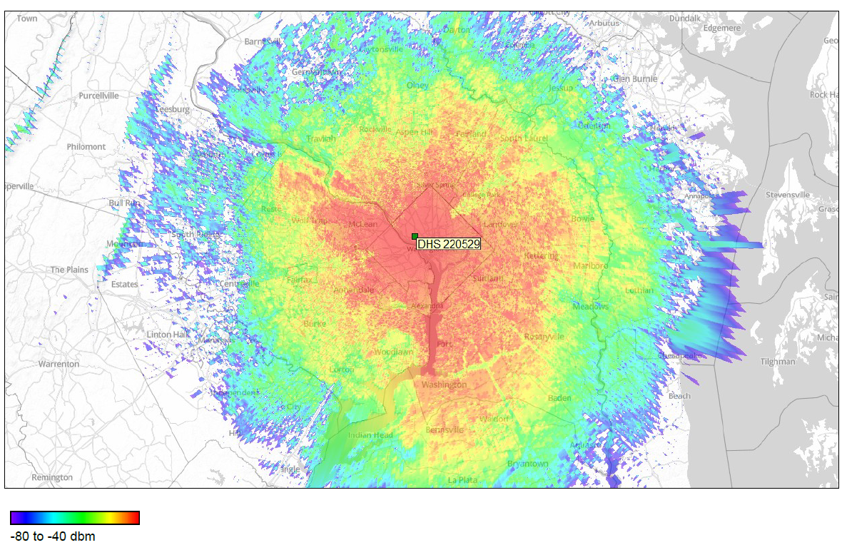
Spectrum Licensing 101
Bug Splat

Slide 10
QUESTIONS?

