Slide 1
5G, Open Radio, and Vendor Diversity
Andrew Thiessen, Division Chief Institute for Telecommunication Sciences National Telecommunications and Information Administration athiessen@ntia.gov

Slide 2
Agenda
5G Primer
3rd Generation Partnership Project (3GPP)
Traditional, Virtualized, and Open Radio Access Networks
NTIA’s Efforts in 5G Vendor Diversity

Slide 3
5G Primer

Slide 4
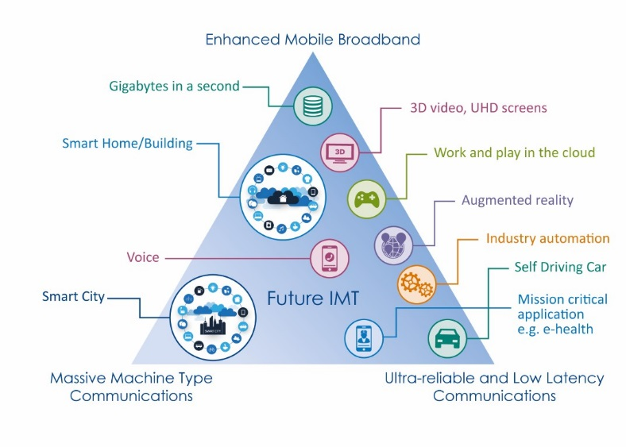
5G Vision — at the Outset
Gbps bandwidth
10 Mbps/m2 traffic
density
1 million
devices/km2
True ms latency
99,999% reliability

Slide 5
What spectrum?
52.6GHz
Where things are new/different
Frequency
Range 2
24.25GHz
What are the use cases for each?
Frequency
Range 1
7.125GHz
Similar to LTE but with more capacity based on larger channels
410MHz
Notes:
Here I am going to talk about the characteristics of FR1 and FR2 and how they lend themselves to different use cases. And how often this is the first dichotomy that I use to separate out what people mean when they say “5G”

Slide 6
Architecture
Architecture options for 5G based on acceleration:
Two radio technologies
LTE
Next Generation Radio (NR)
Radio level aggregation for both variants
Two core networks
Evolved Packet Core (EPC – with potential evolutions)
Next Generation Core Network (NGCN)
This creates 12 options

Slide 7
Option 1) Standalone LTE, EPC connected, Legacy
Option 2) Standalone NR, NGCN connected
Evolved Packet Core
EPC
NGCN
Next Generation Core Network
Radio Access Network
(RAN)
LTE
NR
eNodeB or eNB
gNodeB or gNB
User Equipment (UE)
User Equipment (UE)

Slide 8
Option 3) Non-Standalone/”LTE assisted”, EPC connected
Option 3a) Non-Standalone/”LTE assisted”, EPC connected
EPC
NGCN
EPC
NGCN
1a
LTE
NR
LTE
NR

Slide 9
5G Non-StandAlone (5G NSA)
Quick deployment of 5G radio
Leverage of existing LTE footprint
Uses LTE radio for all signaling between the UE and the core network
High user throughput
Primarily mid-band spectrum for enhanced mobile broadband

Slide 10
5G StandAlone (5G SA)
5G core allows for network functions to be cloud native
Services can be deployed using micro-services to maximize reuse across multiple network functions
New network functions become far easier to deploy
Time and cost savings
End to end network slicing
Network slice selection functionality allows for further isolation between slices
Edge computing
Allows for dynamic traffic management and break out at the edge of the network
Reduction in latency and increase in reliability
Multiple/different QOS flows within a single packet data stream
Access agnostic by design, with unified registration, authentication, session, mobility and policy management for all access types

Slide 11
3GPP 5G SA Architecture
AUSF
NG13
UDM
NG9 – between UPFs
NG14 – between AMFs
NG8
NG10
NG12
AMF
NG11
SMF
NG7
PCF
NG5
AF
NG15
NG1
NG2
NG4
UE
NR air int
RAN
NG3
UPF
NG6
DN
Xn

Slide 12
3GPP

Slide 13
What is the 3rd Generation Partnership Project (3GPP)?
The 3rd Generation Partnership Project (3GPP) unites [Seven] telecommunications standard development organizations (ARIB, ATIS, CCSA, ETSI, TSDSI, TTA, TTC), known as “Organizational Partners” and provides their members with a stable environment to produce the Reports and Specifications that define 3GPP technologies.
The project covers cellular telecommunications technologies, including radio access, core network and service capabilities, which provide a complete system description for mobile telecommunications.

Slide 14
3GPP Original 5G Timeline
2017
2018
2019
2020
Q4
Q1
Q2
Q3
Q4
Q1
Q2
Q3
Q4
Q1
Rel-15 NSA (option-3) freeze
Rel-15 NSA (option-3) ASN.1
“Main drop”
Rel-15 freeze (incl 5G SA)
Rel-15 ASN.1 (incl 5G SA)
“Late drop”
“Early drop”
Rel-15 late drop freeze
Rel-15 late drop ASN.1
Rel-16 Study phase
Rel-16 Study and Normative phase
Rel-16 freeze
Rel-16 ASN.1

Slide 15
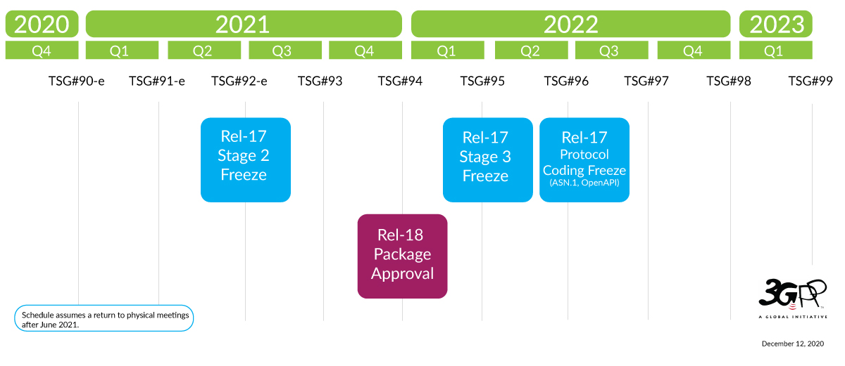
3GPP Current Timeline
Schedule assumes a return to physical meetings after June 2021

Slide 16
T/V/O Radio Access Networks

Slide 17
Break for Terminology (Ugh!)
RAN (Radio Access Network)
O-RAN
Open RAN
oRAN
OpenRAN
ORAN
VRAN
O-RAN Alliance
Disaggregation of hardware from software for RAN
Telecom Infra Project
Open RAN
Virtualized RAN

Slide 18
Break for Terminology (Ugh!)
RAN (Radio Access Network)
O-RAN
Open RAN
oRAN
OpenRAN
ORAN
VRAN
O-RAN Alliance
Disaggregation of hardware from software for RAN
Telecom Infra Project
Open RAN
Virtualized RAN

Slide 19
Take a Quick Step Back
Option 1) Standalone LTE, EPC connected, Legacy
Option 2) Standalone NR, NGCN connected
Evolved Packet Core
EPC
NGCN
Next Generation Core Network
Radio Access Network
(RAN)
LTE
NR
eNodeB or eNB
gNodeB or gNB
User Equipment (UE)
User Equipment (UE)

Slide 20
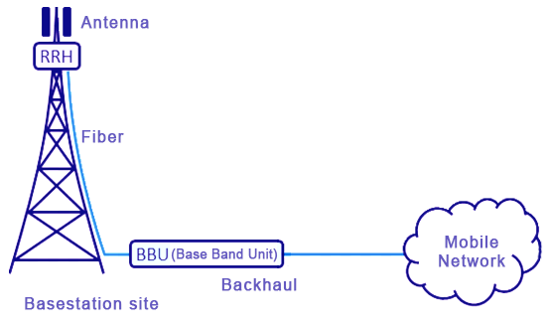
Traditional Radio Access Network
Remote Radio Head
Proprietary Hardware, Software, and Interfaces

Slide 21
Virtualized Radio Access Network
Remote Radio Head
Proprietary Hardware and Interfaces
Proprietary Software w/virtualization of functions
Commercial Off The Shelf Hardware

Slide 22
Open Radio Access Network
Let’s not forget open-source code!
Remote Radio Head
General Purpose Processing hardware
Open interface
Proprietary Software w/virtualization of functions
Commercial Off The Shelf Hardware

Slide 23
What is NTIA up to around 5G and vendor diversity?

Slide 24
5G Testbed
NTIA’s Institute for Telecommunication Sciences is extending its LTE testbed to 5G with a focus on
Test and evaluation of the integration of open radio access network solutions to determine level of difficulty
Test and evaluation of the interoperability of open radio access network solutions to determine level of performance with different ORAN builds
Test and evaluation of virtualized radio access network capabilities and intersection to ORAN
Integration of NTIA’s Software Bill of Materials (SBOM) goals and objectives based on significant focus of ORAN on open-source capabilities
Can/will coordinate with State Dept to leverage unique capability to work with other laboratories to travel to/from to share knowledge engineer to engineer

Slide 25
5G Challenge
NTIA’s Institute for Telecommunication Sciences is partnering with Dept of Defense to explore creation of a challenge to develop open source 5G protocol stacks that support DOD’s mission
Published a Notice of Inquiry in the Federal Register to explore the parameters of the challenge
https://www.federalregister.gov/documents/2021/01/11/2021-00202/5g-challenge-notice-of-inquiry
Comments close February 10, 2021
Details to search
5G Challenge
[Docket No. 210105–0001]
RIN 0660–XC049

Slide 26
Wireless Supply Chain Innovation & Multilateral Security
The Public Wireless Supply Chain Innovation Fund to be established and administered by NTIA:
Promote and deploy technology that will enhance competitiveness for 5G based on open and interoperable radio access networks
Accelerate deployment of open interface standards-based radio access network solutions
Promote and deploy compatible equipment between new 5G equipment with future open standards based interoperable networks
Manage integration of multi-vendor network environments
Identify criteria to define equipment as based on open standards for multi-vendor network equipment for interoperability
Promote and deploy security features aimed at enhancing the above
Promote and deploy network function virtualization to facilitate multi-vendor interoperability and a more diverse vendor market

Slide 27
Vendor Diversity
Challenge: Limited options when selecting vendors to develop and deploy 5G and earlier generation wireless networks
Goal: Unleash the innovative power of the private sector and competition
Opportunity: Lower barriers to entry in the telecommunications equipment market would unlock economic opportunities
Therefore, NTIA is supporting the industry-led development of open, interoperable networks.
Notes:
Talking Points:
The U.S. Government recognizes that many network operators face limited options when selecting legacy vendors to develop and deploy 5G and earlier generation wireless networks.
So our goal is to unleash the innovative power of the private sector and competition to develop more secure, robust, resilient, and affordable telecommunications networks for all.
Importantly, lower barriers to entry in the telecommunications equipment market would also unlock economic opportunities for innovative SMEs and entrepreneurs around the world, including in your own countries.
Therefore, like the U.S. Government as a whole, NTIA fully supports industry’s development of open, interoperable telecommunications networks – like those based on open RAN – while also recognizing the importance of maintaining a full suite of solutions offered by incumbent trusted vendors.
This shift to open and interoperable networks would increase competition and provide operators with additional options when purchasing network equipment and services from trusted vendors.

Slide 28
Vendor Diversity
Promoting the transition toward open and interoperable in a range of multilateral fora, like the Prague 5G Security Conference, OECD, and G7
Engaging directly with foreign governments
Driving U.S. engagement on common international principles on open and interoperable network architectures
Contributing to activities like USTTI and other relevant efforts
We want to hear from you!
Notes:
While efforts to increase vendor diversity should be industry-led, governments also have a role to play in fostering enabling environments for innovative approaches like open RAN.
Therefore, NTIA is working in collaboration with interagency partners to support efforts by companies around the world to develop open and interoperable telecommunications networks.
To that end, we have actively highlighted the importance of vendor diversity in multilateral fora like the 2020 Prague 5G Security Conference and the OECD, and we look forward to continuing those discussions during this year’s G7 cycle.
We’re also speaking one-on-one with foreign governments to explain, discuss, and potentially coordinate on open RAN and other vendor diversity-related matters. We hope that this presentation can be the start of that discussion with your own governments.
We also see an opportunity to build on the Prague Proposals by working with industry and international partners to develop principles on what governments can do to promote open and interoperable networks.
And finally, we are participating in worthwhile capacity-building activities like USTTI to further raise awareness of these issues.
As I mentioned, we would like to begin a dialogue with all of you on this important topic, so I hope that after this training you will feel free to reach out to our International Affairs team to learn more.
Thank you.

