Slide 1
FCC PRESNTATION ON SPECTRUM FOR 5G January 13, 2021 Thomas Sullivan, Chief, International Bureau

Slide 2
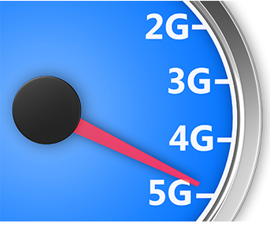
FCC 5G FAST Plan
Market-based U.S. approach to 5G innovation, investments, and deployment
Three key components:
(1) pushing more spectrum into the marketplace
(2) updating infrastructure policy
(3) modernizing outdated regulations
Roll-out of 5G systems is underway

Slide 3
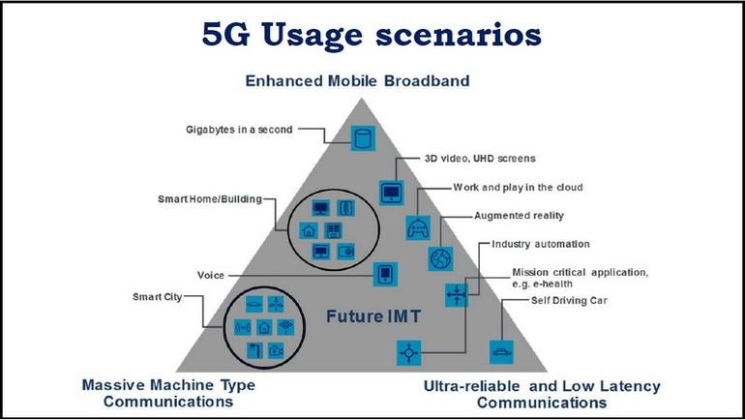
Impacts of 5G
Estimated 3 million new jobs, $275 billion in private investment, and $500 billion in new economic growth in the US.
Connection speeds over 10 Gbps - 100x faster than 4G. Lag times will be one-tenth of what they are today (50 milliseconds to 1 millisecond).
Smart cities and smart transportation networks that reduce traffic, prevent accidents, and limit pollution.
Wireless healthcare and remote surgeries.
Precision agriculture.
Industry automation.
And, of course, 5G will unlock innovations that are yet to be imagined.
Projection of interrelated 5G service tiers (Image: International Telecommunications Union)

Slide 4
FCC: Making Spectrum Available
High-band:
28 GHz band auction (27.5 GHz – 28.35 GHz; 2 x 425) Completed January 2019 [$702.5m]
24 GHz band auction (24.25 – 24.45; 25.25 -25.75 GHz; 7 x100) Completed May 2019 [$2.024b]
37 GHz, 39 GHz, and 47 GHz Largest auction in U.S., releasing 3,400 megahertz of spectrum into the commercial marketplace. Completed March 2020 [$7.569b]
Working to free up additional 2.75 gigahertz of 5G spectrum in the 26 and 42 GHz bands
Low-band:
Unlicensed:
Creating opportunities for Wi-Fi in the 6 GHz, 61-71 GHz and above 95 GHz bands. Recently decided to repurpose the 5.9 GHz (5.850-5.925 GHz) band that has been reserved for use by Dedicated Short-Range Communications (DSRC), to provide greater opportunities for unlicensed while retaining some spectrum for intelligent transportation service.
600 MHz transition from 2016 Broadcast Incentive Auction completed; 5G mobile service rolling-out nationwide
Targeted changes to 600 MHz, 800 MHz, and 900 MHz bands to improve use of low band spectrum for 5G services
Mid-band:
2.5 GHz auction planned, potentially in 2021
3.5 GHz auction completed August 2020, (7x10) [$4.543b – diverse bidders]
3.7-3.98 GHz “C-Band” auction began December 8, 2020 (14x20) > $80b
3.45 – 3.55 GHz future opportunity for an additional 100 megahertz (5x20 to align with the 3.7 GHz band)

Slide 5
Unlicensed Operations
FCC rules provide for operation of low power radio transmitters without the need for the user to obtain an individual license.
These unlicensed (licensed exempt) devices may not cause harmful interference and must accept any interference received.
Unlicensed devices predominately operate in 915 MHz, 2.4 GHz, 5.8 GHz.
Recent FCC Decisions allow unlicensed operations in the 5.9 GHz and 6 GHz Bands
Unlicensed rules (License-exempt is not “unauthorized”) designed to minimize likelihood of interference by:
Identifying permissible frequencies.
Limiting power levels.
Requiring equipment authorization.

Slide 6
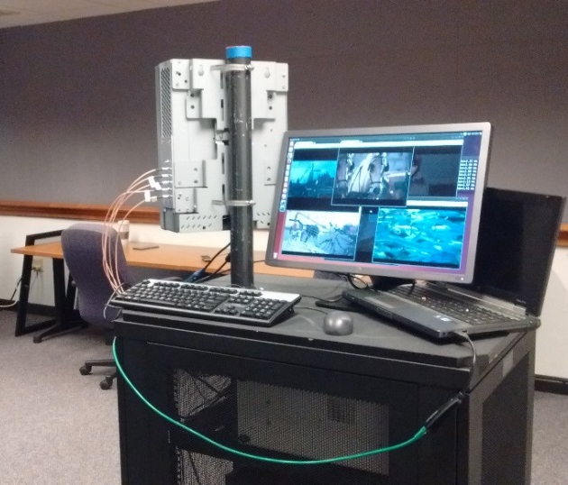
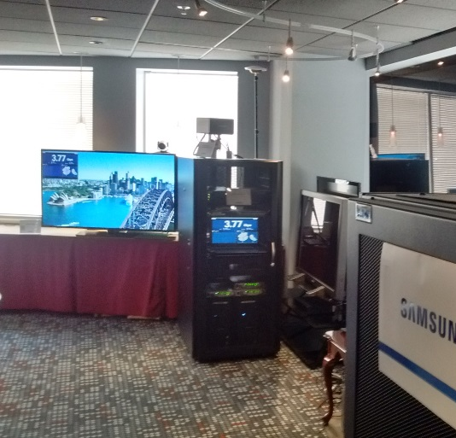
Experimental Licensing
Experimental licensing plays a key role in facilitating innovative new products and services while protecting incumbent services against harmful interference.
Experimental licenses enable trials of new technologies like 5G. The FCC typically grants more than 2,000 experimental licenses a year.
The FCC has a streamlined experimental licensing process for universities, research labs, health care facilities, and equipment manufacturers that frequently conduct trials at a specific location.

Slide 7
FCC Actions for Satellite Services in mmW Bands
Preserved the 48.2-50.2 GHz and 40-42 GHz bands for next generation satellite use.
Flexibility in FCC’s earth station siting rules for the 28 GHz and 39 GHz bands.
Permitted individually licensed FSS earth stations in the 50.4-51.4 GHz band.
Facilitated innovations and investments in satellite-based services.
Allowed NGSO constellations to deliver new options for high-speed broadband service in unserved or poorly served rural areas.
Licensed GSO high-throughput satellites to provided new high-speed broadband options for consumers.
Updated FCC rules and expanded the frequencies available for Earth Stations in Motion (ESIMs) communicating with GSO networks and established rules for ESIMs communicating with NGSO networks, which will make it easier for consumers who need a broadband connection on a plane, train, or in an automobile to get online.
Established an optional new streamlined application process for small satellites with short duration missions.
Streamlined the rules and licensing options for satellite operators, easing the path for the rollout of new services.

Slide 8
Millimeter Band Updates in the USA
Beyond mobile, fixed and satellite use!
HAPS from WRC-19: 31-31.3 GHz, 38-39.5 GHz, 47.2 – 47.5 GHz and 47.9 – 48.2 GHz will be identified for worldwide use by HAPS. Additionally the frequency bands 21.4-22 GHz and 24.25-27.5 GHz by HAPS in the fixed service in Region 2
57-71 GHz: licensed exempt band to provide innovative high-capacity wi-gig type services (wireless gigabyte connectivity to premises)
70/80/90 GHz: June 2020 Order and NPRM
95 GHz and beyond!
Also, important passive bands and U.S. federal use present above 24 GHz

Slide 9
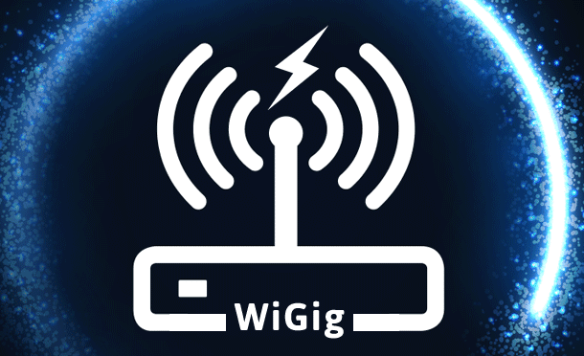
57-71 GHz Unlicensed Spectrum
The FCC has authorized unlicensed operations in the 57-64 and 64-71 GHz bands
Unlicensed devices such as Wi-Fi-like "WiGig" operate under Part 15 of the FCC's rules.
Part 15 includes technical requirements for unlicensed devices to prevent interference.

Slide 10
70/80/90 GHz Bands
In the U.S., the 70 GHz (71-76 GHz) and 80 GHz (81-86 GHz) bands are used commercially for fixed point-to-point links such as wireless backhaul for 5G.
New proceeding in June 2020: 71–76 GHz, 81–86 GHz, 92–94 GHz, and 94.1–95 GHz Bands
making more efficient use of additional millimeter-band spectrum resources, considering additional provisions of wireless backhaul for 5G, broadband services to aircraft and ships, and links from Loon and Elefante.

Slide 11
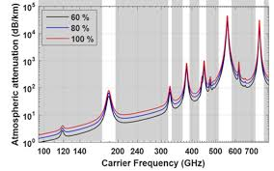
Spectrum Above 95 GHz
Created a new class of experimental licenses for use of frequencies between 95 GHz and 3 THz.
Give innovators the flexibility to conduct experiments lasting up to 10 years, and to more easily market equipment during the experimental period.
Freed up 21.2 gigahertz of the Spectrum Horizons bands for unlicensed use:
116-123 GHz band,
174.8-182 GHz band,
185-190 GHz band, and
244-246 GHz band
Unlicensed use above 95 GHz is authorized similar to unlicensed use in the 57-71 GHz band.

Slide 12
Thank You!
thomas.sullivan@fcc.gov

