Slide 1
Climate Training for USTTI International Cohort
David Herring
NOAA Climate Program Office
October 28, 2019

Slide 2
Presentation Overview
Climate 101 — The Basics of Climate Science
Developing a Climate Communication Strategy
Using the ‘Steps to Resilience’ Framework to Assess Vulnerability & Risk

Slide 3
Part 1
Climate 101:
The Basics of Climate Science

Slide 4
Key concept:
Climate is often described as the long-term average (≥ 30 years) of weather that happens at a given place and for a given season.
Notes:
4

Slide 5
Key concept:
Climate is more than the long-term average of weather.
Climate provides the system in which weather happens.
To put it another way:
The state of the climate system influences the odds that certain types of weather are more or less likely to happen.
Notes:
5

Slide 6
The state of the climate system influences the odds that certain types of weather are more or less likely to happen.
Notes:
6
If this old-fashioned pinball game is like the climate system, determining which bin the ball will end up is like weather. On any single launch of the ball, it’s hard to predict where the ball will land — like weather. Launch the ball 100 times and record where it lands and you begin to produce a “climatology” — an average distribution of endpoints.
But to illustrate how the climate system influences the odds of certain types of weather, suppose you altered the game in certain ways, like increasing the speed of the launch, removing one or two nails from the left side of the game, and perhaps tilting the machine slightly to the left. How might that affect the average distribution of the ball’s endpoints on the next 100 launches?

Slide 7
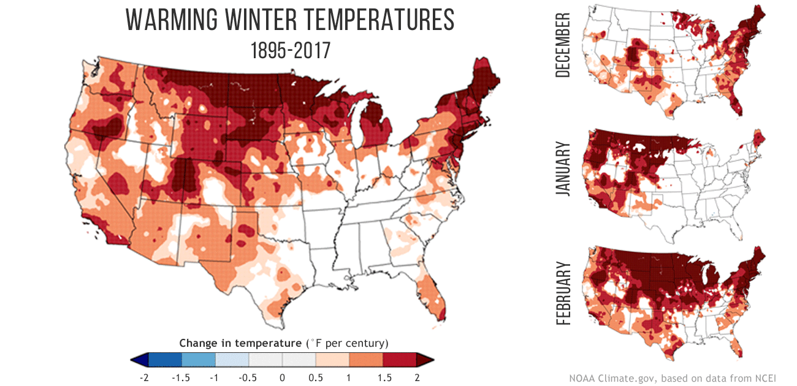
Credit: NOAA Climate.gov

Slide 8
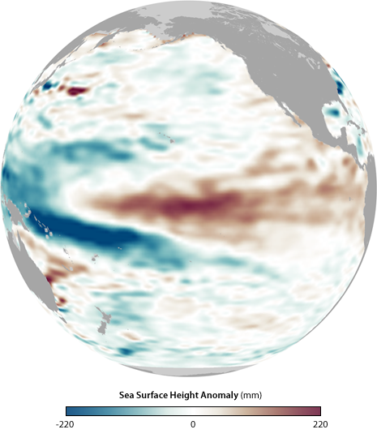
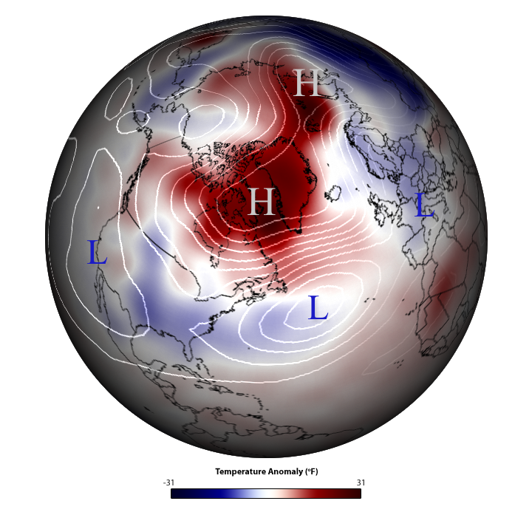
Natural climate variability is also a key factor
El Niño (left) and the Arctic Oscillation (right)…
Credit: NOAA Climate.gov
Notes:
Climate variability is often associated with naturally oscillating patterns in Earth’s climate system, such as the El Niño Southern Oscillation, North Atlantic Oscillation, Pacific Decadal Oscillation, and etc. These oscillations can influence weather and climate patterns around the world.
Natural climate variability patterns can last for months or even years.

Slide 9
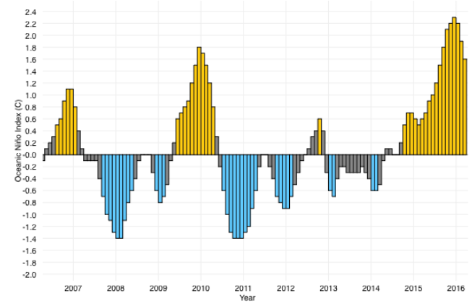
For example, changes in El Niño (top) and the Arctic Oscillation (bottom) are due to natural climate variability
Credit: NOAA Climate.gov
Notes:
Climate variability is often associated with naturally oscillating patterns in Earth’s climate system, such as the El Niño Southern Oscillation, North Atlantic Oscillation, Pacific Decadal Oscillation, and etc. These oscillations can influence weather and climate patterns around the world. Natural climate variability patterns can last for months or even years.
NOTE: In 2010, we had a moderately strong El Niño and then we observed the strongest ever recorded negative phase of the Arctic Oscillation. When those two patterns team up in winter, you have perfect conditions for a winter “bomb.”

Slide 10
For example, changes in El Niño (top) and the Arctic Oscillation (bottom) are due to natural climate variability
Credit: NOAA Climate.gov
Notes:
NOTE: In 2010, we had a moderately strong El Niño and then we observed the strongest ever recorded negative phase of the Arctic Oscillation. When those two patterns team up in winter, you have perfect conditions for a winter “bomb” in the mid-Atlantic region — precisely the conditions we experienced there that year!

Slide 11
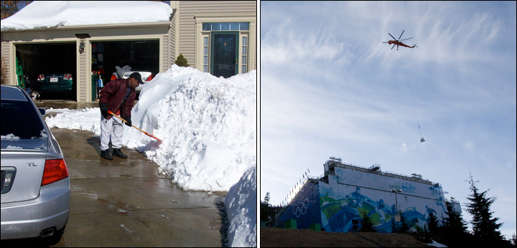
Natural climate variability is also a key factor
… brought a tale of two winters in 2010.
…while there was no snow for Olympic games in Vancouver, Canada
‘Snowmaggedon’ hit the mid-Atlantic
Credit: David Herring, NOAA
Credit: Associated Press
Notes:
“Climate Variability” refers to short-term (from weeks to decades) changes in weather and environmental conditions.

Slide 12
Forcing & Feedback Mechanisms that Cause Global Warming and Cooling

Slide 13
Things that reflect & emit energy to space
Things that absorb energy into the system
Notes:
So how does this natural system work to influence and maintain global temperatures?
It’s really a balancing act – and it depends on two things:
things that reflect and emit energy to outer space; and
things that absorb energy into the system.

Slide 14
Things that reflect & emit energy to space
Things that absorb energy into the system
Earth’s energy budget
—
=
Notes:
All the energy reflected and emitted by Earth to space over the course of a year MINUS all the energy that is absorbed into the system in that year EQUALS Earth’s energy budget for that year.

Slide 15
Things that reflect & emit energy to space
Things that absorb energy into the system
Earth is cooling
>
=
Notes:
If you have a long span of years in which the amount of energy that is reflected and/or emitted to space is GREATER than the amount of energy that is absorbed into the system, then average global temperature will decrease (i.e., Earth is cooling).

Slide 16
Things that reflect & emit energy to space
Things that absorb energy into the system
Earth is warming
<
=
Notes:
Conversely, if you have a long span of years in which the amount of energy that is reflected and/or emitted to space is LESS than the amount of energy that is absorbed into the system, then average global temperature will increase (i.e., Earth is warming).

Slide 17
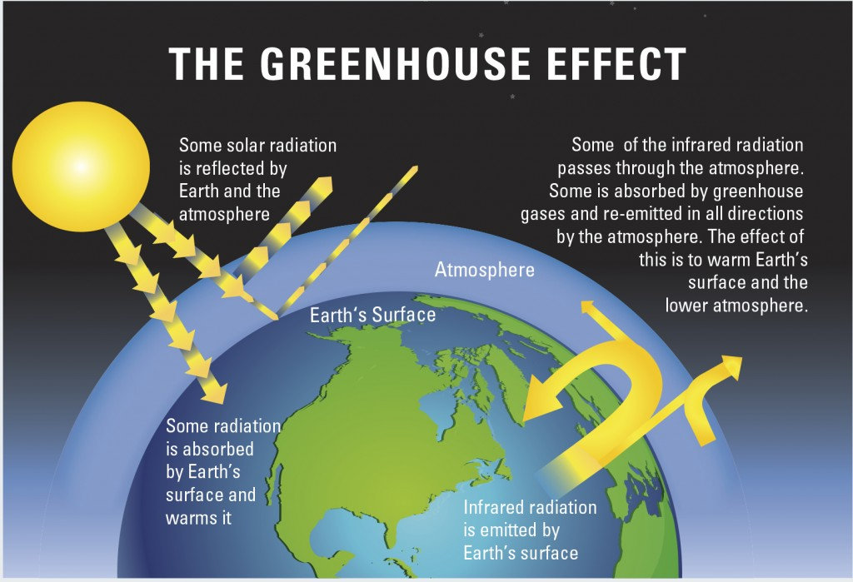
Image based on figure from U.S. EPA
Notes:
To understand these influences and interactions, we need to understand some basic climate science.
SO…let’s start with nature: that system looks a bit simpler (though it’s pretty complex, too)!
Our earth possesses an elegant, brilliant, natural process that has produced a climate which supports the rich, complex array of species and landscapes and waters that we depend on for our survival. This is sometimes referred to as the “greenhouse effect” – the natural one!
In this process, the sun radiates energy to the earth, some of which is immediately reflected back out by the earth’s atmosphere (a layer of gases and water vapor blanketing our earth), and some of which reaches the earth’s surface.
Of the solar radiation reaching the earth’s surface, some is again reflected back out by land and ice, while some is absorbed, warming the earth.
The warmed earth radiates heat (‘infrared radiation”) back out into the atmosphere, with some of the heat passing back through the atmosphere, while some is trapped by the atmospheric “blanket” of gases and water vapor, to be re-emitted in all directions, warming the earth’s surface and lower atmosphere. The effect is similar to the warming in a greenhouse with a glass ceiling – thus the nickname. And the net effect is that most of the initial solar radiation is kept within the atmosphere instead of escaping back into space.
The naturally-occurring, heat-trapping gases in the atmosphere include water vapor, carbon dioxide (CO2), methane, and nitrous oxide, often referred to as “greenhouse gases.” At their natural levels, and in their balanced proportions, these gases have helped to maintain a relatively stable global climate over many thousands of years.
And this effect is vital: without this natural greenhouse effect, scientists have estimated that the Earth’s atmosphere might be close to 33-degrees centigrade (60 degrees Farenheit) colder, and most of the earth’s water would be ice. The planet would be too cold for most plants and animals.
So how does this natural system work to influence and maintain global temperatures?

Slide 18
Observed Climate Changes
& Their Impacts (Global)

Slide 19
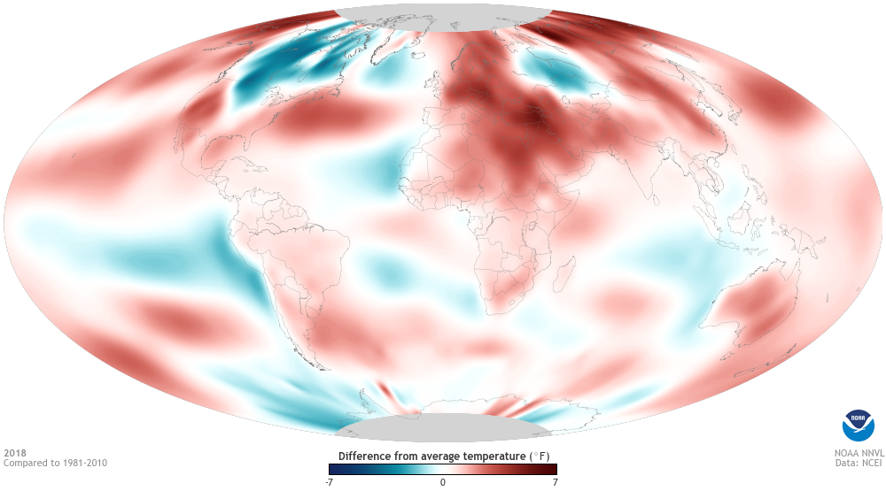
2018: 4th warmest year in recorded history
The 5 warmest years occurred since 2014.
Credit: NOAA Climate.gov
Notes:
• Overall, Earth is warming. 2018 is ranked as the 4th warmest year in recorded history (depending on which dataset is used).
• Notice that it’s not warming everywhere, and places that are warming are warming at different rates.
• This map shows average annual temperatures for 2018 compared to the 1981-2010 average. There were a few patches of below-average temps (blue) whereas most of the planet was warmer (red) to much warmer (dark red) than average. White indicates about average; gray indicates no data (e.g., over the poles).

Slide 20
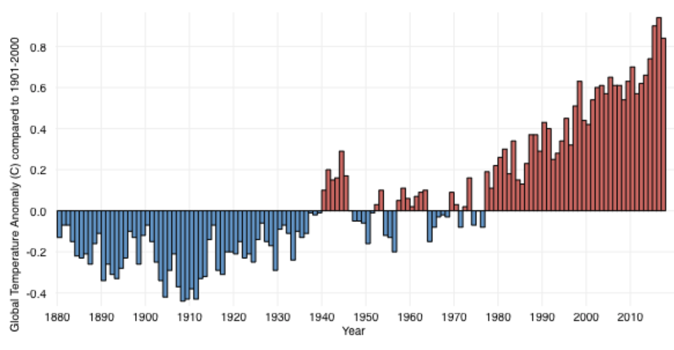
Globally averaged annual temperature has risen by ~1.5°F (~0.85°C) since 1880. Why?
Credit: NOAA Climate.gov
Notes:
This graph shows global average surface air temperature “anomaly” (or difference from average) for every year from 1880 to 2014 (as compared to the average from 1880-2014). While there are year-to-year changes, and some brief periods of cooling, the overall trend has been one of warming. Specifically, Earth has warmed by 1.5°F (0.85°C) since 1880. Most of that warming has occurred since 1976.
The last five years have been the warmest years in recorded history. They rank in this order: 2016, 2015, 2017, 2018, and 2014.

Slide 21
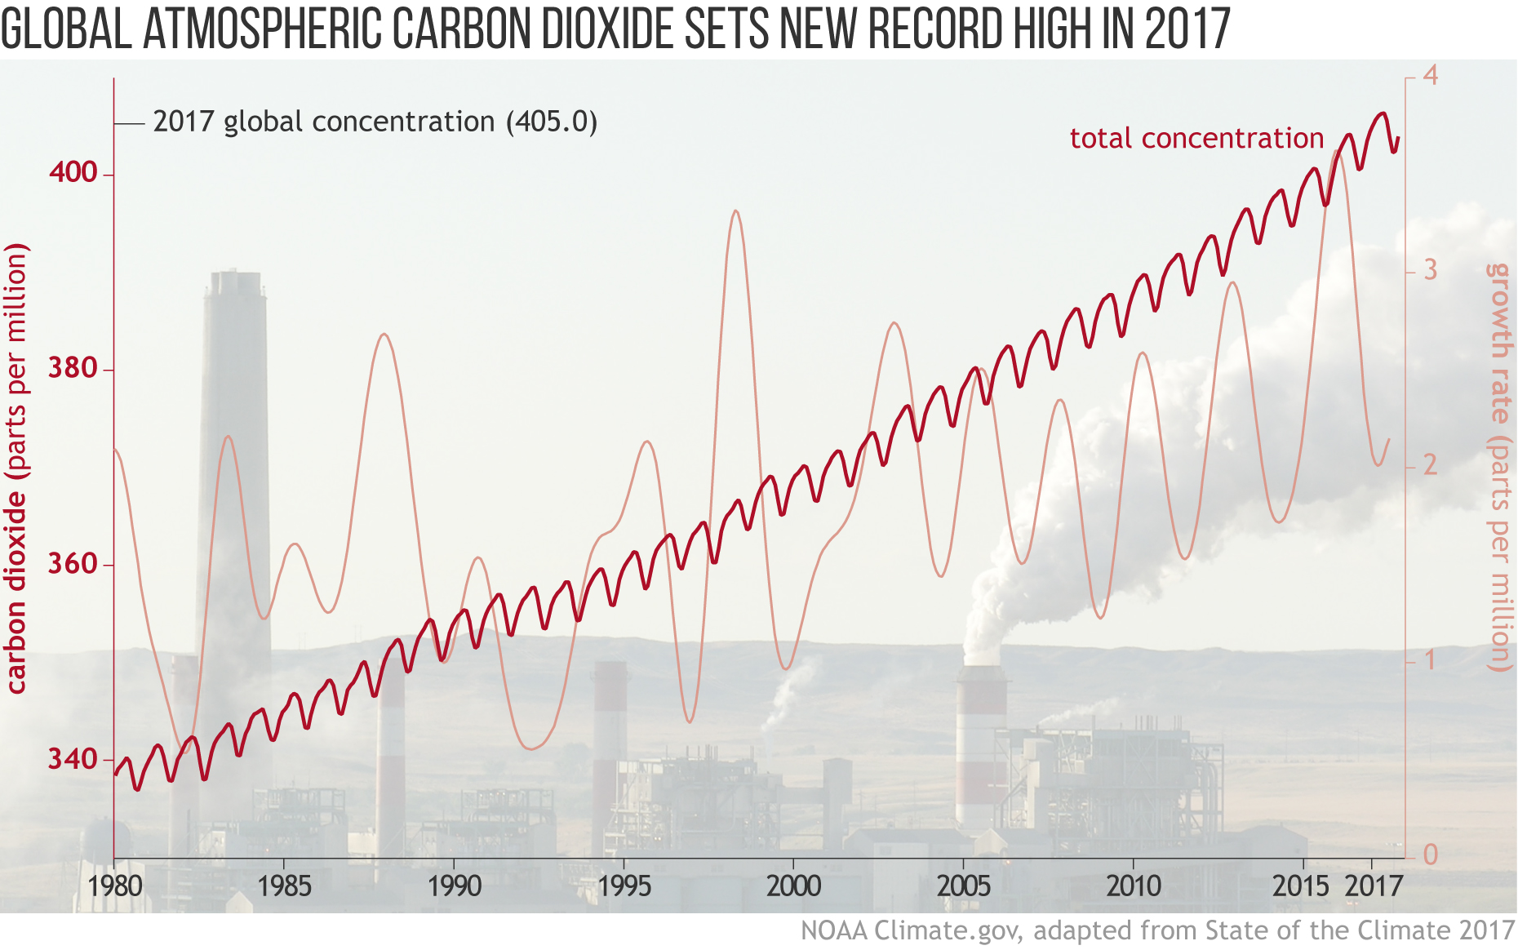

Slide 22
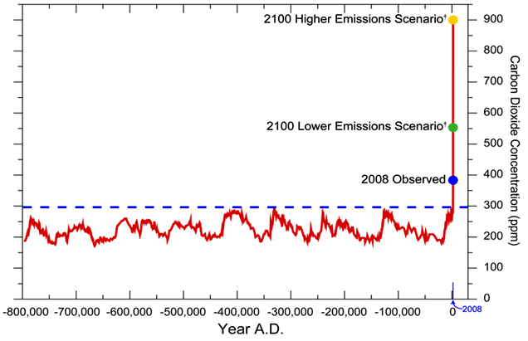
Historical perspective: an 800,000-year record of carbon dioxide concentration
Average for 2011 (almost 392 ppm)
2011
Updated from Karl et al 2009
Notes:
From the beginning of the industrial revolution to today, humans have driven up carbon dioxide concentrations in the atmosphere from about 288 ppm to about 405 ppm.

Slide 23
We’re outside the historical range, projected to move WAY outside that range by 2100
Average for 2011 (almost 392 ppm)
2011
Updated from Karl et al 2009
Notes:
If we remain on our current emissions trajectory, we could reach as high as 900 ppm by 2100, which well beyond values seen on Earth for many millions of years. Climatologically speaking, our world will become a very different place if this trend continues.

Slide 24
How much radiative forcing did it take to warm Earth to interglacial periods between the ice ages?
Answer:
~1.0 watt per
square meter
(±0.4 W/m²)

Slide 25
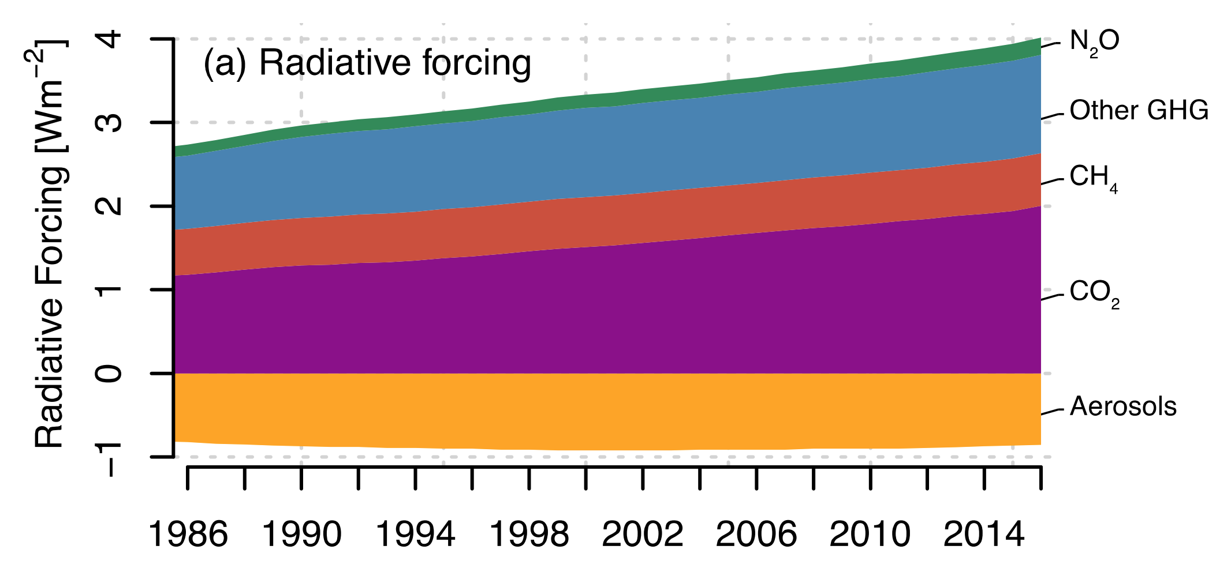
By comparison, what radiative forcing are humans exerting on Earth’s climate system today?
Credit: IPCC AR6
Notes:
IPCC AR6 SR15 Figure 1.SM.14: Time series of anthropogenic radiative forcing (a) CO2, methane (CH4) and nitrous oxide (N2O) emissions (b–d) for the period 1986–2016. Anthropogenic radiative forcing data is from Myhre et al., (2013), extended from 2011 until the end of 2017 with greenhouse gas data from Dlugokencky and Tans (2016), updated radiative forcing approximations for greenhouse gases (Etminan et al., 2016) and extended aerosol forcing following (Myhre et al., 2017). Bar graph shows the sum of different forcing agents. Anthropogenic CO2 emissions are from the Global Carbon Project (GCP2017; Le Quéré et al., 2018), and EDGAR (Joint Research Centre, 2011) datasets. Anthropogenic emissions of CH4 and N2O (e) are estimated from EDGAR (JRC, 2011) and the US Environmental Protection Agency (EPA, 1990).

Slide 26
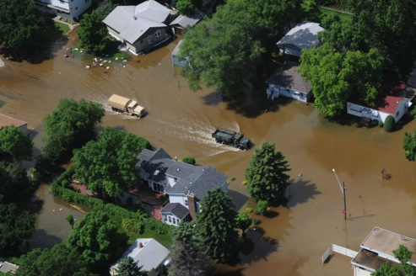
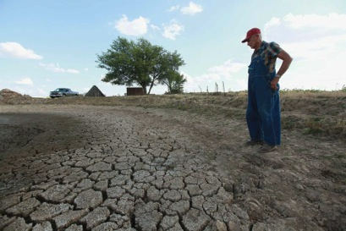
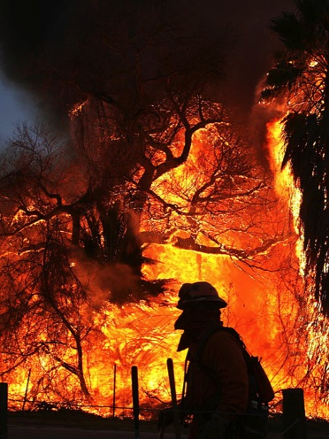
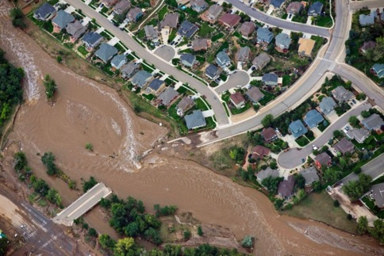
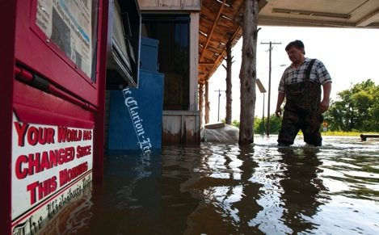
More frequent & more severe extreme events. Communities & businesses are feeling the impacts.
Department of Defense, 2014
© Scott Olson/Getty Images
©AP Photo/The Press-Enterprise, Terry Pierson
© Dave Martin/AP/Corbis
© John Wark/AP/Corbis
Notes:
Extreme events are occurring more frequently, and with increasing severity due to both natural variability and the climatic effects of global warming.
What is an “extreme event”?
» Can be defined as any event that falls into the top / bottom 5% or 10% of all observed occurrences of that type of event.
» The impact is the cumulative total of damages and disruptions caused by the event over time.

Slide 27
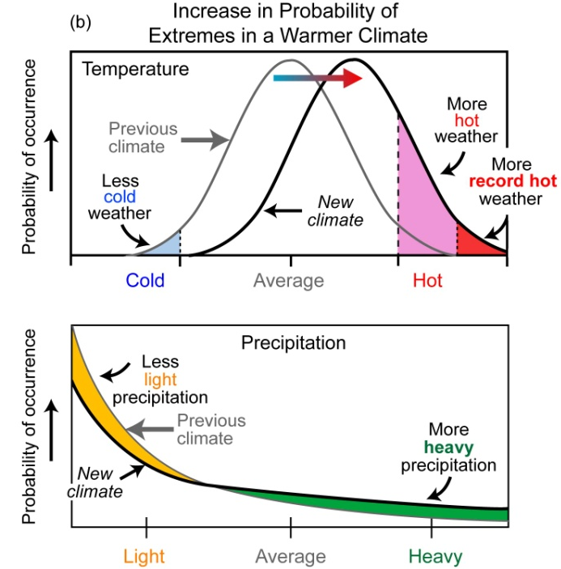
Climate scientists predicted an increase in the probability of extreme events occurring due to global warming…
Notes:
Everyone faces increasing risks from extreme events.
We have always experienced extreme events. However, in a changing climate, the probability of certain extremes, such as hotter temperatures or more heavy precipitation, is also likely to change. These extremes will challenge individuals, businesses, communities, and the natural resources they depend on

Slide 28
Natural catastrophes
are on the rise
Source: Munich Re NatCatSERVICE
Notes:
This chart, published in April 2018 by Munich RE, shows the total number of natural catastrophes worldwide (purple line) from 1980-2017. The trend has been steadily going up, from just over 200 events in 1980 to about 700 in 2017.
Colored lines show the trends in different types of catastrophes: hydrological (blue), meteorological (green), climatological (orange), and geophysical (red).

Slide 29
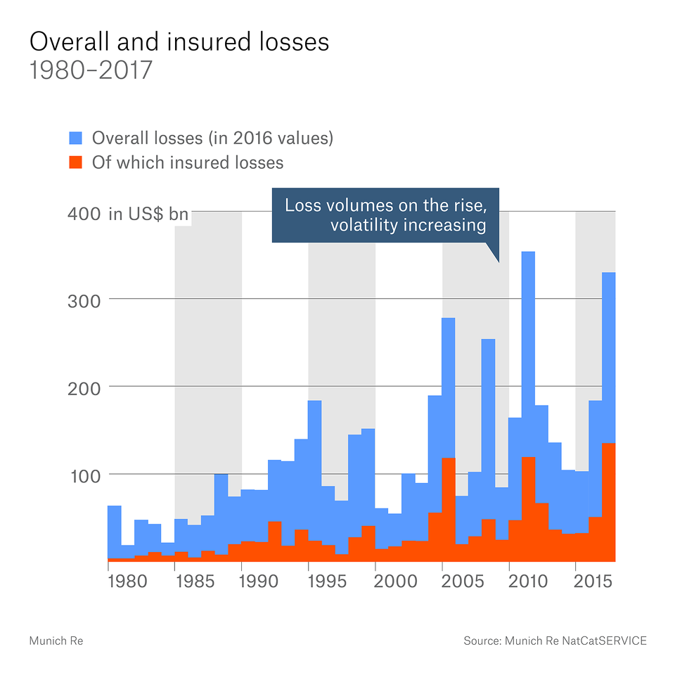
Overall and insured losses are rising as well
Source: Munich Re NatCatSERVICE
Notes:
According to Munich RE, both overall losses ($170 billion) and insured losses ($49 billion) from natural disasters were significantly higher than average for the last 10 years.
Munich Re reports that 97% of those losses were due to meteorological (81%), hydrological (8%), and climatological (8%) events.

Slide 30
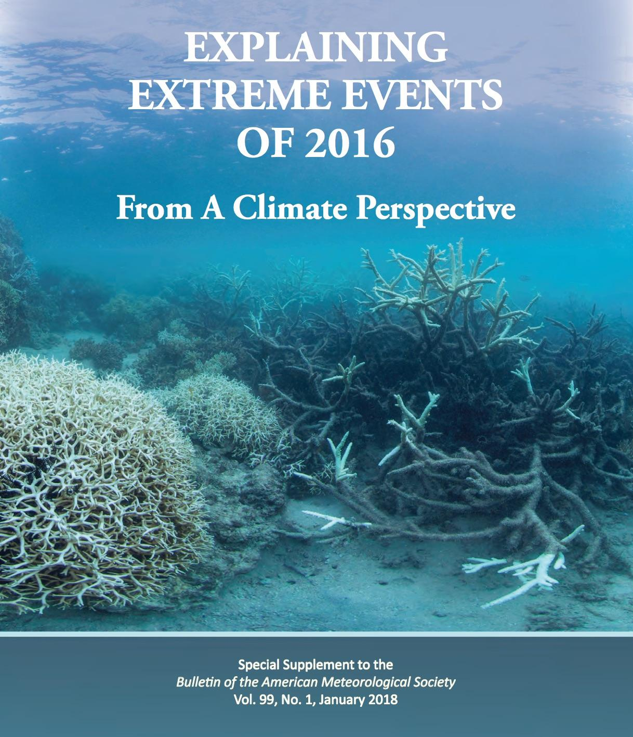
…and an increase in the occurrence of extreme events has now been observed.
http://www.ametsoc.net/eee/2016/2016_bams_eee_low_res.pdf
“This… is the first of these reports to find that some extreme events were not possible in a pre-industrial climate.”
— Stephanie Herring et al.
(editors)
Notes:
Every year, for the last 6 years, AMS BAMS has published a special issue focused on the results of climate attribution research. According to the latest report: 21 of the 27 events studied in this edition identified climate change as a significant driver of an extreme event, while 6 did not. And of the 131 papers examined in this report over the last 6 years, 65% have identified a role for climate change, while 35% have not found an appreciable effect.

Slide 31
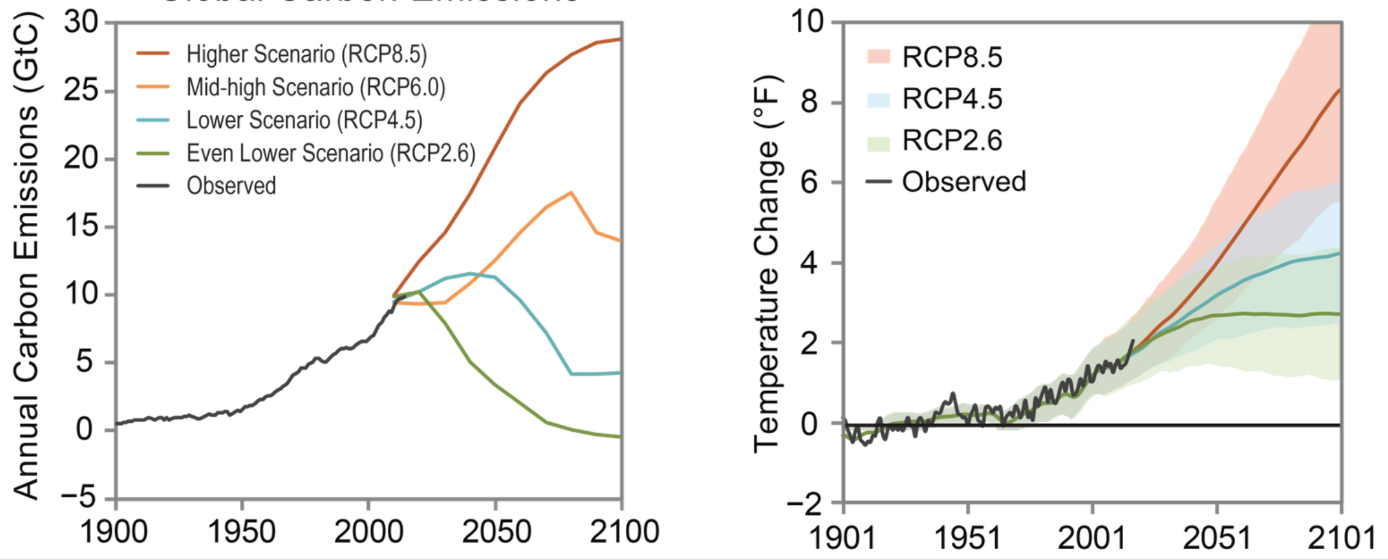
Due to the unusually rapid build-up of heat-trapping gases, Earth is projected to warm unusually rapidly this century.
Projected Annual Global Carbon Emissions
Projected Global Temperatures
Source: U.S. Climate Science Special Report

Slide 32
Part 4
Links between Climate-Related Extreme Events & Displaced Human Populations

Slide 33
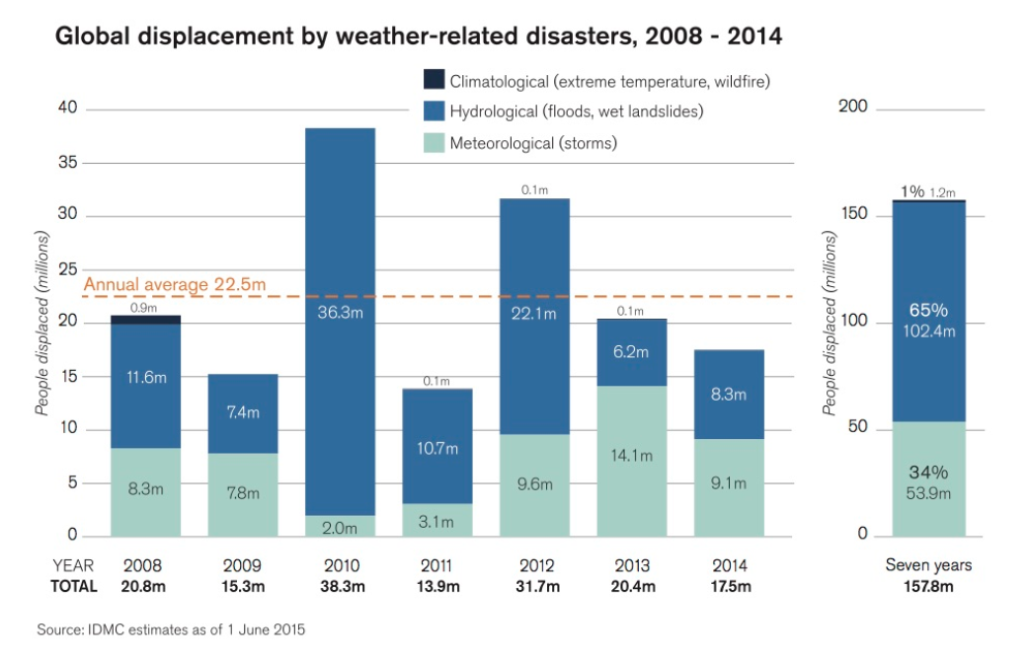
Global displacement by weather-related
Disasters, 2008-2014
Notes:
According to the Internal Displacement Monitoring Center, a part of the Norwegian Refugee Council, an annual average of at least 22.5 million people were displaced by the direct threat or impact of floods, landslides, storms, wildfires and extreme temperatures on their safety, homes, and livelihoods. The 7-year total is 157.8 million people displaced. Developing countries account for more than 90% of that total.

Slide 34
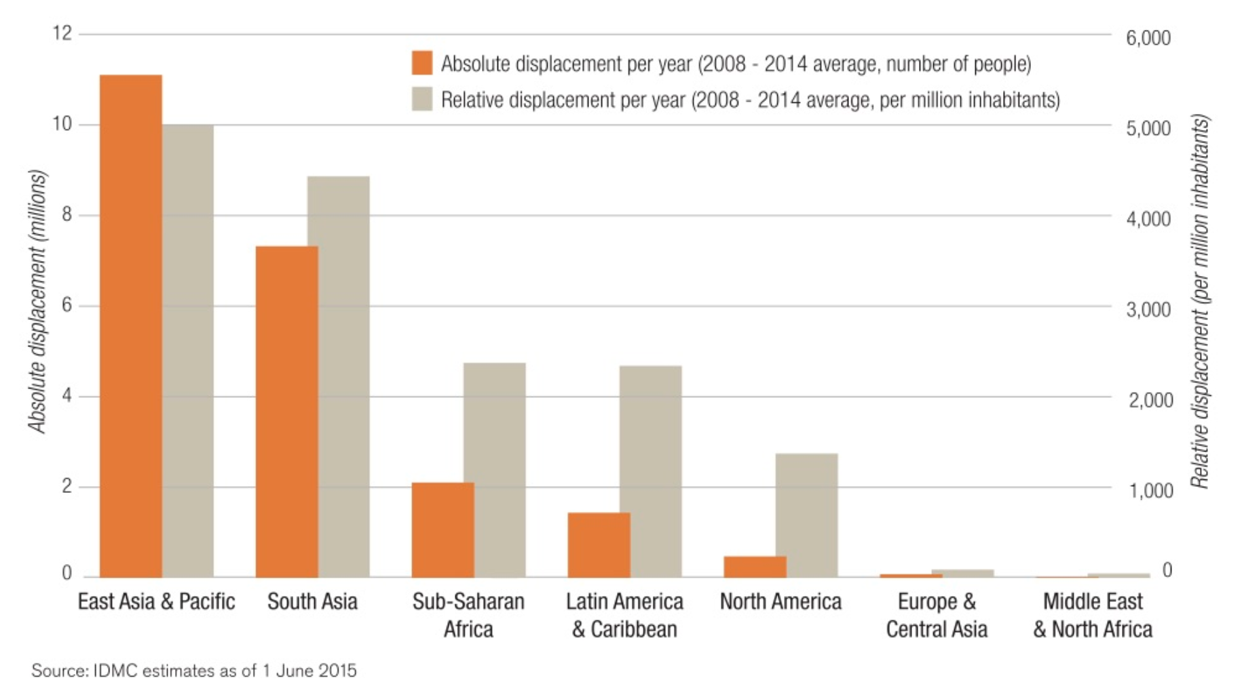
Developing countries account for >90%
of the 157.8 million displaced, 2008-2014.
Notes:
According to the Internal Displacement Monitoring Center, a part of the Norwegian Refugee Council, an annual average of at least 22.5 million people were displaced by the direct threat or impact of floods, landslides, storms, wildfires and extreme temperatures on their safety, homes, and livelihoods. The 7-year total is 157.8 million people displaced. Developing countries account for more than 90% of that total.

Slide 35
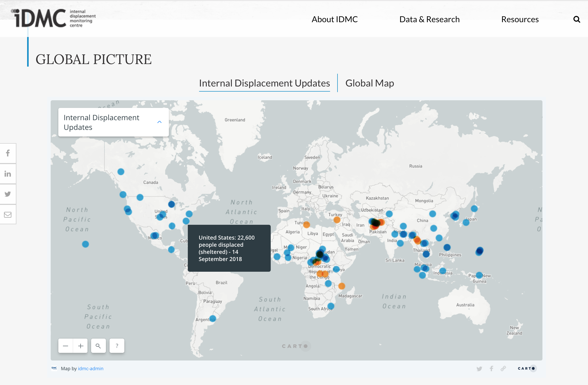
Internal Displacement Monitoring Centre, online at www.internal-displacement.org

Slide 36
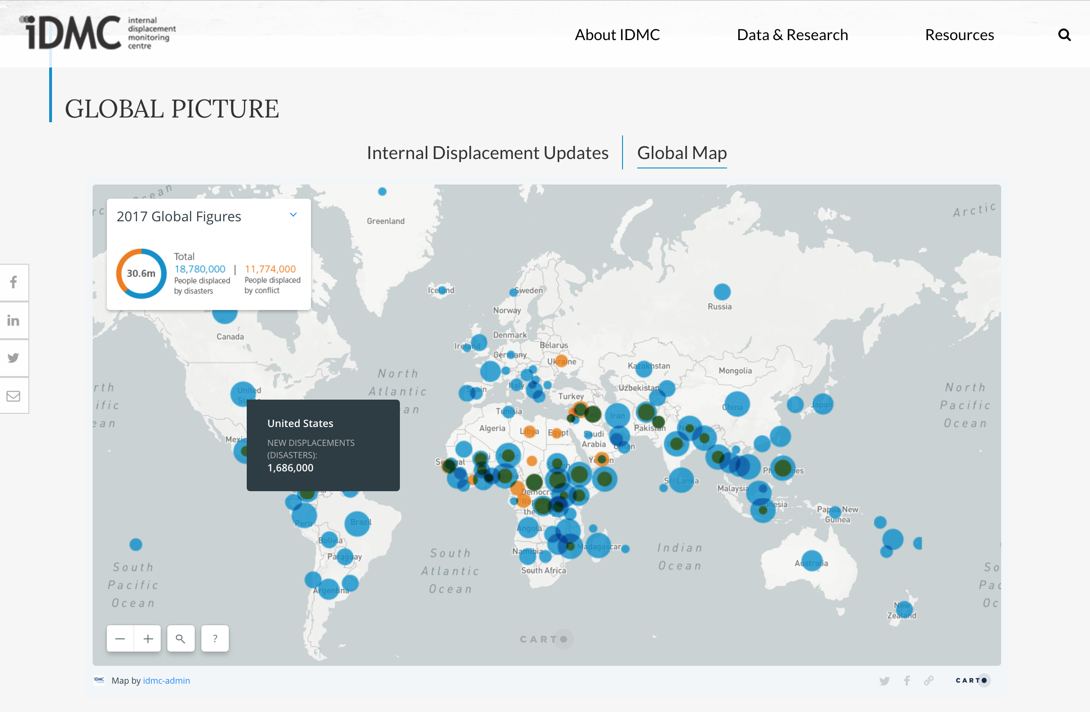
Internal Displacement Monitoring Centre, online at www.internal-displacement.org

Slide 37
What can we do about climatic changes and their associated impacts?
Notes:
Now that we understand the basics of climate science and global warming, does it match up with what we’re seeing on the ground (or in the air)?

Slide 38
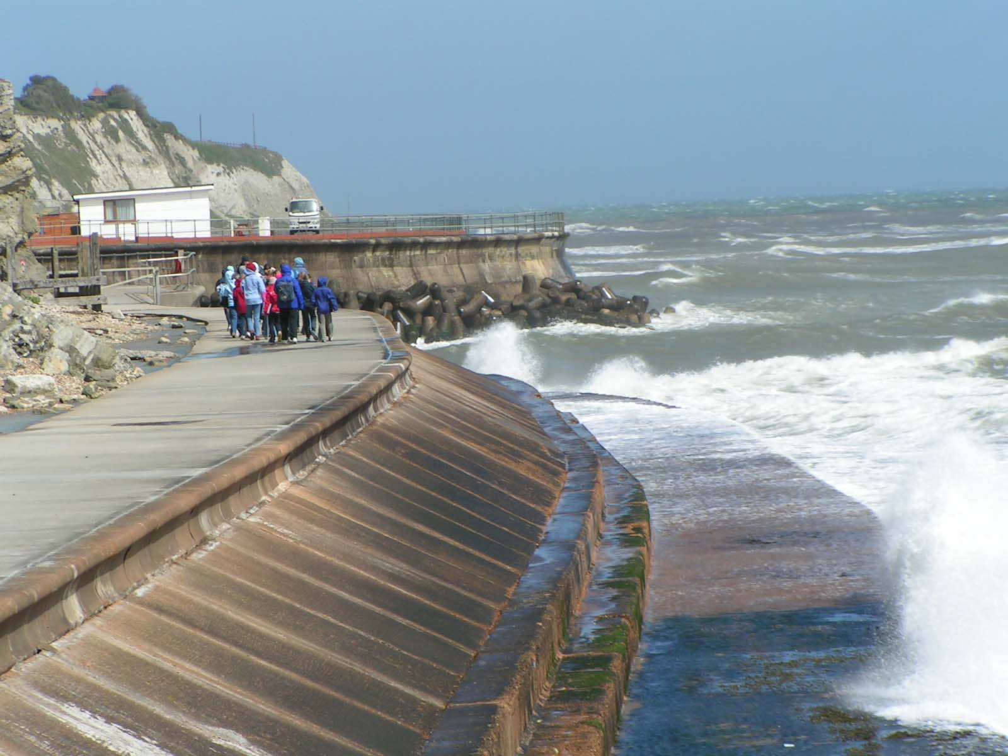
Mitigation
Adaptation
Reducing greenhouse gas emissions &/or removing carbon dioxide from the atmosphere can lessen the severity of climate change & its impacts.
Improving our ability to cope with or avoid harmful impacts; or taking advantage of newly favorable conditions. Reducing risk and vulnerability; exploiting opportunities.
Reducing atmospheric CO₂
Coping with new conditions
carbon dioxide
time
Notes:
There’s a saying: “Mitigation is avoiding the unmanageable and adaptation is managing the unavoidable.”

Slide 39
Mitigation: reducing CO₂ in the atmosphere
Develop new habits to avoid wasting energy
Switch to carbon-free energy sources, such as solar & wind
Plant trees to increase the amount of CO₂ taken up by forests & to reduce severity of ‘urban heat islands’
Restore wetlands for carbon storage (per COP21 agreement).

Slide 40
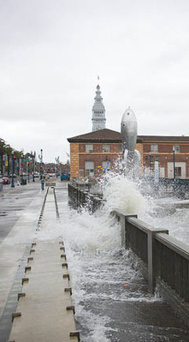
Adaptation – Anticipating and adjusting to new conditions
What changes are coming?
What changes do we need to make?
Protect habitat or structures threatened by sea level rise
Develop plans to ensure adequate water supplies
Plant different crops
Develop new businesses
Assessing a region’s ability to handle sea level rise and flooding

Slide 41
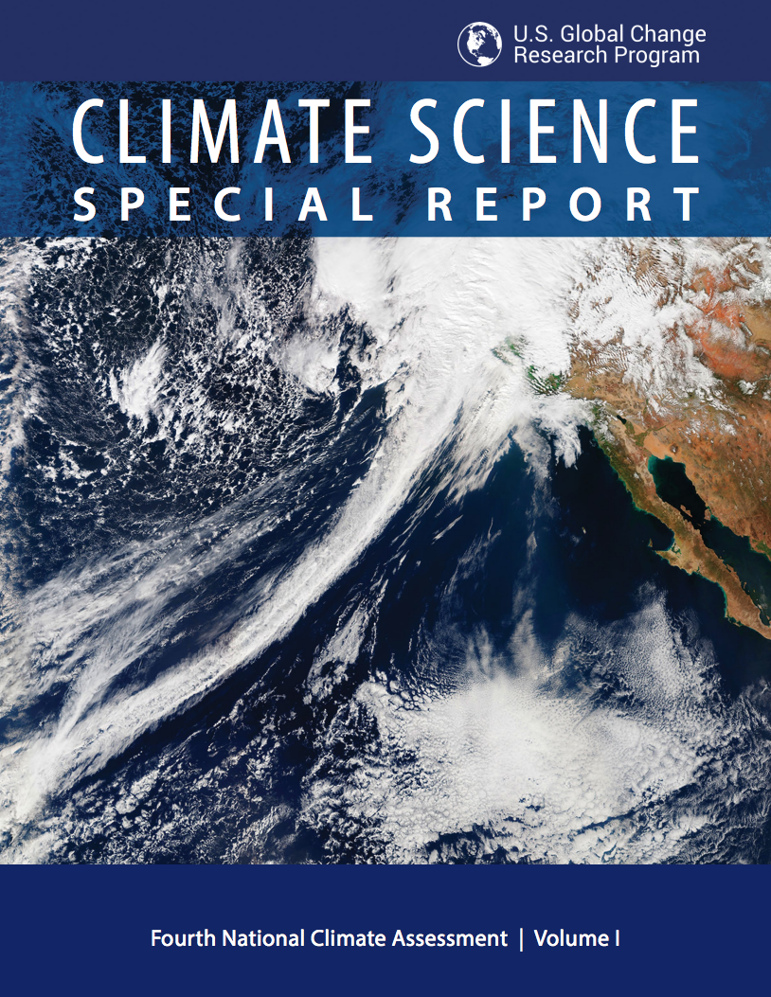
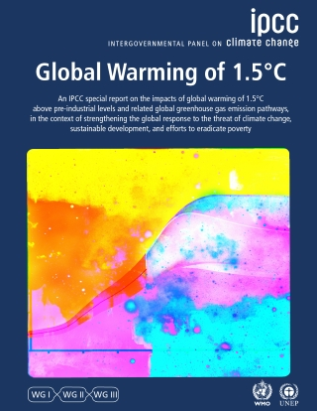
Free, authoritative sources of information about climate change, impacts & projections
science2017.globalchange.gov
www.ipcc.ch/report/sr15/

