Slide 1

Cybersecurity: Enabling digital transformation
Notes:
Overall presentation objectives
Demonstrate MSFT’s thought leadership in digital transformation
Underline the importance of cybersecurity and cybersecurity policy for digital transformation
Target audiences for this presentation
PRIMARY:
Cybersecurity decision makers, e.g. national cybersecurity agency, ICT ministry and/or regulator, national standards bodies.
Government stakeholders dealing with cloud computing, procurement authorities
SECONDARY:
Stakeholders concerned with technology, risk management and future planning, e.g. special government units that oversee technology-related cross-sectoral initiatives such as smart cities, economic planning authorities, etc.
Business or industry associations in ICT sector

Slide 2

Agenda
1
Cybersecurity: Enabling the Digital Transformation
Cybercrime
Cloud Computing & Cybersecurity
Discussion
2
3
4

Slide 3

What is digital transformation?
Notes:
Section objectives
Give a definition of digital transformation/digitalization that will underpin the rest of the presentation.

Slide 4
IT’s role increases dramatically
ERA 1
ERA 2
ERA 3
IT Craftsmanship
Industrialization
Digital transformation
TODAY
Technology focus
Process focus
Business model focus
Sporadic automation and innovation; frequent issues
Services and solutions;
efficiency and effectiveness
Digital business innovation; new types of service
Notes:
Slide objectives
Discuss how technology has evolved over the years, heading towards digital transformation.
Give an initial definition of digital transformation and the era of digitalization.
Outline some of its primary consequences, notably for the competitive landscape of most industries.
Main messaging
It is not just the political world that has changed, every single industry will be digitally remastered.
Craftsmanship:
This early era of technology use in the 70s and 80s, was one where automation was sporadic and difficult. The innovation that came about as a result of technology did so in fits and starts.
The world has changed dramatically since then.
Industrialization:
We are currently in but quickly passing through the era of industrialization. This was an era ICT had planned and predictable schedules and road maps.
It focused on automating mostly back-end processes to deliver stable and reliable outcomes.
It was an era of individual productivity gains and business process efficiency that had great impact on the bottom line for business.
This has been going on since the 90s but it is giving way to another wave of technologically-led change…
Digital transformation:
Digital transformation, also known as digitalization, changes business activities, processes, and models to fully leverage the changes and opportunities of digital technologies.
New customers can be reached through new channels, e.g. mobile apps.
New services can be rapidly developed and deployed, e.g. Internet of Things tools to remotely run domestic appliances.
New skills and approaches will be needed by creators and by users of these new tools/services/products.
A reliable and secure back-end will still be needed but agility and flexibility (front-end and back-end) will be essential.
Gartner defines digitalization as: “The use of digital technologies to change a business model and provide new revenue and value-producing opportunities; it is the process of moving to a digital business.”
It will be (it currently is, in fact) less about the technology and more about how users (businesses, governments, individuals) adopt technology.
As the marker shows, we are now entering this third era of IT, digital transformation.
It is underpinned by cloud.
And it is enabled by cybersecurity.
Businesses and governments will not put their data and processes online without being certain they are safe from harm.
In his book "Digital to the Core" (2015), Mark Raskino (VP & Gartner Fellow) wrote that “Every single industry will be digitally remastered.”
This “remastering” or transformation will utterly reshape the competitive landscape for businesses and in doing so will change policy-making and the operational practices of the public sector.
Competition will be able to come from completely different industries or areas, e.g. search engines could provide telephony, online book stores could sell cloud services.
This change will therefore create winners and losers for most industries.
It will allow a new competitive mix that combines the familiar names with a new breed of technology-powered disruptors.
The new generation of competitors can spin a whole business up in weeks using cloud infrastructure and readily-available business and technology resources.
From an ICT perspective, this is going to be an era characterized by:
Rapid innovation;
Unpredictability;
An explosion of devices and users;
New security and disaster threats;
Consumerization;
Business leadership pressure.

Slide 5

Cloud is central to digital transformation…
for industry and
Challenge
Improve aircraft efficiency.
Increase aircraft availability.
Reduce engine maintenance costs for airlines.
Strategy
Aggregated data from engines remotely with Azure IoT Suite.
Utilized Cortana Intelligence Suite to assess health and detect operational anomalies.
Results
Retain asset value throughout an engine’s life cycle.
Reduce flight disruptions.
Potential cost savings of millions of dollars per year.
“The Microsoft Azure platform makes it a lot easier for us to deliver on our vision without getting stuck on the individual IT components. We can focus on our end solution rather than on managing the infrastructure.”
— Richard Beasley, senior enterprise architect, Rolls-Royce
Notes:
Slide objectives
This slide uses an example of Rolls Royce to illustrate one aspect of digital transformation’s benefits for business (intelligent cloud).
Main messaging
This case study is an excellent example of building that “intelligent cloud” in the context of the Internet of Things and Rolls Royce.
Rolls-Royce has more than 13,000 engines for commercial aircraft in service around the world.
Its comprehensive engine maintenance services help keep aircraft available and efficient, and is a major source of revenue.
Effective maintenance reduces flight delays and disruptions (which have a cost to airlines), increases fuel efficiency (fuel accounts for 40 percent of airlines’ operating expenses), and extends the life of the engine itself (reducing replacement costs).
Determining the optimum time for an engine to be cleaned and maintained requires the analysis of a lot of data.
Each engine has many sensors and generates thousands of signals, producing huge numbers of data points.
The rapidly increasing volume of data coming from many different types of aircraft equipment would have overtaken the ability to analyze and gain insight from it.
“There are terabytes of data coming from large aircraft fleets, with gigabytes per hour—rather than kilobytes—to process and analyze. We can use data and insight in new ways to refine our customers’ operations to add more value to them and allow them to do more with less.” Nick Farrant, Senior Vice President, Rolls-Royce.
Microsoft’s cloud solutions enable Rolls Royce to enable and expand their existing maintenance service and to develop new services to their customers.
Using the Azure IoT Suite, Rolls-Royce collects and aggregates data from disparate and geographically distributed sources at an unprecedented scale.
Using Microsoft Cortana Intelligence Suite, Rolls-Royce then analyzes the rich set of data and performs data modeling at scale to accurately detect operational anomalies and help customers plan relevant actions.
Azure Data Factory is used for orchestration and Azure HDInsight for high-level data aggregation and summarization. Azure SQL and Azure Blob Storage are used to handle all the different types of storage needs.
[See here for more information on this case study: https://customers.microsoft.com/doclink/rollsroycestory ]

Slide 6

…and for the governments
Challenge
Involve citizens in determining how to use land and the areas surrounding the former Hindenburg Barracks.
Strategy
Deployed open-source solution OpenDoors on Azure to enable collaboration and joint decision making
Results
Scalable platform to solicit feedback, inform citizens of updates, share answers, and generate a clear picture of public opinion.
“We have experienced that when we have good tools and products, professional and experienced service providers, this means a certain relief for the municipal administration and an improvement in terms of contact with our citizens.”
— Gunter Czisch, first mayor of Ulm, Germany
Notes:
Slide objectives
Highlight the benefits of cloud that are specific to governments.
It uses an example of the German city of Ulm to illustrate one aspect of digital transformation.
Main messaging
Some of the benefits of cloud computing are the same across governments and the private sector: speed, scale, economics
Governments can increase the agility and efficiency of their operations, and they can lower their overhead ICT costs.
With “elastically provisioned” cloud resources governments only pay for what they use, when they need it.
This can be very helpful for e-government services such as online tax filings/returns, which have predictable spikes in usage and capacity.
With constrained government budgets cloud can be very helpful.
The same or better services for less cost.
But cloud computing can also have a more direct effect on citizens and business.
It can dramatically reshape how governments engage and respond to their citizens.
Sophisticated systems can be used to answer simple questions, perhaps even basic Artificial Intelligence (AI), freeing up civil servants to focus on more complicated priorities.
Increased availability of computing resource also removes barriers to understanding and use of ICT by all sections of society, helping to democratize computing.
A government’s adoption of cloud can give its national ICT industry and other businesses the confidence to innovate and develop new approaches, e.g. via the Internet of Things (IoT) or Industry 4.0.
Case study: Ulm and public engagement through scalable, low cost cloud tools
This case study is an excellent example reimagining the experience of the “customer” or “citizen” in this case, and of “opening up new channels”, which are core to the digital transformation of “personal” computing.
It is also an excellent example of how digital transformation can “reinvent productivity” relieving pressure on constrained public sector budgets whilst also providing speed and scale.
The southern German city of Ulm had to make a decision on how to use the land and surrounding areas of the former Hindenburg Barracks.
In order to involve citizens directly and enable collaboration and joint decision-making, the city deployed an open-source solution, opendoors, on Microsoft Azure.
“We wanted a productive dialog with residents about future uses of the area. We had a variety of choices, such as a playground or a park and adjacent housing. We needed to inform and involve citizens as part of the decision-making process.” Stephanie Köhler, Town Planner.
City planners wanted to move quickly and avoid expense, but were unsure how many residents would participate. The solution needed to be scalable and built on a cross-media platform that would support a variety of information-dissemination and public-participation models.
“We chose opendoors because it taps the innovative possibilities of the cloud. By pairing it with Azure, we built a cost-effective and low-overhead website for digital citizen participation. Cost is always a factor in the public sector. It’s also faster for the city to deploy and easier to maintain.” Christian Geiger, Ulm Digital Officer.
By running opendoors on Azure, the city’s only expense was the pay-as-you-go pricing for computing resources.
Encouraging public debate on specific questions also reduced conflicts, which lowered project costs because fewer objections were filed with the city during the formal review process.
Ulm now has a scalable platform to solicit feedback, inform citizens of updates, share answers, and generate a clear picture of public opinion.
[See here for more detail on this case study: https://www.microsoft.com/empowering-countries/en-us/sustainable-cities-and-communities/city-of-ulm/ ]

Slide 7
How does cybersecurity enable digital transformation?
Notes:
Section objectives
Emphasize the core contention of this presentation, that cybersecurity enables digital transformation.
Outline how the cybersecurity environment has evolved, became increasingly complex.

Slide 8
…because more connectivity means more risk
$400Bn
cost of cyberattacks to companies each year
$3Tr
estimated cost in economic value from cybercrime
by 2020
71%
of companies admit
they fell victim to a successful cyber attack
the prior year
140+
Median # of days between infiltration
and detection
160M
Data records
compromised from
top 8 breaches
in 2015
556M
victims of cybercrime
per year
Notes:
Slide objectives
Highlight the costs incurred when cybersecurity fails.
Main messaging
The truth is that more of our governments, businesses, jobs, lives and assets move online, the more they become exposed to cyberthreats.
The financial impact of cyberthreats, notably cybercrime, is large and growing, even if many organizations do not reveal publically their losses and costs from cyber attacks.
The numbers on the slide are far from exact, but they provide an idea of the scale of the problem.
The direct costs to business and the indirect costs to states, due to lost economic activity, are notable.
In addition to these economic costs, there are a number of other important, if less immediately tangible costs from cybercrime:
Lost confidence in internet commerce and online services, potentially resulting in negative impacts on national economies overall;
Erosion of individual privacy, as a result of constant attacks and increased government regulatory reactions;
Disruption and actual destruction caused by attack against critical infrastructure;
Funding of other criminal activities with money made by organized crime groups through profitable, hard to trace cybercrime.
This is not to say that we should abandon the technology because of the challenges that follow in its wake.
The opportunities of the digitalization are too good to simply walk away from.
But what these figures do tell us is that as technology changes, so do threats. And this means that cybersecurity itself has to evolve.

Slide 9
Cybersecurity used to mean building a bigger wall…
Notes:
Slide objectives
Explain that cybersecurity used to mean one thing but now has evolved to mean something different (and something a lot more complex).
Main messaging
Securing valuable information used to mean ‘securing the perimeter’ in an attempt to make the systems impenetrable to malicious outsiders.
ICT assets typically lived in closed environments; work computers tended to stay at work, data was held “on-premises”.
It was easy to take an out-of-the-box approach to cybersecurity with firewalls and anti-virus engines.
That said, protecting corporate infrastructure was resource intensive, as the design and maintenance of these security frameworks required time and personnel.
This old concept of secure perimeters is, in many ways dead.
It is no longer about building a bigger wall because the perimeter is permeable, dynamic and mobile.
Cloud, mobile apps and a plethora of devices (some personal, some organizational) mean that the perimeter is transformed.
The threat footprint is also larger than before, with a larger “attack surface” to target, and multiple possible weaknesses to exploit.

Slide 10
…but now the wall has had to transform
PROTECT
across all endpoints, from sensors to the datacenter
DETECT
using targeted signals, behavioral monitoring, and machine learning
How do you build
a wall to protect a cloud?
RESPOND
closing the gap between discovery and action
Notes:
Slide objectives
Explain that cybersecurity used to mean one thing but now has evolved to mean something different (and something a lot more complex).
Main messaging
Securing valuable information used to mean ‘securing the perimeter’ in an attempt to make the systems impenetrable to malicious outsiders.
ICT assets typically lived in closed environments; work computers tended to stay at work, data was held “on-premises”.
It was easy to take an out-of-the-box approach to cybersecurity with firewalls and anti-virus engines.
That said, protecting corporate infrastructure was resource intensive, as the design and maintenance of these security frameworks required time and personnel.
This old concept of secure perimeters is, in many ways dead.
It is no longer about building a bigger wall because the perimeter is permeable, dynamic and mobile.
Cloud, mobile apps and a plethora of devices (some personal, some organizational) mean that the perimeter is transformed.
The threat footprint is also larger than before, with a larger “attack surface” to target, and multiple possible weaknesses to exploit.

Slide 11

Multi-factor authentication
Data encryption
User accounts
Device log-ins
Malware
Unauthorized data access
INTELLIGENCE
Attacks
INTELLIGENCE
User log-ins
Phishing
Denial of service
Spam
System updates
Enterprise security
Notes:
Security Opportunities
Cloud computing allows for a defense at tremendous scale, learning from millions of data points…
-massively scaled threat intelligence and proactive response

Slide 12



UNIQUE INTELLIGENCE
300B user authentications each month
1B Windows devices updated
200B emails analyzed for spam and malware
Notes:
This kind of massive awareness allows CSPs to do more than just respond to threats…
it can enable public/private collaboration to make defenders proactive
There’s opportunities for real time tracking in this infrastructure where customer opts in. The cloud provider can identify, track, and even Halt attackers, mid-way through an attack as they move through computer systems. This has happened before.

Slide 13
Where does government action fit into
digital transformation?
Notes:
Pulse check: What do you see as government’s role in regulating and overseeing this digital transformation?
Section objectives
Explain how government actions are having both positive and negative effects on cybersecurity

Slide 14




Governments’ roles in cyberspace
50+ Countries with Defensive Capabilities
37+ Countries with Offensive Capabilities
95+ Countries Developing Legislative Initiatives
70+ Countries with Cybersecurity Strategies
Protector
Rising International Insecurity
Increasing Regulatory Pressure
Exploiter
User
Innovation at Risk
creator
Notes:
Slide objectives
Explain the different roles government have in cyberspace.
Underline the impact of government action in cyberspace on the private sector, and security overall.
Main messaging
States actions in cyberspace vary and governments are rarely doing “just one thing” in terms of the internet and technology.
They are large users of ICT, but their “customers” are “citizens” who may want to find information, file for benefits, pay their taxes, etc.
They are responsible for protecting the Internet as well as the security and privacy of Internet users, and to fulfill that mission, may use its regulatory powers.
Although it wants to protect computer security, a government may exploit networks for a number of reasons, including economic espionage, military espionage, and military operations.
They are the legislator, the creators of laws and policies in support of cybersecurity and critical infrastructure protection
The figures on states’ spending on cyber operations are naturally somewhat vague, as they touch on intelligence and military operations budgets that are not always transparent.
What is apparent is that some states are spending considerably sums on both offensive and defensive technologies.
And in cyberspace it can sometimes be difficult to distinguish between offensive and defensive capability.
Nonetheless, an increasing numbers of states are currently investing in both defensive and offensive cyberspace capabilities. Based on internal Microsoft research, we have determined that:
In 2016, over 95 countries have discussed legislative initiatives focused on cybersecurity;
50+ countries have developed defensive capabilities against cyber-attacks on their networks;
38+ have offensive capabilities;
18 likely have offensive capabilities that have not been acknowledged, but can be inferred from operational activity;
20 have specifically declared offensive capabilities.
Actions in cyberspace could constrain economic growth, limit innovation, or restrict trade and investment.
Creating policies to reduce cyber risk and/or to bolster military cyberspace capacity can divert investment, reduce choice in ICT suppliers, distort technologies and limit online behaviors.
E.g. locking-in certain cybersecurity standards or excluding some technologies can limit a state’s ability to keep up with technological developments or to create a domestic ICT industry.
E.g. Reducing investments in R&D and in STEM education will lead to lower annual disposable income and slower economic growth.
Microsoft produced an econometric analysis of this problem in its whitepaper Cyberspace 2025: Today's Decisions, Tomorrow's Terrain (June 2014).
It sets out “peak”, “plateau” and “canyon” models for economies depending on how they approach fundamental choices around cybersecurity.
The development of defensive and offensive cyberspace capabilities could even promote cyber-insecurity between governments.
Shifting cybersecurity spending from civilian defense and law enforcement to offensive military capabilities, means other states will react.
A chain reaction could exacerbate cyber-insecurity regionally or globally, driving broader tensions in the international system.
Unchecked such cyber-insecurity could reach the global level and erode trust in the foundations of the Internet and in the global fabric of ICT-driven innovation.

Slide 15
Global policy developments 2017
Notes:
Our team tracks and monitors policy developments related to cybersecurity and cloud across over 100 countries worldwide. Our data from the past year is shown in this graph. A number of these policy trends are directly or indirectly affected by cloud, and we will highlight a few now and go into a deeper dive on some of these topics later today.
Securing government and critical infrastructures continues to be a top priority for governments across the world.
Given the perception and reality of increasing threats online, governments are utilizing legislative instruments to try and tackle the challenges as they see them, sometimes having direct and indirect negative effects on adoption of cloud, therefore challenging government opportunities to innovate and adopt new technology

Slide 16
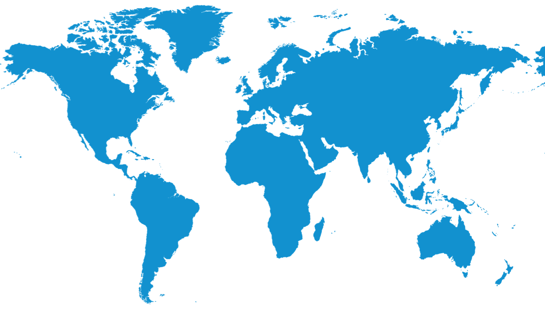
2
Critical infrastructure laws are prioritized
Americas
Austria
Bermuda
Canada
Cayman Islands
Chile
Colombia
Mexico
United States (including several states)
EMEA
Denmark
France
Germany
Ireland
Kenya
Lithuania
Netherlands
Poland
Romania
Russia
Serbia
Slovakia
Slovenia
Sweden
UAE
Ukraine
Asia Pacific
Australia
Bangladesh
China
Japan
Singapore
Vietnam
To better manage cybersecurity risks in critical infrastructure, governments are introducing regulations or guidelines that are increasingly modelled off of the EU NIS Directive and China Cybersecurity Law.
Notes:
Main message: Recognizing the need for secure and resilient ICT, governments are evaluating how to manage cybersecurity risks.
Over 40 countries are in the process of creating new CI regulations (these on the slide highlight some across the regions) with two primary models:
In the EU, the Directive on Security of Network and Information Systems (“NIS Directive”), which was adopted in early FY17 and goes into force in 2018, aims to harmonize approaches on critical infrastructure security in Europe.
China has also put forth its own critical infrastructure regulation, as part of the implementation of the cybersecurity law that entered into force this summer.
The approaches that governments take in developing critical infrastructure legislation will have far-reaching impacts.
Effective approaches will not only increase security, but will also enable continued innovation, productivity, and economic opportunity
For governments, the potential fragmentation that would result from divergent interpretations across the different regions would introduce significant compliance challenges for industry without necessarily improving security
Way forward: Aligning to international standards and widely recognized best practices, such as the NIST Cybersecurity Framework, which has long been used by industry, and we are now seeing more governments recognize its utility (i.e. EO 13800)

Slide 17
Policy topics at play: Security baselines
Data Security and Access
Operational Security and Controls
Incident Reporting and Information Sharing
Security of
government
systems
Enterprise
Security and Compliance
Audit and Compliance
Security Certification
Notes:
Slide objectives
Examine some of the core policy challenges that effect both government and the providers/users of modern ICT products and services.
Main messaging
As a result of increasing digitalization, governments and the private sector have faced similar and rising concerns in cyberspace.
As noted on the previous slide, governments have increasingly taken action to secure both its own systems and those of the companies operating in their environments. The main policy areas resulting from this are set out on this slide.
As the graphic shows, in a digitalized world with near ubiquitous technology, the issues affect both government and business.
Operational security and controls
The primary area where we have seen governments take action is in operational security. In particular, the last 4 years have demonstrated an increased focus on critical infrastructure protection legislation adoption.
Governments typically already have traditional security measures in place for this sector, e.g. guards, barriers, cameras, but they are now re-assessing in light of greater connectivity re. making them cyber-secure.
See Network and Information Security (NIS) Directive in the EU.
See NIST Cybersecurity Framework in the US.
Governments have begun to realize that they need to take a risk-based approach and prioritize their investments.
100% of all systems cannot be 100% secure for 100% of the time, so they are assessing which ones are most critical and investing accordingly.
Includes assessing functions within organizations, e.g. an energy company’s website is less critical than its electricity distribution system.
Microsoft has found the NIST Cybersecurity Framework (now in the process of becoming ISO27103) has proven to be a particularly useful framework to follow:
It follows the principles of prioritization and risk management.
It is focused on outcomes rather being very prescriptive.
Its broad industry adoption internationally could significantly raise the cyber defenses across the world.
Data security and access
Another focus area that has emerged has been data security. Governments need to have confidence that their data is appropriately protected from unauthorized access or tampering and that their data is only used in a manner that is consistent with the privacy expectations of their citizens.
Over 90 countries today have some sort of data protection policy in place, the most prominent of them – of course – the EU’s General Data Protection Regulation (GDPR).
Moreover, governments are also adopting data classification policies that protect data security and access by ensuring that assessments, categorization, and protection are commensurate with risk.
A lot of these polices, as per critical infrastructure protection, are not new, and have been used for decades to help manage the integrity of organization’s data. However, they now need to be adopted to a new environment and that is not easy.
Many governments, including the UK’s, have discovered that simpler is better, given the scale of data generated every day.
Incident reporting and information sharing
The right information exchanged or shared at the right time can reduce risks, deflect attacks, mitigate exploits and enhance resiliency.
Forewarned can mean forearmed.
Governments have recognized that and have begun encouraging industry players to share information around cybersecurity incidents amongst each other and with the government.
However, effective information sharing is not simple and requires trust between the participants.
Only a small number of actors possess the information that is actionable and can be used to effectively defend networks.
The creation of information sharing initiatives has been slow therefore.
Governments have begun considering mandatory incident reporting requirements but Microsoft believes that such approaches should be limited, as they might in fact damage security if incorrectly implemented.
Mandatory approaches should be narrowly defined and implemented through trusted mechanisms. This helps ensure that only the right information is shared with the appropriate stakeholders in the proper timeframe.
A narrow approach strengthens privacy and the protection of civil liberties.
Policy efforts should encourage information sharing processes which are transparent about how such data is used and which ensure that information shared back to the submitters is valuable and timely.
Audit and compliance
As states adopt cloud and wider digitalization, they will need to adapt their risk management activities to balance this technology evolution against traditional audit and certification regimes.
Striking the right balance will enable businesses and governments to reap the benefits of a modern connected economy (reduced costs, improved e-government, and increased convenience).
The risk of creating burdensome compliance regulations is that they will ultimately restrict economic innovations in key sectors of their economy domestically and internationally.
The risk of incongruous and fragmented compliance and regulatory requirements may well be the limitation of the growth of new companies.
Furthermore, attackers can exploit inconsistent security policies and compliance frameworks that were created to enhance security but have resulted in systems that are difficult to administer and defend.
E.g. The risk of focus on compliance over security
Security certification
Governments also want to ensure that the security products and services available on the market do what they say they do and that customers have an informed view of what they are buying through labelling.
This area needs to be addressed carefully any such initiative needs to be connected to the global environment.
Established frameworks should be utilized, for example Common Criteria is an international standard (ISO/IEC 15408) that enables users to define their security functional and assurance requirements through Protection Profiles, against which vendors can make claims about their products and have them independently evaluated by testing laboratories.
Both government voluntary and industry driven cybersecurity tools should be encouraged and these should be accessible, transparent, scalable across borders and focused on processes;
Self-certification with a declaration of security including detailed and comprehensive processes to cover should be one of the options.
Any initiative should promote security-by-design processes to meet security profiles or goals and new risk management models to address cyber risks.

Slide 18
Security Baselines
Government Systems
Critical information systems
Enterprise
Individual
Notes:
Slide objective:
Underline the importance of harmonized security baselines (across sectors and across geographies)
Main messaging:
A national strategy should establish a process to establish both critical and minimum security baselines for ICT systems that are determined to be nationally significant. Achieving a security baseline will significantly reduce the risk facing a nationally significant entity.
A “security baseline" typically defines a set of basic security requirements that aim to minimize cybersecurity risk. Security baselines typically span a wide range of operation and risk management activities, including protection against cyber threats and ensuring that organizations can detect and respond to incidents that do occur. While largely welcome, the objectives they set should be comprehensive, pragmatic, and should not impose technical means.
NIST Cybersecurity Framework is an example of an approach that has worked well and Microsoft advocates to be replicated around the world
The security baselines and the appropriate security measures establish a flexible foundation upon which the nation can drive security enhancements for citizens. The strategy should recognize the need to include (in order of priority):
Government systems baselines. The government is responsible for participating in cybersecurity standards development, as well as establishing and meeting security baselines for critical and non-critical information government systems.
Critical information and information systems baselines. The strategy should also call for government, in concert with private industry, to establish security baselines for information and information systems deemed to be critical. These baselines should also consider broad cross-sector interdependencies and promote means to reduce these risks.
Enterprise baselines. Unlike critical information and infrastructure, where attacks can create immediate national security concerns, attacks against enterprises can create serious economic impacts for the individual company but are less likely to create national-level economic or security risks. Over time, the theft of intellectual property, business secrets, personally identifiable information, or funds can create risks to the competitiveness of the nation.
Individual baselines. Threats against individual Internet users are unlikely to create situations of national importance, but over time, attacks against individuals can become significant for the nation. Setting a baseline that includes consumers will help service providers and consumers alike to migrate toward a more secure environment over time, which is consistent with the needs of the strategy.

Slide 19



Ensure IT supply chain security
Software
assurance
International standards
Supply chain
Source
Make
Deliver
Notes:
Slide objective:
Highlight the role government can play in fostering cybersecurity with procurement activity, throughout the supply chain
Main messaging:
As the national strategy considers the broader implication of the needs of the country’s ICT infrastructure and its supply chain, it is important that the strategy remains focused on the principle of global relevance and remains focused on recommending principles of technology neutrality and supply chain security that are rooted in international standards. Secure in-house development and global supply chains requires:
Best practices for all constituents in the supply chain.
Supplier security. Mechanisms to ensure that suppliers have demonstrable processes for: (1) managing employee identity, including tying identity to role-based access for system development and production; (2) a secure development process, such as the Microsoft Security Development Lifecycle and ISO 27034:1; (3) code integrity practices that prevent or remediate potential risks associated with intentional or unintentional insertion of malware; (4) digitally signing code; and (5) swift recognition of counterfeit products.
Common requirements and international standards backed by assurances.
International standards such as ISO 27034 for secure software development and emerging international standards for supply chain risk management are useful references for developing such policies.
Software assurance. When governments choose to base their software assurance and supply chain policies on international standards and globally recognized best practices, they create flexibility for vendors and suppliers and increase the range of available potential solutions.
Customers attuned to concerns, so that they reward trusted constituents through procurement:
Threat model for supply chain risk developed by the government and shared with its ICT vendors and suppliers
Genuine products. Policies and controls to ensure that the government is buying genuine products from trusted sources as well as capabilities that can identify and remove counterfeit or gray market systems that can create risks to the integrity of government information, services, and assets.

Slide 20
7
Think globally
Foster CERT relationships
Foster international standards
Promote law
enforcement cooperation
Shaping government international activity
Notes:
Slide objective:
Remind your audience that technology, but cybersecurity in particular cannot be looked at solely in the context of their national borders. Their actions will have an impact beyond.
Main messaging:
While improving domestic defense and response capabilities is largely the focus of national cybersecurity strategies, there are important international elements that impact domestic defensive efforts: cyber-criminal groups operate across national borders; espionage is carried out remotely; and foreign nation-states have the capability to launch destructive attacks against critical infrastructure. With the advantage of the attacker in cyberspace, these risks cannot be properly managed simply through domestic defense.
Recommendations for a national strategy:
Foster international CERT cooperation. National-level CERTs should be tasked with building relationships and agreements with one another in order for each to receive timely information on potential threats and vulnerabilities and be able to respond effectively to incidents as a result.
Promote law enforcement cooperation. The national strategy should identify a law enforcement entity with primary responsibility for cybersecurity issues, and ensure that the entity has adequate training and resources. In addition, law enforcement should also be strongly encouraged to participate in efforts to harmonize global law enforcement forensic capabilities and expedite the ability to share information across borders.
Highlight the importance of MLAT reform
Foster international standards and harmonizing international certifications. The strategy should require a continued focus on the creation and adoption of international standards. Microsoft strongly supports a global approach to setting a security baseline, rather than a domestic one. Given the global nature of the creation of ICT, creating products or services to meet hundreds of national standards of varying degrees on the same issue is both unworkable and unnecessary.
Discuss the work around harmonization/internationalization of the NIST cybersecurity framework, including the fact that it is referenced in Australia, Italy and the US and that there is currently ongoing work to turn the best practices retained in it into an international standards in ISO
Help shape government cyber activity. The national strategy should set out principles for cybersecurity activity by governments, appoint a clear leader to coordinate and develop those norms, and establish a process for communicating positions in existing international forums.
Underline our efforts around the Digital Geneva Convention.

Slide 21
Supply Chain Lifecycle Assurance Story
1
2
3
4
Transparency
Security Strategy & Standards
Contracting
Supplier Continuity
Government Security Program
Data Protection Requirements
Firmware SDL Requirements
Specific Supplier Policies & Training
Requirements, Benefits, Code of Conduct & Guidelines
Continuity of Supply
Standardized Risk Approach
- No Single Point of Failure
7
6
5
Receiving & Installation
Transport Security
Automated Software Checks
Detailed Checklists
Shipped Direct to Data Centers
Global Control Tower Operations
DHS C-PTAP Level 3 & Trusted Trade Partner
Secure packaging, tamper resistant tape & seals
Performed at Supplier/Integrator
Documents What was Produced/Shipped
8
9
10
Automated Software Validation
Data Center Operations
Contract Supply Chain Security
Requirements Update Process
Performed Once Received by Azure
Validates Product Shipped = Product Received
Repair – Maintenance – Destruction
Detailed Checklists
Specific Security Boundary Countermeasures
Innovation – Engagement – Partnership – Education – Transparency

Slide 22
Policy topics at play: Cybercrime legislation
1
Challenge
Lack of harmonization
Difficulty for law enforcement
Way Forward
Improve MLAT process
Align with internationally recognized conventions
Notes:
While we have seen revisions of legislation in developed markets, seeking to address new crimes such as ransomware, this trend is particularly prominent in the emerging markets.

Slide 23
Cybercrime
Notes:
Question: What types of attacks or activities have people noticed increasing in recent years in their own context?
Overall presentation objectives
Give an overview of the cybercrime landscape today
Highlight effective legislative actions that can be taken to tackle it
Target audiences for this presentation
PRIMARY:
Cybercrime experts and practitioners; e.g. prosecutors, judges, police investigators;
Cybersecurity decision makers, e.g. national cybersecurity agency, ICT ministry, etc.
SECONDARY:
Industry stakeholders concerned with cybercrime;
Business or industry associations

Slide 24
Our reality is changing
Geopolitical change
Evolution of technology
Persistence
of threat
Notes:
Slide objectives
Introduce the main threads of the conversation, focusing on the factors that drive the cybercrime challenge today.
Main messaging
Tremendous economic and social opportunities for consumers, governments, and businesses are being created by the combination of:
expanded access to the internet;
explosive increase in connected devices;
rapid expansion of innovative cloud-based services.
At the same time, we have seen the cybersecurity environment change and evolve over the past few years.
Tried and tested methods (e.g. ransomware) are still being used…
…but cyber threats are reaching new levels, including the destruction of property.
Our attack surface is ever expanding, e.g. with the Internet of Things.
New technologies are regularly introduced to the market
They simultaneously reduce risk in some area and introduce them in others.
Governments are becoming involved:
As perpetrators or sponsors of cybercrime,
As developers of legislative frameworks to tackle cybercrime.
Industry and governments are struggling to confront the growing threat, sophistication, and prevalence of cybercrime, including:
identity theft;
online scams and fraud;
malware distribution schemes;
attacks against the integrity of data and systems; and,
online distribution of illegal content.

Slide 25
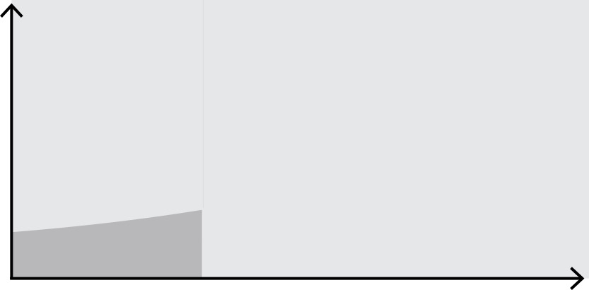
Persistence of threat
Evolution of attacks
2003-2004
Script Kiddies
BLASTER, SLAMMER
Motive: Mischief
Sophistication
Volume and Impact
Notes:
Slide objectives
Describe how today’s situation has emerged as cybercrime evolved, starting with early 2000s
Main messaging
The situation today is the result of threats that have been evolving since the early 2000s.
Looking back at the attacks from 2003, the attacks were not terribly sophisticated.
Frequently run by so-called script kiddies: unskilled individuals using scripts or programs developed by others to attack computer systems and deface websites.
The typical motive was mischief and fame.
However, the defenses were not terribly sophisticated either.
While the majority of the attacks had low impact, when malware like Blaster and Slammer hit there were problems:
Blaster Worm (also known as Lovsan, Lovesan or MSBlast) was a computer worm that spread on computers running the Microsoft operating systems Windows XP and Windows 2000, during August 2003.
SQL Slammer was a computer worm that caused a denial of service on some Internet hosts and dramatically slowed down general Internet traffic, starting at 05:30 UTC on January 25, 2003. It spread rapidly, infecting most of its 75,000 victims within ten minutes.
Although titled "SQL slammer worm", the program did not use the SQL language; it exploited a buffer overflow bug in Microsoft's flagship SQL Server and Desktop Engine database products, for which a patch had been released six months earlier.

Slide 26
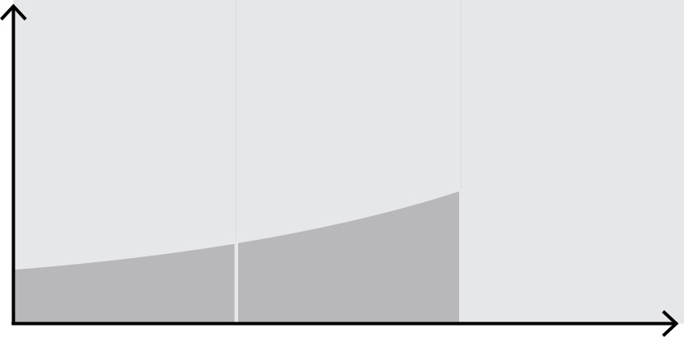
Persistence of threat
Evolution of attacks
2003-2004
2005-2012
Script Kiddies
BLASTER, SLAMMER
Motive: Mischief
Organized Crime
RANSOMWARE,
CLICK-FRAUD,
IDENTITY THEFT
Motive: Profit
Sophistication
Notes:
Slide objectives
Continue to describe how cybercrime has evolved, from 2005 to 2012.
Main messaging
In 2004, Microsoft shipped Service Patch 2 for XP (XP SP2), which was effective at stopping some of the key vulnerability exploit techniques.
It was with Vista’s launch in 2006 that Microsoft implemented many of the key aspects of the defense in depth strategy:
Ensuring that all engineers are trained on security;
Developing the security development process (SDL);
Establishing security by design;
Driving innovations, such as BitLocker.
It’s worth noting that Microsoft significantly postponed the launch of Vista to implement these changes.
By 2006 and Vista, Microsoft started to see a lot less of script kiddies: the level of difficulty had been increasing substantially, eliminating most of them.
However, script kiddies were quickly replaced with organized crime groups motivated by the potential of profit. These groups have become adept at monetizing cyber-crime and they often run multi-million dollar organizations that:
run click fraud campaigns;
steal identities which can be sold on an increasingly prolific black-market;
use ransomware to encrypt information, from business documents to family photos.
In summary, from 2005 to 2012, attacks got more sophisticated, more targeted, and more lucrative.

Slide 27

Persistence of threat
Evolution of attacks
2003-2004
2005-2012
2012 - Today
Script Kiddies
BLASTER, SLAMMER
Motive: Mischief
Organized Crime
RANSOMWARE,
CLICK-FRAUD,
IDENTITY THEFT
Motive: Profit
Sophistication
Nation States, Activists, Terror Groups
BRAZEN,
COMPLEX,
PERSISTENT
Motives:
IP Theft,
Damage,
Disruption
Targeting
Notes:
Slide objectives
Complete the discussion of evolution of attacks, ending in the present.
Main messaging
From around 2012 Microsoft started to see a big shift where nation states, cyber activists and even terror groups started to get involved in cyber-attacks.
They often targeted the private sector or indeed each other, using the private sector as a battle-field.
Some of the attacks from these actors were at highest levels of sophistication.
Their motives seem to have changed: causing damage and disruption rather than just undertaking mass IP theft.
These type of attacks can and do cause substantial damage, physical, commercial and reputational, to targets.

Slide 28
Cybercrime challenge
Significant organized crime element
Disruption and dangers
to critical infrastructure
and systems
Impact
goes beyond finances
Invasions
of privacy
Reduced
innovation
Content related crime including child pornography, and extremist recruiting
Decreased
trust
Notes:
Slide objectives
Underline that the costs of cybercrime go well beyond just financial impact
Main messaging
In addition to these economic costs, there are a number of other important, if less immediately tangible costs from cybercrime
Lost confidence in internet commerce and online services, potentially resulting in negative impacts on national economies overall;
Erosion of individual privacy, as a result of constant attacks and increased government regulatory reactions;
Slow adoption of cloud-based innovation and reduced benefits of promising new technologies, resulting from lost of trust in security of new technologies;
Disruption and actual destruction caused by attack against critical infrastructure;
Funding of other criminal activities with money made by organized crime groups through profitable, hard to trace cybercrime;
The personal and societal cost of content-related cybercrime, notably child pornography.

Slide 29
Approaches to cybercrime laws
Notes:
Section objectives
Set out thinking around six core principles for good cybercrime law

Slide 30
Legal frameworks are essential to fighting cybercrime
Deterring perpetrators and protecting citizens
Enabling law enforcement investigations while protecting individual privacy
Enabling cooperation between countries in criminal matters involving cybercrime and electronic evidence
Requiring minimum protection standards in areas such as data handling and retention
Providing fair and effective criminal justice procedures
Setting clear standards of behaviour for the use of computer devices
Notes:
Slide objectives
Make the general case for governments to adopt modern legal frameworks to fight cybercrime
Do we need new laws? Or can we adapt old ones?
Question:
Under current law, would it be illegal to…
Main messaging
Legal measures play a key role in the prevention and combating of cybercrime.
Law is dynamic tool that enables the state to respond to new societal and security challenges, e.g.
the appropriate balance between privacy and crime control;
the extent of liability of corporations that provide services.
Cybercrime law must achieve several things:
Enable international cooperation in criminal matters
Provide for fair and effective criminal justice procedures
Enable law enforcement investigators while protecting privacy
Set clear standards for the use of computer devices
Require minimum standards in areas such as data handling and retention
Deter perpetrators
However, technological developments mean laws must grapple with new concepts and objects, that they have not traditionally addressed.
In many states, laws on technical developments date back to the 19th century.
These laws were, and to a great extent, still are, focused on the physical objects around which industrial society revolved.
They do not take into account the particularities of information and IT, e.g. crimes generating electronic evidence or the existing of non-physical, intangible objects, such as data or information.
The question before us is, therefore: Do we need new laws? Or can we adapt old ones?
Equally, we should ask how can we ensure that our new laws can stand the test of time?
Question:
Under current law, would it be illegal to…

Slide 31
Best practice principles
Investigative powers
Empowers law enforcement through clear due process
Outcome focused definitions
Preserve ability to persecute new forms of crime
Privacy protections
Designed with privacy in mind
Cooperation with private sector
Enabling cooperation and public private partnerships
Jurisdiction
The scope of law enforcement activity limited by physical borders
International cooperation
Establishes the framework for international cooperation
Notes:
Slide objectives
Set the tone for the next six slides by outlining Microsoft’s view on the six best practices in developing national frameworks
Main messaging
A state’s answer to the previous slide’s question is largely dependent on that state’s existing laws, legal structures and traditions. Governments around the world take slightly different approaches to cybercrime legislation:
some have stand-alone laws (cybercrime laws);
E.g. Kenya’s “Cybercrime and Computer Related Crimes Bill”
some incorporate them into legal frameworks that deal with the online environment overall (electronic commerce laws);
E.g. Namibia’s “Electronic Transactions and Cybercrime Bill”
some merge them with data protection and general cybersecurity frameworks.
E.g. South Africa’s “Cybercrime and Cybersecruity Bill”
Microsoft has, therefore, identified six broadly applicable best practice principles to guide governments in their development of national cybercrime frameworks:
Follow clear due process in investigatory activity;
Put forward outcome focused definitions to ensure laws can stand the test of time;
Design with privacy in mind;
Enable public private collaboration: only together can the public and private sector truly understand the threat facing them and find new ways to challenge it;
Be precise in establishing jurisdiction: states are still limited by their physical borders;
Focus on international cooperation.

Slide 32
1. Create necessary investigative powers
Clear scope of application of the power, in order to guarantee legal certainty in its use
Real time collection of data
Remote access search
Preservation order
Sufficient legal authority for actions such as ensuring preservation of computer data, and the collection of stored and real-time data
Disclosure of traffic data
Order for computer
data
Search and seizure
warrant
Notes:
Slide objectives
Discuss the complexity of investigating cybercrime and the need for legislation that defines and enables appropriate investigative powers for law enforcement
Main messaging
When looking at existing powers we should ask:
Is their scope of application sufficiently clear that they can be applied with legal certainty to cybercrime?
Is their sufficient legal authority to underpin then application of those powers in the next contexts created by cybercrime?
With respect to cybercrime, clearly defining these powers is important because of the international nature of cyber crimes and investigations.
As can be seen from the slide’s examples, there are a range of powers seem necessary in tackling cybercrime:
In order to secure the non-physical, intangible evidence generated by cybercrime, investigators will need to be able to access various types of stored data, possibly located in other countries.
This data could be held by the victims or the accused, or it could held by internet service providers, platforms or others that might have been, in the language of the physical world the “scene of crime”, “witnesses”, “accessories”, etc.
Investigators will not only need to have access to that data they must also be able to ensure that it is preserved until they do so.
They will also need to be able intercept or access data as cybercriminals are “in the act”, in real time. In some ways the 21st century equivalent of a wire tap.

Slide 33
2. Define crimes in an outcome focused way
Acts against confidentiality, integrity and availability of computer systems
Illegal access to a computer system
Illegal access, interception or acquisition of data
Illegal interference with a computer system or data
Production, distribution or possession of misuse tools
Breach of privacy or data protection measures
Fraud or forgery
Identity theft
Copyright or trademark abuse
Spam
Solicitation or “grooming” of children
Acts for personal or financial gain or harm
Child pornography
Terrorist related content
Content
related acts
Notes:
If we try too hard to legislate a process, will need to continually update the laws.
Question:
Slide objectives
Introduce the different categories of cybercrime typically used – Budapest Convention
Show that outcome-oriented legal definitions are the best basis for new cybercrime laws
It’s important when defining crime that the definitions are specific enough to be workable, while broad and forward looking enough to encompass new, but as yet unknown, tactics that cybercriminals may employ.
Main messaging
The Budapest Convention on Cybercrime identifies different categories of cybercrime:
Acts again confidentiality, integrity and availability of computer systems: Breaches and hacks;
Acts for personal or financial gain or harm: These crimes also exist offline, but use ICT to commit fraud, or identity theft;
Content-related acts: Crimes that are not specific to cyber, but use technology to disseminate illegal content, such as child pornography.
Earlier we said old laws often cannot take into account the new particularities of cybercrime, e.g. electronic evidence.
Equally we may need to take into account that old legal definitions of what constituted a criminal act might need to be complemented by new thinking about what constitutes a criminal outcome. It’s also important to consider that the punishment fit the crime as new crimes and tactics emerge. For example, small-time ransomware cases might either be punished as misdemeanors when similar crimes in the physical world would warrant that, or might be punished as felonies when done dozens or hundreds of times.
In this way we can ensure that as technology continues to develop, creating new potential criminal acts, our outcome focused laws can still apply.

Slide 34
3. Privacy Policy
Effective cyber crime investigation
Balance privacy with investigative powers
Societal Acceptance
Conflict of laws & compliance dilemmas
National or Regional
Cross border or international
Notes:
Question: What are some ways investigative powers might conflict with privacy concerns with cybercrime?
Slide objectives
Outline the challenge of balancing privacy with investigative powers necessary to fight cybercrime.
Main messaging
It’s important when defining crime that the definitions are specific enough to be workable, while broad and forward looking enough to encompass new, but as yet unknown, tactics that cybercriminals may employ.
This can lead to establishing expanded and potentially more intrusive investigative powers;
Any such moves must be balanced with existing privacy expectations, laws and norms.
Failure to balance privacy considerations could make enforcement worse than the crime, from a societal acceptance perspective
Cybercrime enforcement increase trust in, and willingness to adopt, new technologies but this could be more than offset by unchecked investigative powers that users feel go too far.
This can be culturally specific; European perspectives on privacy are different from those in the United States or across Asia.
In addition, there is potential for conflict of laws across international jurisdictions.
An order to produce data or information stored in another country might force a provider to violate the privacy laws of the country in which the data is stored.
The potential for conflict and impossible compliance situation requires international agreements and conventions to bridge the gap, and ensure certainty and transparency for consumers, businesses and law enforcers.

Slide 35
4. Enable cooperation with private sector
Enable rather than inadvertently criminalize researchers and private investigation
Enable information and data sharing between and among the private sector and law enforcement
Consider methods of private enforcement
Consider methods of private active defense
Notes:
Slide objectives
Outline ways in which the private sector can be enabled to help in the fight against cybercrime.
Main messaging
New approaches to going after the criminals are going to be needed and finding ways to scale enforcement efforts will be critical. Better public private partnerships (PPP) and more/better private enforcement are options for doing so.
Working with industry on best practices and emerging issues, would allow governments to take advantage of the expertise and resources of the private sector in the fight against cybercrime.
This could be technology suppliers educating enforcement officials about new and emerging threats in the real world that they and their customers see as priorities.
It could also mean enabling information sharing within the private sector and with law enforcers, which can be inadvertently hindered by data protection and privacy rules.
An effective PPP approach could more proactively harness the ICT industry’s extensive understanding of the technologies and of those who abuse them.
There is a clear case for empowering a level of research and investigation into cybercrime by responsible private sector groups.
This is not to give them legal power or to enable “vigilante” behaviour but to supplement law enforcement’s abilities with those of the people making the products and services underpinning the “cyber scene of crime”.
Taken to its logical conclusion, however, there is a case for looking at the role of private enforcement.
Private companies can act in certain circumstances to deter, protect, or recover from cybercriminals, either on their own or in cooperation with law enforcement
After all, cyberspace is fast moving and complex, so greater latitude for action by private players means greater speed and flexibility of response.
Is “retaliation” something companies should be able to engage in?
On the one hand, vigilantism or corporate extra-judicial actions do not look any more attractive online than they do in the real world.
On the other, ‘hack back’ falls short of the ‘tit for tat’ retaliation, and instead can facilitate law enforcers in catching criminals, disrupting their operations, or depriving them of the fruits of their illegal conduct.
E.g. The digital equivalent of “dye packs” could help trace criminals through what they steal.
If genuine process is to be made on this issues, the technology industry, law enforcers, lawyers and concerned society groups will have to consider at least three questions:
What is technically feasible?
What is legal and for whom?
What will it be wise to do?

Slide 36
5. Address jurisdictional issues
Criminal attacks can originate from anywhere
Love Bug Virus
Originated in the Philippines in 2000
Spread through email “I love you” in subject line
Overrode files and sent a copy of the email and virus to everyone in the email address book
Est. $10 billion in economic damage
Perpetrator could not be persecuted as no law in the Philippines at the time prohibited the conduct
Even intra-country crimes often involve computers and service providers located in other countries
Inadequate legal frameworks can create “safe haven” countries
National sovereignty may limit ability to obtain evidence in other countries
Timely cooperation between enforcement bodies is important but difficult
Notes:
Slide objectives
Underline that governments need to address their own jurisdictions as well as cooperate internationally (which is set out in next slide).
Main messaging
Cybercrime is not just complicated because of novel and innovative technologies: it is complicated because it is borderless, like the Internet.
Increasingly, cybercrime is committed by organized groups operating in one country that target victims in another.
There is clearly a case for cross-border cooperation, which we will come to in a minute, but equally important is the addressing inadequate legal frameworks in some countries.
Inadequate frameworks create safe havens for cybercriminals, since their actions may be criminal in the target’s country but not in the country in which they are based.
One example of this is what happened with the Love Bug virus from 2000.
The virus originated in the Philippines and caused wide-spread, international economic damage.
The responsible party was identified quickly but never brought to justice, because at the time, the Philippines did not have a cybercrime law and what he did was not considered a crime.
It seems likely that more and more states will see the need for domestic cybercrime laws:
The need will become obvious as computers, the Internet, etc. become increasingly involved in crimes within that state.
Furthermore, as a state’s citizens, businesses, public bodies and critical infrastructure become subject to cybercrime from outside its national borders, the more obvious will be the need for cross border harmonization of cybercrime legislation.
Even if a state’s criminal law asserts jurisdiction over a perpetrator in another state, that other state will still have to cooperate, which it may not do if the act isn’t considered to be criminal locally.
The spread of national cybercrime laws is an essential prerequisite for the harmonization needed by law enforcers to act against cross-border cybercriminals.
These law enforcement efforts can be pursued with due respect to the sovereignty of all nations, especially those that have clearly formulated their approaches to cybercrime and the fundamental rights and liberties of their citizens.

Slide 37
6. Build global cooperation
SCO Membership*
(including Observers)
African Union Convention
on Cybersecurity*
Budapest Convention on Cybercrime* (ratified, signed and invited to accede)
Have cybercrime laws in place (includes the vast majority of *)
Notes:
Slide objectives
Underline the importance of international cooperation and harmonization of legal frameworks
Main messaging
The map here shows the countries which have cybercrime laws in place today and the main mechanisms for Harmonization and Cooperation among nations on cybercrime
The Budapest Convention on Cybercrime (Council of Europe); ratified by 50 nations (including non members US, Japan, Australia, Canada) and used as a model by many more;
The Shanghai Cooperation Organization (SCO) which governs much the former eastern block and the non-aligned states, including South America, the Middle East and Asia;
The African Union (AU) Convention, which came into force a few years back and it is a great initiative, but has sadly not been adopted widely;
The Commonwealth of Independent States (CIS) Agreement which covers much of the former USSR;
The League of Arab States Convention on Combating Information Technology Offences, which takes in the Gulf States, North Africa and the Horn of Africa.
This matrix of overlapping regional approaches and standards in how to address cybercrime demonstrates the challenge touched on in the previous slide:
Even with national cybercrime laws coming into effect, and some level of commonality within certain regions, the existing differences can cause problems for law enforcers and opportunities for cybercriminals.
A concerted effort is needed therefore to make the next steps towards greater global harmonization by:
Tackling criminal safe havens;
Addressing principle of dual criminality;
Enabling global evidence collection.
To avoid criminal safe havens: In the field of cybercrime, as for all transnational crimes, the main advantage of harmonizing criminal law lies in the prevention of cybercrime safe havens for perpetrators.
If harmful acts involving the internet are criminalized in State A, but not in State B, a perpetrator in State B can be free to target victims in State A via the internet.
If State A cannot, on its own, effectively protect against effects from such transnational activities, it will require consent or assistance from State B, e.g. gathering evidence or extradition, which State B is unlikely to give.
NB the Love Bug example from the previous slide.
The principle of dual criminality: This is central to many forms of international cooperation and will be important to cross-border cybercrime enforcement. It can be found, for example, in multilateral and bilateral extradition treaties, as well as national laws. It recognises that to protect persons within its own jurisdiction a state is unlikely to assist where the conduct in question is not also criminalized domestically.
Dual criminality plays a role in mutual legal assistance, such as requests for interviewing of witnesses, or collection of evidence.
While not all mutual legal assistance agreements between states include this requirement, many instruments ensure that coercive or intrusive measures, such as search and seizure, or freezing of property, are subject to dual criminality.
To enable global evidence collection: The harmonization of procedural law is another indispensable requirement for effective international cooperation on cybercrime.
As per the above example, if State B does not have the necessary procedural power for expedited preservation of computer data, then State A will not be able to request this facility through mutual legal assistance.
In other words, a state can only provide assistance to another state to the extent that it could do for an equivalent national investigation of its own.

Slide 38
Call to action in cybercrime law
Develop new ways to prevent cybercrime
Facilitate information sharing
Adopt laws that are consistent with broadly accepted international conventions
Strong enforcement and balanced rules
Work with industry on best practices and emerging
issues
Notes:
Slide objectives
Deliver call to action
Main messaging
To strengthen enforcement in a balanced way, governments should consider the following steps:
Strong enforcement and balanced rules. To fight cybercrime effectively, law enforcement and industry must have the legal tools necessary to pursue cybercriminals wherever they are.
Governments should work to update their criminal laws so that they are capable of addressing both existing and emerging threats posed by online criminals.
At the same time, these laws should be conscious not to adversely affect innovation or the adoption of new technologies. They should also support efforts at industry self-regulation.
Adopt laws that are consistent with broadly accepted international conventions. The Council of Europe’s Budapest Convention provides a good model for cybercrime legislation that can help harmonize laws and drive better cooperation across borders.
International coordination and cooperation will help eliminate safe havens for malicious actors.
It will also minimize the risks that arise when intermediaries and other innocent parties are subject to conflicting obligations or liabilities.
Facilitate information sharing. In some cases, companies with information about online crimes face potential liability under privacy, data protection, or other laws if they voluntarily share that information with law enforcement.
To facilitate and encourage timely cooperation, governments should clarify rules for data-sharing by companies with law enforcement. Lack of clarity about rules for information-sharing and liability risks may prevent companies from working with law enforcement agencies, even when cooperation could be critical to preventing or responding to cybercrime.
Enhancing the procedures and mechanisms for international, cross-border cooperation by modernizing mutual legal assistance processes will help streamline enforcement efforts and help clarify important issues related to jurisdiction and access to evidence.
Develop new ways to prevent cybercrime. Current efforts to enforce laws against cybercrime are woefully inadequate given the enormity of the problem. New approaches to going after the criminals are needed.
One example may be a pilot program launched by the City of London police in partnership with private law firms using civil courts to seize cybercriminals’ assets.
Finding other ways to scale enforcement efforts will be critical.
Study potential “hack back” or “active defense” technologies and practices
Work with industry on best practices and emerging issues. Governments can take advantage of the expertise and resources of the private sector in the fight against cybercrime.
Opportunities include working with industry to educate enforcement officials about new and emerging threats that technology suppliers experience in the real world and that their customers see as priorities.
Governments often lack sufficient resources to deal effectively with cybercrime. Working with the private sector can help them achieve greater success, which will help drive trust in online computing.

Slide 39
Fundamentals of the Cloud
Notes:
Overall presentation objectives
Demonstrate MSFT’s thought leadership in digital transformation
Underline the importance of cybersecurity and cybersecurity policy for digital transformation
Target audiences for this presentation
PRIMARY:
Cybersecurity decision makers, e.g. national cybersecurity agency, ICT ministry and/or regulator, national standards bodies.
Government stakeholders dealing with cloud computing, procurement authorities
SECONDARY:
Stakeholders concerned with technology, risk management and future planning, e.g. special government units that oversee technology-related cross-sectoral initiatives such as smart cities, economic planning authorities, etc.
Business or industry associations in ICT sector

Slide 40

Cloud computing is:
“[A] Paradigm for enabling network access to a scalable and elastic pool of shareable physical or virtual resources with self-service provisioning and administration on-demand” –ISO/IEC DIS 17788:2015
E-mail
Blogs & tweets
E-commerce
Search
Photos
Videos
Social networking
Music
E-government
Notes:
Pause and ask – This is a wordy & technical definition. Develop your own answer, in more simple language, to “what is cloud computing?” or try and explain this definition.
QSSSD

Slide 41
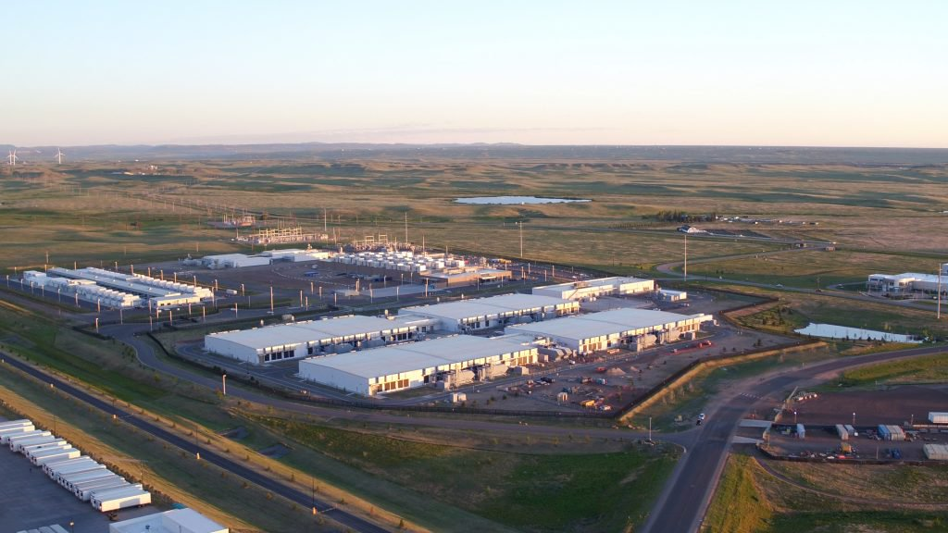
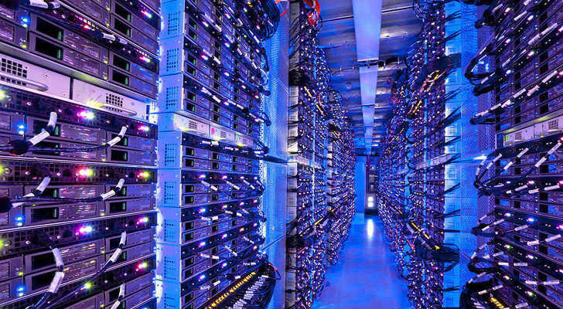
What do we mean by “cloud?”
Filled with thousands of rows of server racks housing customer data
Made up of massive datacenters of concrete and steel
Notes:
Slide objectives
When people talk about to “the cloud” they are in fact referring to data stored in massive datacenters around the world, which are each filled with many thousands of servers.
Main messaging
The cloud is not an abstract concept, it is a physical space with physical boundaries, requirements and limitations
These physical resources dedicated to the Azure cloud are commonly referred to as the “Azure Fabric” on which all the Azure cloud services run

Slide 42
Characteristics of cloud computing
Network access to cloud services
Pay only what you need from a measured service
Multi-tenancy – many customers in same space
On-demand self-service to scalable resources
High bandwidth links to and between datacenters
1
2
3
4
5
Notes:
Explain the technical characteristics that define the cloud

Slide 43





Business & government in the cloud
Email
Social Networking
Photos
Music
E-commerce
Search
Online Games
Videos
Blogs & Tweets
E-government
PRODUCTIVITY
LOWER COSTS
NEW SERVICES
Lower Costs
Notes:
In principle, the goal of the cloud is to accomplish 3 things
Increased productivity – based on faster access to more resources as needed
Lower costs – based on the ability to outsource storage, computing and security requirements
New services – lowers barrier to entry for new businesses, and easier access to services of others far away

Slide 44
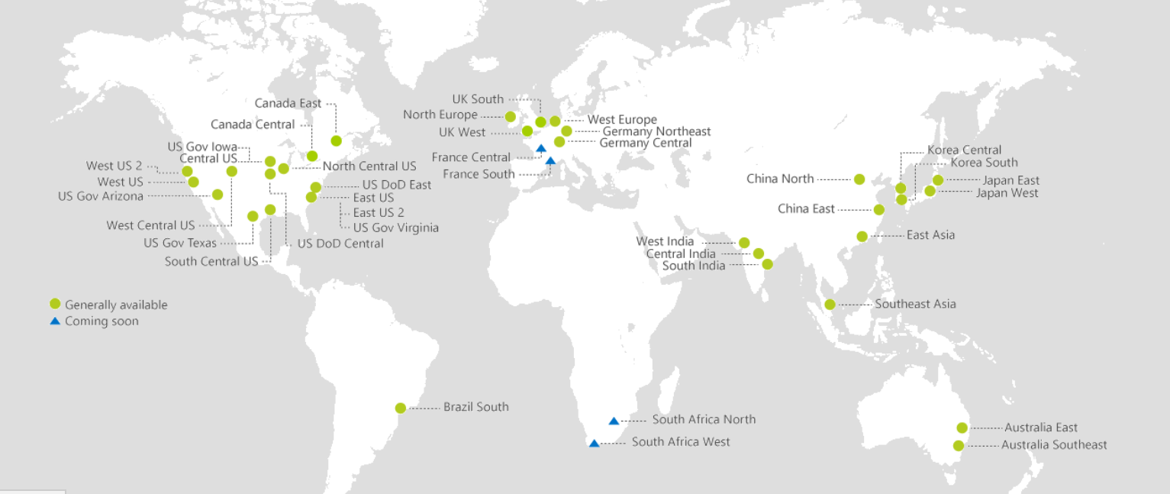
Large public cloud services have near-global reach
Cloud needs global scale – the larger the network, the greater the economies of scale
A global network of data centers provides seamless service, higher reliability and service availability to customers
  35+ factors in site selection:
  Proximity to customers
  Energy, fiber infrastructure
  Skilled workforce
  Regulatory environment

Slide 45



Options for services and deployment
Service models
Deployment models
hybrid
private
public
  Infrastructure as a Service (IaaS)
  Platform as a Service (PaaS)
  Software as a Service (SaaS)
CHOICE
Environment operated solely for a single organization; it may be managed by that organization or by a cloud service provider.
Public or private environments remain unique entities but are bound together with on-premises ICT by common technology that enables data and application portability.
Multi-tenant environments in which cloud service providers own and make available to the general public their cloud infrastructure, including storage and applications.
Source: Cisco
Notes:
Hybrid models: Azure Stack is a hybrid cloud model that lets you deliver cloud services from your organization’s datacenter, while balancing the right amount of flexibility and control.
In global deployment contexts, sometimes you need to host different instances of the same application to Azure or Azure Stack, depending on your business and technical needs. Develop and deploy applications in Azure, with full flexibility to deploy on-premises using Azure Stack to meet your specific regulatory or policy requirements—without changing any code.
The implementation of apps can be done on-premise, and other apps that we can shift into the public Azure cloud, we can move them from Azure Stack (on-prem) to Azure (public)

Slide 46
Three service models:
  Infrastructure as a Service (IaaS)
  Platform as a Service (PaaS)
  Software as a Service (SaaS)
Notes:
Section objectives
Give a definition of digital transformation/digitalization that will underpin the rest of the presentation.

Slide 47

Infrastructure as a Service (IaaS)
With Infrastructure as a Service customers access raw computing resources in the form of storage space, various sizes of virtual machine, networking services, and other related management tools.
Customers pay for time and space on a server(s).
Responsible to install and manage their own operating system and software.
Examples:
AzureStack, ExpressRoute
Infrastructure Services
Compute
Storage
Network
Virtualization Fabric

Slide 48
Platform as a Service (PaaS)
Platform as a Service offers customers direct access to services rather than to raw computing resources for application design and deployment.
The PaaS model provides metered (pay as you go) access to services.
Cloud service is responsible for individual virtual machines, and managing basic resources.
Examples:
Azure App Service & IoT device analytics
Platform
Services
Security & Management
Operations
Infrastructure Services
Compute
Storage
Network
Virtualization Fabric

Slide 49
Software as a Service (SaaS)
Software as a Service are the cloud applications, usually designed for end-users, accessible by internet-connected devices anywhere.
Customers pay to use particular applications that are developed and exist on the cloud.
Cloud service handles most of the work to build and deliver a service.
Examples:
Office365, Google apps, Whatsapp, Signal
Applications
Platform
Services
Security & Management
Operations
Infrastructure Services
Compute
Storage
Network
Virtualization Fabric

Slide 50
Cloud service models
Software as a Service (SaaS): cloud applications
  Google Apps, Microsoft O365
Applications
Platform as a Service (PaaS): On-demand application-hosting environment
  Google AppEngine, Salesforce.com, Windows Azure
Platform
Services
Security & Management
Operations
Infrastructure Services
Infrastructure as a Service (IaaS): basic compute, network and storage resources
  On-demand servers
  Amazon EC2, VMWare vCloud
Compute
Storage
Network
Virtualization Fabric
Notes:
Pulse Check:
If I am accessing Netflix to watch a movie, is that IaaS, PaaS or SaaS?
If I am purchasing space in a data center to store government records, is that IaaS, PaaS or SaaS?

Slide 51

Three deployment models:
hybrid
private
public
CHOICE
Notes:
Section objectives
Give a definition of digital transformation/digitalization that will underpin the rest of the presentation.

Slide 52


Choice of cloud deployments
From…
Connected to…
On-premises
Cloud Service Provider
Private Cloud
Commercial Public Cloud
Regional Cloud
Country Cloud
Deployed on agency or government infrastructure using cloud technologies to increase efficiency and reduce cost
Secure public cloud with worldwide redundancy and access
All government and/or enterprises in a region access a cloud service, with two datacenters in region for redundancy.
Deployed public cloud resources located within a specified country to satisfy local data residency requirements, perhaps accessed by other governments and/or agencies
Lowest cost, widest access for processing appropriate data
Useful where there are consistent regional norms
Countries with large computing needs and regional leadership
Notes:
Objective: Explain and differentiate between different cloud deployments
Private cloud – Exclusive physical space for a particular organization. Can be managed on premises or by a dedicated space from a cloud service provider.
Public cloud – based on the standard cloud-computing model. A service provider makes resources, such as virtual machines (VMs), applications or storage, available to the general public.
Constrained by national and regional regulatory and legal requirements
Hybrid – a combination of private or on-premises cloud deployments and public cloud services.
EX. Government classified servers vs public cloud usage

Slide 53

Building a cloud:
Exploring the technology and security of cloud computing
Notes:
Overall presentation objectives
Provide a basic, 101-level, explanation of Azure and its associated services
Target audiences for this presentation
Those with policy influence but limited understanding of cloud

Slide 54

Cloud computing – back to basics
Three ways, service, models, to consume cloud computing:
Infrastructure as a service - computing resources are provided in the form of dedicated physical servers, or virtual space within a server.
Customers pay for the particular computing services they will use in a datacenter.
IaaS
Platform as a service - offers customers direct access to services, rather than to computing resources, housed remotely in datacenters.
Provides metered – pay as you go – access to various services.
paas
Software as a service - oriented more towards the end user experience, with users using remotely-based software.
Microsoft has SaaS products (Office365), but it is not an Azure offering.
Saas
Notes:
Slide objectives
Review broad understanding of the IaaS, PaaS and SaaS models
Main messaging
IaaS – Analogy: this would be akin to having a particular safe deposit box where you keep your $. Same place each time. You are effectively renting space in the bank.
PaaS - Platform as a Service offers customers direct access to services rather than to computing resources. Where under IaaS a customer might pay for time on a virtual machine and then need to install and manage their own operating system and software, the PaaS model provides metered (pay as you go) access to services like SQL databases, machine learning based translation software, and security products like the Azure Security Center.
SaaS – Software as a Service is cloud computing for the end user, who is simply using software that exists remotely. A good example would be Microsoft365. However, Azure does offer a specific SaaS product, and so will not be the focus of this presentation.
This presentation is going to focus on the technology and security considerations for IaaS and PaaS services.

Slide 55
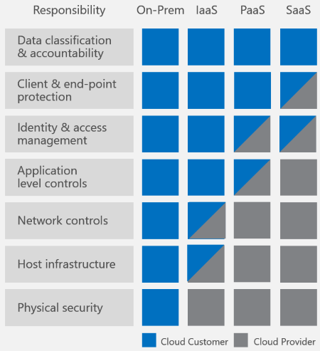
Security responsibilities
The various cloud services require different levels of customer engagement and responsibility for security.

Slide 56

Today: looking under the hood of the cloud
Technology underpins Architecture which supports Operations
The cloud offers new
risks and benefits
for policymakers to consider

Slide 57
The technology of the cloud
Hypervisor
Software-Defined Networking
Container managers
Datacenters
Broadband
Hypervisor
Software-Defined Networking
Container managers
Datacenters
Broadband
Enables SaaS
Enables PaaS
Enables IaaS
Notes:
Slide objectives
Overview of the technology that underpins the cloud services provided by Azure
Main messaging
Discrete technological capabilities allow for the cloud to operate, and provide for IaaS and PaaS services respectively.
The technology is all designed to allow information in the cloud to be dissociated and dissolved into component parts, separated and then reassembled instantly as needed.
1. Datacenters – allow for the remote storage of information, the existence of the cloud
2. Software-Defined Networking – allows machines in the datacenter to talk to each other, to maximize efficiency
3. Hypervisors – allow data to be isolated within a server
4. Container managers – allow software to be separated within operating systems

Slide 58
Datacenters: Foundations of the Cloud
Datacenters
Notes:
Section objectives

Slide 59
Technology – datacenters
Datacenters
Data centers are the heart of the cloud: miles of wiring for networking and power
Built and operated for maximum power and temperature efficiency
Notes:
Slide objectives

Slide 60
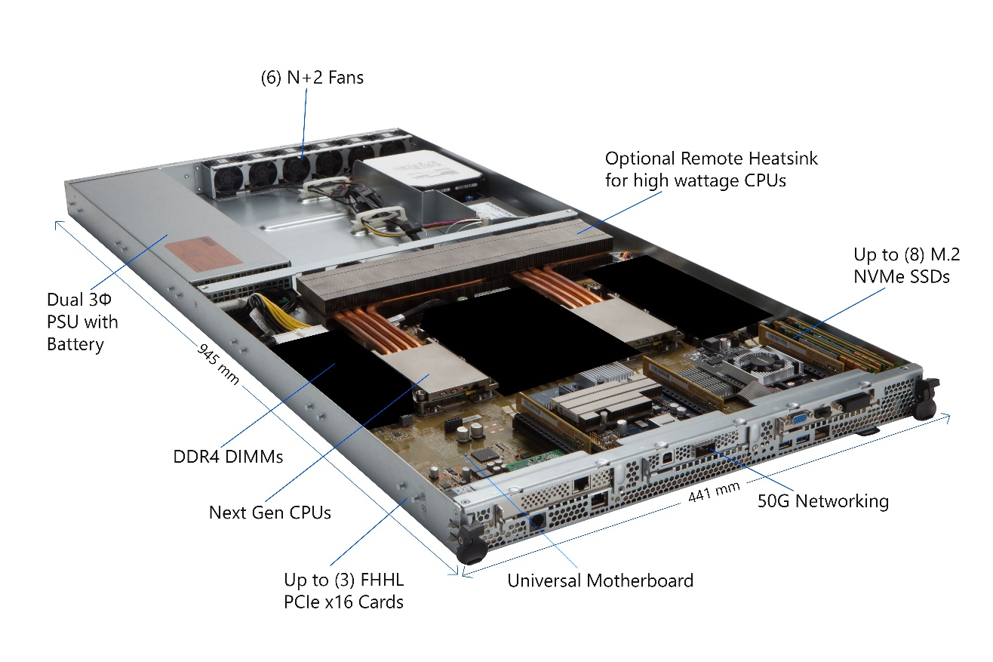
Architecture – servers
Datacenters
The datacenters are filled with thousands of rows of racks, filled with dozens of servers.
Your average server will have:
processor
storage
network card
memory
motherboard
Notes:
Slide objectives

Slide 61
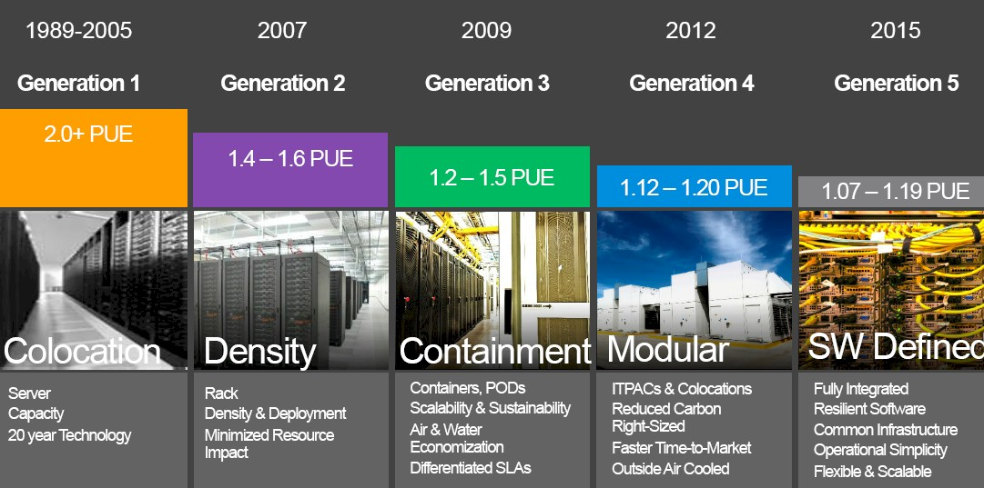
Operation – generations of power & cooling
Datacenters
Challenge: efficient power use and cooling of the equipment
The latest cloud offerings include specialized hardware which can often demand even greater power.
Microsoft Azure Datacenters…through the Years
Notes:
Slide objectives

Slide 62
Risks & policy considerations
Datacenters
Technology
Placement – where datacenters are located has much less to do with where they can deliver services than you might think. Strong requirements to localize all the data or software located in the customer’s cloud can create costly duplication and the potential for security gaps.
Physical – disruption from natural disasters, mistake, or intentional harm are a constant danger for these facilities. Preparation, proactive security, and building in redundancy are critical.
Architecture
Access and Identity – Effective security programs include strict controls on identifying employees and allowing access based on role and the permissions of particular hardware. Background checks on personnel working with cloud computing equipment and multiple layers of security at these facilities can help catch threats that flow through the cracks.
Operation
New technologies and adversary innovation can pose novel security challenges. Regulations must allow innovation to avoid locking in insecurity.
Notes:
Slide objectives
Main messaging
Technology –
Architecture – As you have seen in this and the previous section, the architecture of the cloud changes rapidly based on technological capabilities. Therefore, regulations that focus on security outcomes are more likely to provide the desired level of security while allowing for further innovations and improvements in the quality of cloud service
Operation – Widely used vs. esoteric standards – Greater emphasis on unique national standards can make it more difficult for cloud vendors to leverage the cost efficiencies and best practices gained from working with so many other customers.

Slide 63
Software-Defined Networking (SDN):
Wiring the cloud
Software-Defined Networking
Notes:
Section objectives

Slide 64
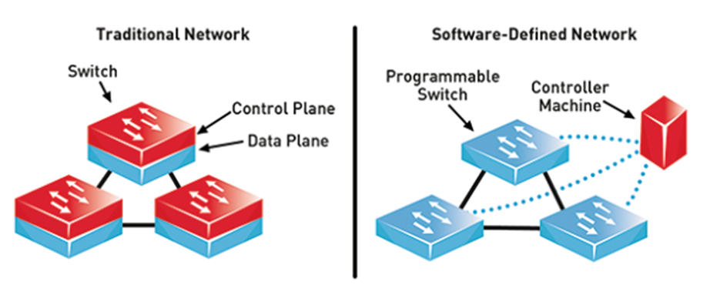
Technology – Software Defined Networking
SDN
SDN takes specialized networking hardware and replicates it in software that runs on general purpose computers.
Instead of having a dedicated machine, such as a router, to coordinate networking activities, they can be written as programs.
Notes:
Slide objectives
Main messaging

Slide 65
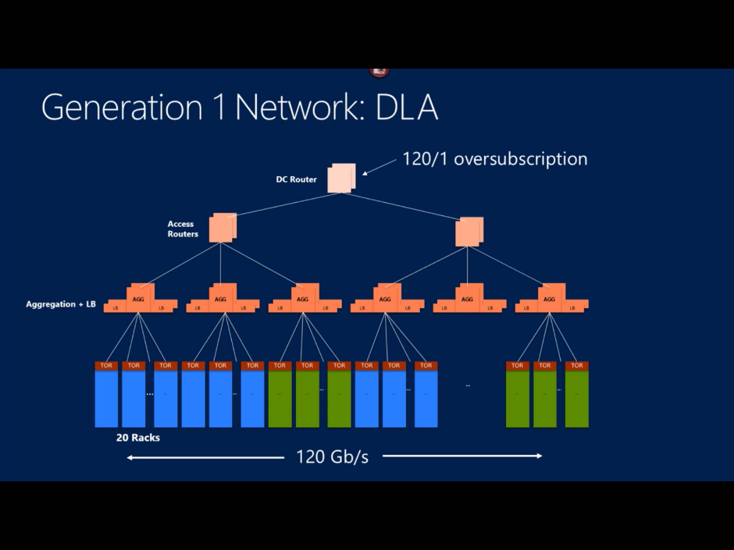
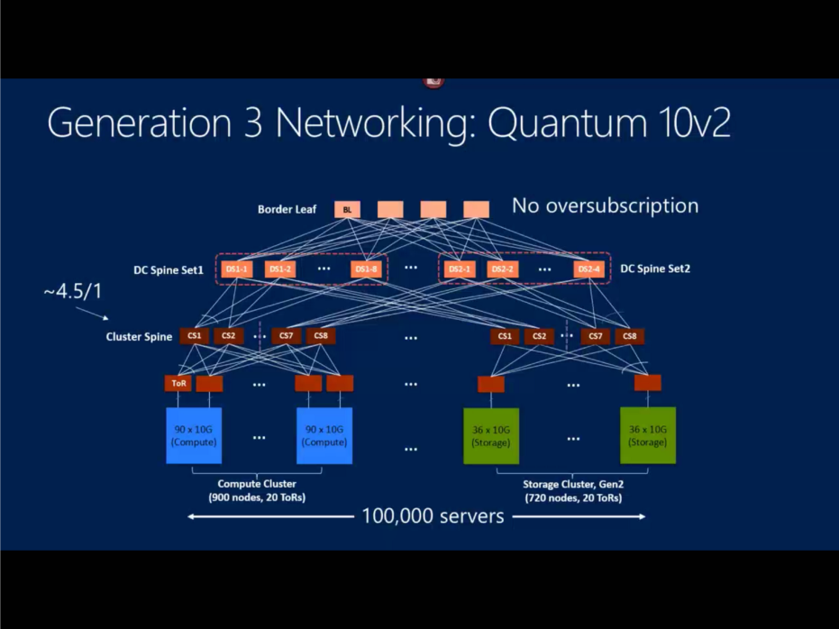
Architecture – networking behind the curtain
SDN
Servers on their own are just computers. Servers talking together are the cloud.
From North/South to East/West Networking
Early cloud datacenters focused on traffic between the user (you) and the server
The latest datacenters emphasize dense traffic between servers as well as to the user
Notes:
Slide objectives
Main messaging

Slide 66
Operations – fast, flexible, and fun-sized
SDN
SDN allows cloud computing to:
Rapidly change the size and shape of networks to meet customer demand
Enforce strong security boundaries between different customers and services
Modify and expand datacenters without severely interrupting network operations
Impose sophisticated security controls across all layers of the network
Notes:
Slide objectives
Main messaging

Slide 67
Risks & policy considerations
SDN
Technology
Requirements for specific kinds or classes of equipment may limit access to the latest technologies and impede the availability of the most secure cloud services.
Architecture
Cloud computing network architecture relies on tremendous intra-datacenter traffic flows. Resilience of these networks and those between datacenters are now more important than ever.
Operation
Regulations based on old conceptions of how networks were defined and laid out may impede such responsive security behavior.
Notes:
Slide objectives
Main messaging

Slide 68
Hypervisors: Enabling IaaS
Hypervisor
Notes:
Section objectives

Slide 69
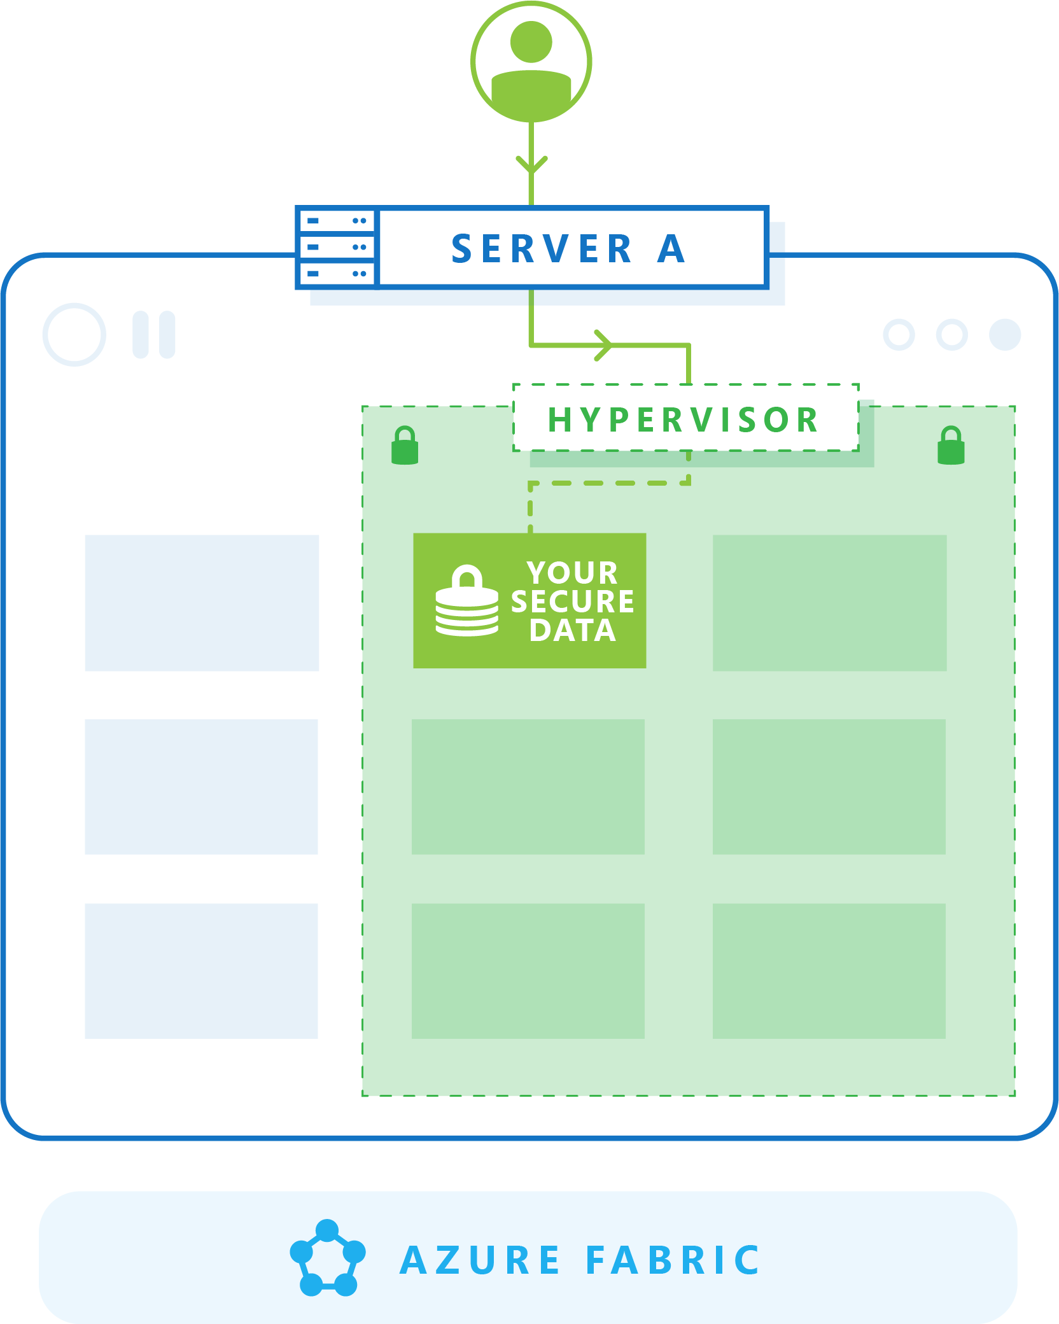
Technology – hypervisor
Hypervisor
A hypervisor is the technology that allows for the logical isolation of data within a single server
The diagram models a hypervisor logically isolating a particular customer’s data within a single server blade
Notes:
Slide objectives
Main messaging

Slide 70
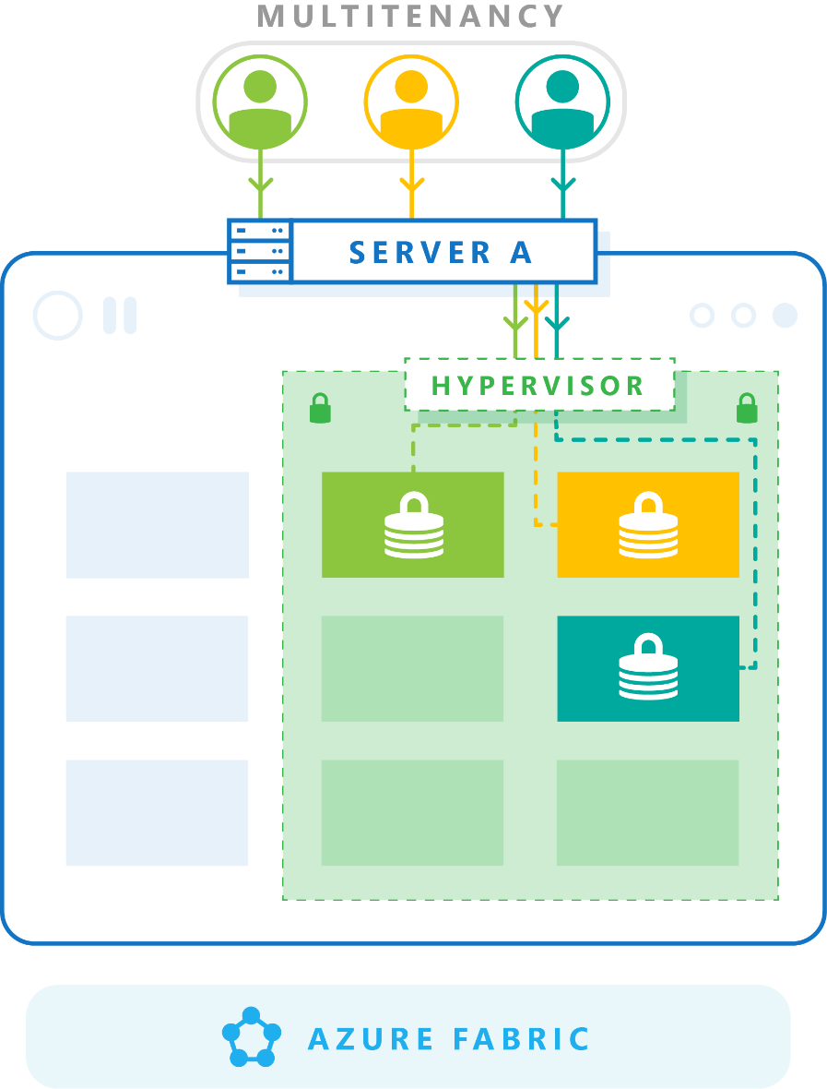
Architecture - virtualization
Hypervisor
The hypervisor technology allows for the architecture of IaaS offerings
Virtualization refers to data being isolated within a single server
Multitenancy is the cohabitation of multiple customer’s data on a server
The diagram now reflects a multitenant server
Notes:
Slide objectives
Main messaging

Slide 71
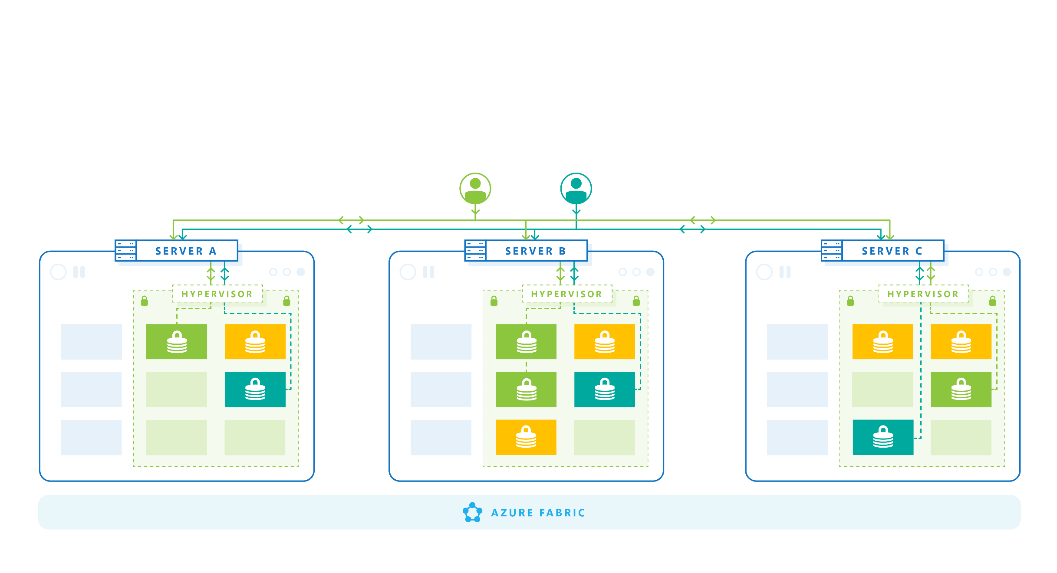
Operation - elasticity & decoupling
Hypervisor
From the architecture, IaaS operations are possible:
Resource elasticity – Computing, storage, and networking resources can be accessed and delivered to customers independently
Decoupling hardware and software – hardware can be replaced entirely independently of the software running on top of it
Notes:
Slide objectives
Main messaging

Slide 72
IaaS security responsibilities
Hypervisor
With Infrastructure as a Service, the customer is buying space on particular physical servers.
Therefore, the customer has more security responsibilities.

Slide 73
Risks & policy considerations
Hypervisor
Technology
Managing thousands of servers and millions of customer environments breeds highly capable automated tools and gives CSPs tremendous scale to learn how to best manage these systems. This allows patches and new software versions to be applied as soon as they are available, reducing vulnerability to attackers exploiting such flaws.
Architecture
Cloud architectures evolve to rapidly deliver new services and security features. Regulations should focus on security outcomes, enabling customers and CSPs to rapidly add new capabilities and functionality.
Operation
Unique national standards can make it more difficult for CSPs to leverage cost efficiencies and best practices.
Global standards are widely available and best when widely used.
Notes:
Slide objectives
Main messaging
Technology –
Architecture – As you have seen in this and the previous section, the architecture of the cloud changes rapidly based on technological capabilities. Therefore, regulations that focus on security outcomes are more likely to provide the desired level of security while allowing for further innovations and improvements in the quality of cloud service
Operation – Widely used vs. esoteric standards – Greater emphasis on unique national standards can make it more difficult for cloud vendors to leverage the cost efficiencies and best practices gained from working with so many other customers.

Slide 74
Container Managers & Microservices: Enabling PaaS
Container managers
Notes:
Section objectives

Slide 75
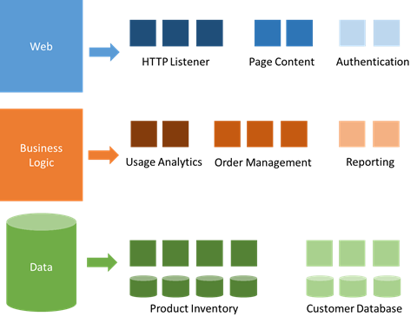
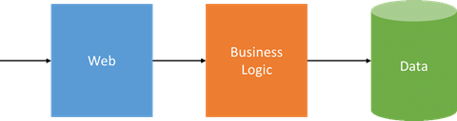
Tech – container managers & microservices
Container managers
Container managers interact between containers and the Operating System; isolating software from software, like the hypervisor isolates software from hardware.
Microservices break-up software into component parts and run them as distinct services.
Traditional monolithic software model
Microservices model
Notes:
Slide objectives
Main messaging

Slide 76
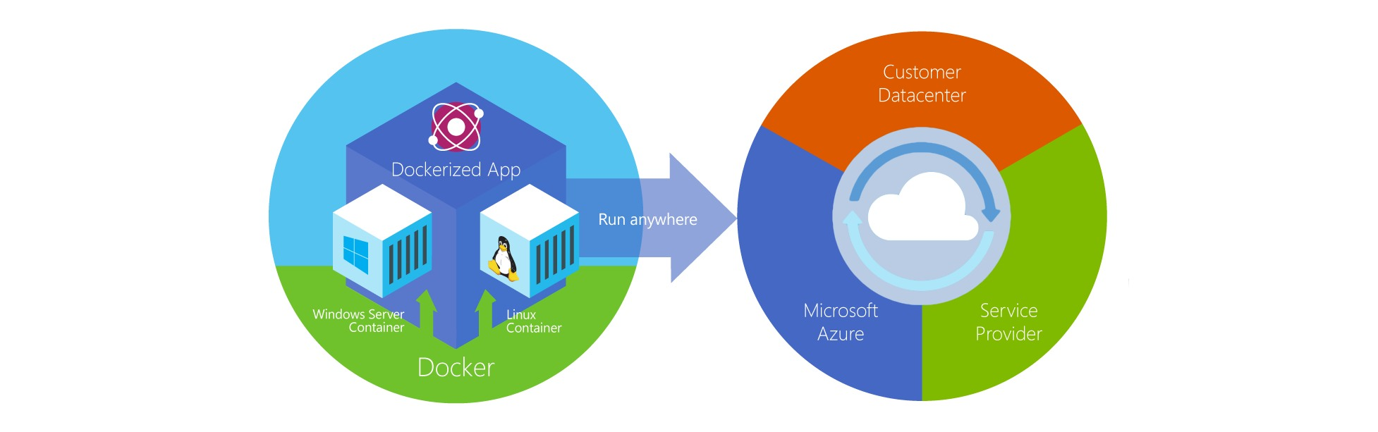
Architecture - containers
Container managers
Containers…
Use the isolation of container managers, and can contain traditional software or much smaller microservices
Allow software to be deployed in a modular fashion – containerize once, deploy a thousand times
All programs, and supporting components, kept in a single container
Notes:
Slide objectives
Main messaging

Slide 77
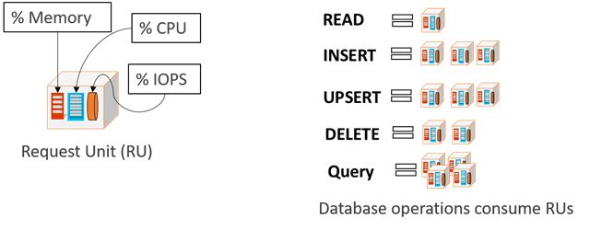
Operation – serverless computing
Container managers
“Serverless”
Combines different measures of cloud consumption, like memory/CPU time, into more relevant compute units like READ or DELETE
New “serverless” compute options allow developers to write simply the core functions of a program then tie them easily together (i.e. Azure Functions)
These different “serverless” options allow applications to run with maximum efficiency, only operating (and thus accruing cost) when in use.
Notes:
Slide objectives
Main messaging

Slide 78
PaaS security responsibilities
Container managers
With Platform as a Service, the customer is running their own programs on space managed by the cloud service provider.
The security responsibilities are more evenly shared between customers and cloud service providers.

Slide 79
Risks & policy considerations
Container managers
Technology
Microservices and other “serverless” computing options may present new challenges for customers to classify data and categorize applications under old regulatory models.
Architecture
Containers mirror the security challenges of standalone software applications and, to a lesser extent, virtual machines. Secure development and lifecycle management are key. Consistent regulatory approaches and inclusion of industry expertise in secure coding will help drive positive security outcomes.
Operation
Many of the efficiencies gained in “serverless” computing are limited or reversed when the public cloud is fragmented by national localization requirements.
Notes:
Slide objectives
Main messaging

Slide 80
Broadband: Enabling SaaS
Broadband
Notes:
Section objectives

Slide 81

Technology – Broadband
Broadband
Broadband refers to large bandwidth data transmission
SaaS relies on broadband access to deliver content
Running applications integrated for delivery create heavy bandwidth demands
Wide bandwidth allows fluid interaction indistinguishable from working on a local application
Notes:
Slide objectives
Main messaging

Slide 82

Architecture – Standard Protocols
Broadband
With the ability to rely on broadband connections, SaaS was able to take off when several key web protocols standardized.
Ruby on Rails
REST
Standard Protocols
JavaScript
This standardization lowers the cost of service development.
Notes:
Slide objectives
Main messaging

Slide 83

Operations – DevOps
Broadband
Use of broadband links and standard protocols drives new thinking about how to develop and deploy code.
Testing
Integration
Deployment
Development
DevOps – Development and Operations aims to bring together the development, testing, integration, and deployment of software into a single iterative process, rather than disparate functions.
Under a SaaS model, rapid innovation and incremental change – no major deployment cycles.
SaaS
Notes:
Slide objectives
Main messaging

Slide 84
SaaS security responsibilities
Broadband
With Software as a Service, customers act as end-users of software platforms wholly-contained within the cloud.
The only security responsibility exclusively reserved to the customer is data classification & accountability.

Slide 85
Risks & policy considerations
Broadband
Technology
Access to broadband is important to maximize the value of cloud computing. Policies which introduce barriers to internet access can depress the benefits of cloud computing for economic growth.
Architecture
SaaS relies commonly used web frameworks which are constantly improving. Policies which support rapid and effective vulnerability disclosure, including avoiding penalizing researchers, contributes to better security.
Operation
DevOps makes rapid changes to software possible and quick to push to users. Policy changes which require slow or manual intensive regulatory review may imperil the security of users in a fast-changing threat environment.
Notes:
Slide objectives
Main messaging

Slide 86

Thank you.
Notes:
Remarkable Intelligence
-new capabilities at the end point and computing at scale and accessible specialization
Massive Awareness
-learning from millions of nodes and billions of transactions, some hyperscale CSPs can leverage data from systems across the world to adapt defences to attackers
Shared Responsibility
-between user and CSP
-between private sector and public – collaboration over legal tools and shared information + efforts to shape policy environment to enable adaptation and proactive approaches as well as rapid response

